Slide 1

Evolving Recycling Systems and Strategies
The Effect on State Recycling Goals
Georgia Recycling Conference
Amanda Fairley
Sustainability Manager South Atlantic ARea
Waste Management
August 17, 2015
Notes:
Thank you for the chance to be here today. I thought that I would provide a broader context about what is happening to the waste stream as our society changes – resulting in changes to the products and package that we use, and why this ultimately matters to the state of Florida in reaching its 75% recycling goal, and why it matters to businesses in Florida, who may ultimately end up having to pick up a bigger piece of the pie if the state is to achieve its recycling goals.
According to the EPA, about 30% of all municipal waste generated in the U.S. is packaging. And, if you think about it, almost all of the material that we collect in curbside recycling programs is packaging, which means that changes to the waste stream matter a lot to recyclers. It also means that even if residential customers recycle everything they can – the state won’t hit its goals.
As the largest recycler in North America, changes in the waste stream matter a lot to Waste Management, and we are spending more time understanding the changing waste stream.
I’m going to talk about trends that affect the composition of the waste stream - and what it means for recycling.

Slide 2
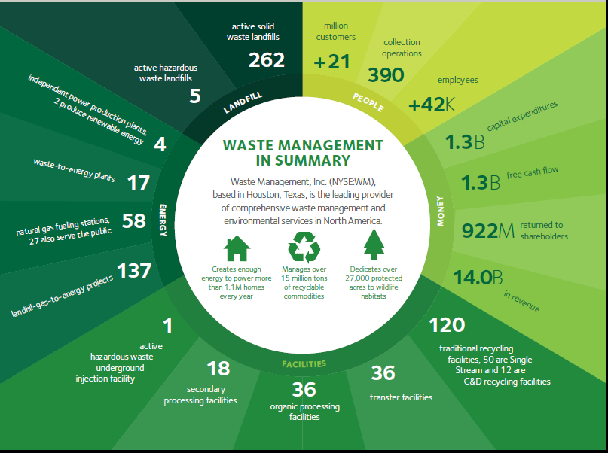
Notes:
Waste Management is a $14 billion environmental services company with diverse operations that include recycling, renewable energy and traditional waste services.
WM is the largest recycler in North America. We have over 120 processing facilities for recyclables and organic material and we managed over 15 million tons of recyclable materials last year.

Slide 3
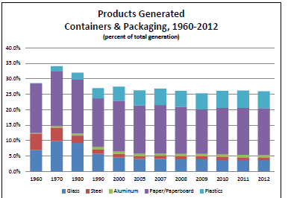
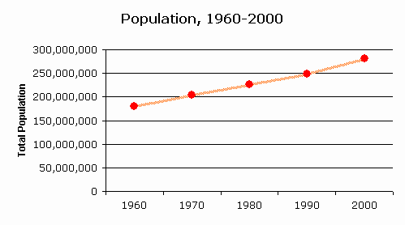
Disposal and recycling in the US: 1980 to 2013
 | 1980 | 1990 | 2000 | 2005 | 2010 | 2013
Solid Waste generation/ person/ day | 3.66 | 4.57 | 4.74 | 4.69 | 4.40 | 4.40
We are generating less waste per person as the waste stream changes.
Notes:
Let’s start with some basic EPA data. Beginning with the top table, you’ll see that the amount of waste that we each generate has been dropping since 2000. We are now generating almost 8% less waste per person than we did in in 2000.
Next – look at the graphs on the bottom. On the left are products and containers generated since 1960, and on the right is population growth during that same time period.
Even as our population has increased by 9-13%, our packaging waste has been decreasing.
To understand why, let’s look at what is happening to packaging and how these changes have led to the reduction in waste generated per capita.

Slide 4
What’s in the Waste Stream?
US EPA Facts and Figures - 2013
Materials generated | Percent of MSW
Paper, paperboard and packaging | 22%
Containers | 16%
Food | 14.6%
Yard waste | 13.5%
Durable goods (furniture, textiles, carpet) | 20.3%
Other (non recyclable products, plastics and other materials) | 13.6%
* Nondurable goods are newspaper, mechanical papers
Traditional recyclables make up about 38% of the waste stream, while yardwaste and foodwaste make up another 28% for a total of 66% of the waste stream served in curbside recycling programs
Notes:
So, let’s dig into the details a bit.
According to the EPA’s most recently released waste report, we know that 38% of the waste stream is made up of printed paper and all types of packaging – the basic material in residential recycling programs.
Another 28% is yardwaste and foodwaste. This totals 56% of the wastes stream.
So - if we recycle 100% of the recyclables in our curbside programs we’ll get to a 36% recycling rate and if we If we recycle all of the foodwaste and yardwaste that we generated, we’ll get to 56%.
The rest of the waste stream is made up of non-recyclable paper (tissue and toweling) durable goods like furniture, carpet, textiles, nonrecyclable paper (tissue and toweling), other nonrecyclable plastics such as many types of film plastics and toys, various hazardous waste, and the “stuff” that we all use in daily lives and discard every day. As the waste stream changes, there is more plastic that is not recyclable.

Slide 5
Change in Paper and Packaging: 1990-2012
Declining prevalence
Increasing prevalence
% Change from 1990
Courtesy: RRS
©2015 Waste Management
Notes:
This graph uses EPA data to looks at changes in the types of packaging since 1990. The materials on the left are declining in prevalence, while those on the right (green shading) are increasing.
On the left – you’ll see declining use of paper, metal and glass
Whereas everything on the right is lightweight plastic – except for cardboard, which is increasing thanks to Amazon and on line ordering.
Whether your are making these materials, using them or recycling them – the composition of the waste stream is changing a lot.

Slide 6
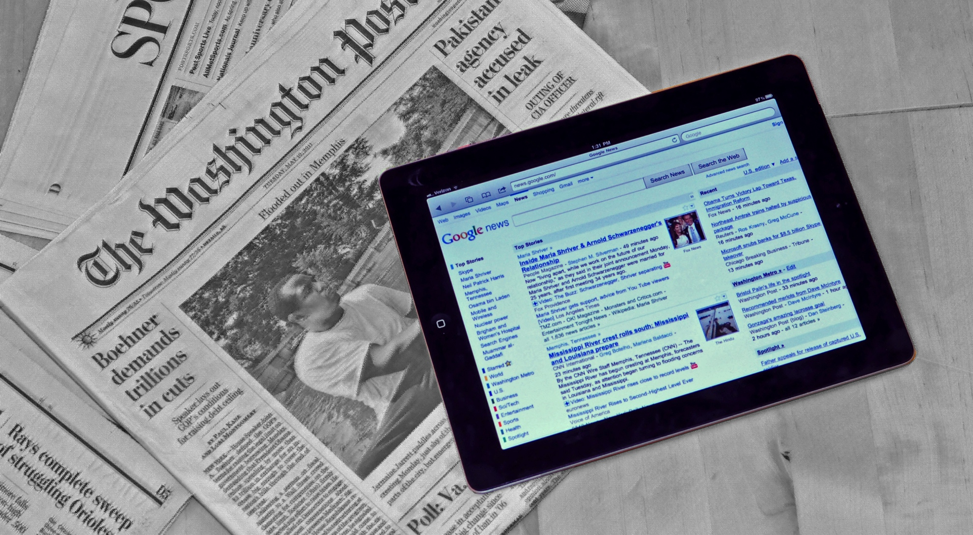
The Evolution of Materials Use
Newsprint Shipments
2000: 15.8 (peak)
2005: 12.7
2010: 7.8
2011: 7.3 2012: 6.7 2013: 6.4
50% decline
Notes:
Our friends to the North in Canada starting tracking these trends about 5 years ago when they noticed decreases in not only waste disposal, but also in tons from their Blue Box and their organics collection programs.
They started to notice a direct relationship between decreasing waste and a decrease in newspaper circulation. As cities moved from daily to weekly circulation, or stopped newspaper circulation altogether, overall tons disposed and recycled decreased.
In the U.S. we generate 50% less newspaper than we did a decade ago, and 20% less paper overall. That’s a big decrease in less than a decade.

Slide 7
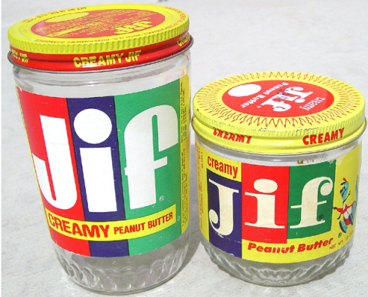
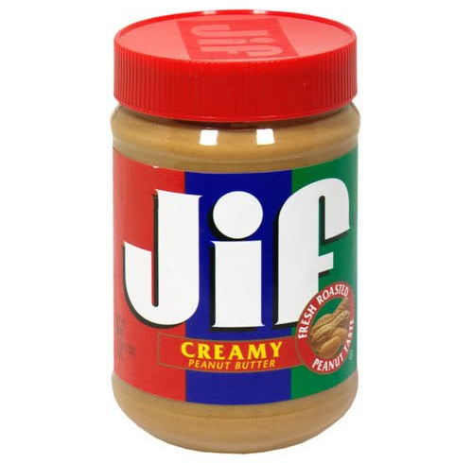

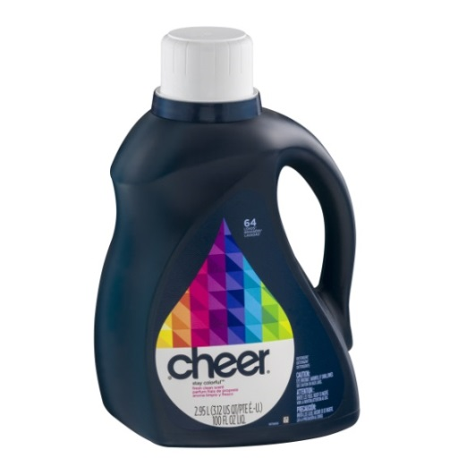
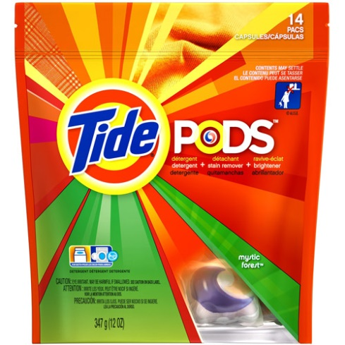
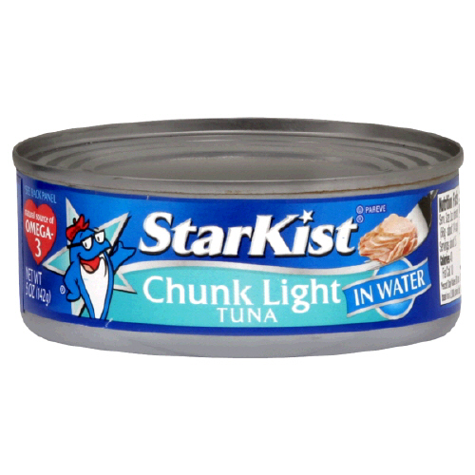
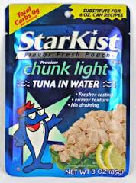
The evolving package
Glass jars, metal cap to PET jar, PP cap
Light-weighting
Flexible packaging expected to grow 4-6.5% annually in the next few years
HDPE Bottle, PP Cap to multi-layer, flexible film pouch
From steel can, paper label adhesive to multi-layer, foil-lined flexible film pouch
Notes:
At the same time, we are seeing more plastic. A LOT more plastic. In fact, we are generating 20% more plastic containers by volume now than we did a decade ago.
Certainly, over the years, we’ve seen shifts from glass bottles and jars to aluminum and plastics.
Now we are seeing shifts from rigid plastics and metals to flexible packaging. What exactly is flexible packaging?
It’s often Multi-layer and Multi-resin plastic film
They come in the form of pouches that often have non-plastic layers such as foil and other custom barriers designed for specific products
They often have zip closures for convenience. So instead of transferring product to another container for storage, the pouch is the storage receptacle.
Entire product lines often switch from other packaging substrates to pouches… In fact, this transition has its own new term – I heard one large retailer call it “pouching”…
.

Slide 8
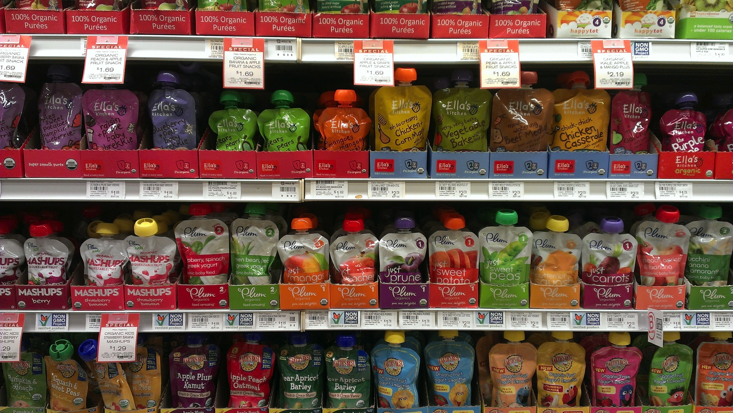
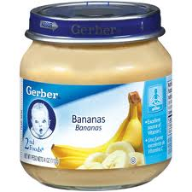

A Packaging Evolution
Notes:
And here is an example.
The baby food aisle looks a lot different now than it did when my kids were little.
Moms’ love these – children can feed themselves with pouches.
They are a great package in many ways – but they not recyclable and are replacing packages that are.
And they are growing by 4-6.5% per year through 2017

Slide 9
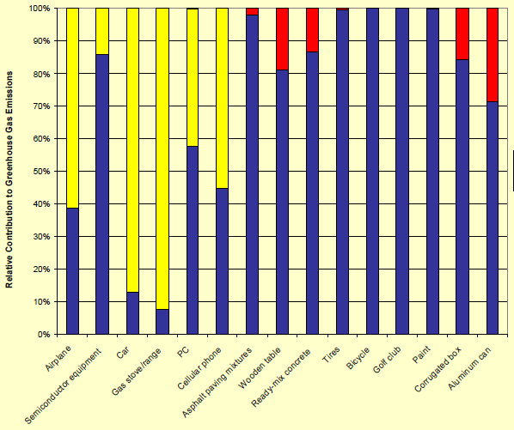

The Role of Life Cycle Thinking
Why product/packaging design is important
Courtesy: American Chemistry Council
©2015 Waste Management
Notes:
Which brings us to an interesting policy discussion. Does the fact that something can’t be recycled necessarily make it “bad” from a sustainability perspective?
This slides helps put into perspective the role of manufacturing and product use (the yellow and blue shading) versus the end-of-life role that our industry plays - red bars.
Flexible packaging for beverages results in less energy use than PET, HDPE, Tin or aluminum, and reduces overall energy use by 97% than glass.
Eventually we will figure out how to recycle flexible packaging; however, in the meantime, WM is focusing on recycling what we can, as efficiently and effectively as we can.

Slide 10
The Millennials are coming - what should we expect?
Millennials want meals they can prepare and eat quickly, with little or no cleanup – and minimal leftovers. The average Millennial eats nearly one-third few meals per year involving leftovers than adults in their late 30’s and 40’s.
Brand Aptitude, 2012
Millennials are defined by the group of young adults between 19-27 in 2015. They number 79 million this year, making them a larger demographic group than Baby Boomers (76 M). They are just starting to have children and to reach their peak purchasing years.
Millennials are not beholden to traditional packaging. Cans, jars and bottles do not always fit with their lifestyle.
They are more likely to eat convenience food, food on the go, and 17% more likely to purchase food from convenience stores and one-stop-shop mass merchandisers than traditional grocery stores.
©2015 Waste Management
Notes:
Next, let’s spend a minute talking about demographic changes that are impacting the waste stream. An aging population means that there are more singe person household – with people buying smaller portions and more pre-prepared foods.
Then, there are the Millennials. Millennials are young adults between 19-27 in 2015. There are 79 million of them - making them a larger demographic group than Baby Boomers. They are just starting to have children and to reach their peak purchasing years.
Millennials are not beholden to traditional packaging. Cans, jars and bottles do not always fit with their lifestyle.
They don’t like leftovers.
They are more likely to eat convenience food, food on the go, and 17% more likely to purchase food from convenience stores and one-stop-shop mass merchandisers than traditional grocery stores.
Millennials buy products for the product and packaging – they go together like never before.

Slide 11
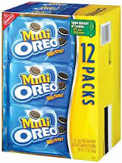
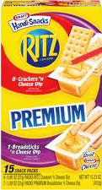
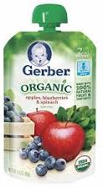
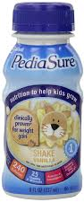
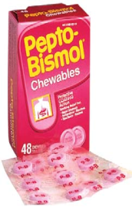
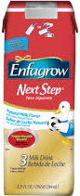


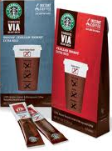
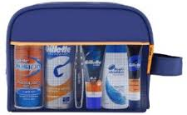



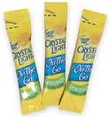

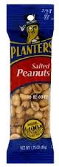
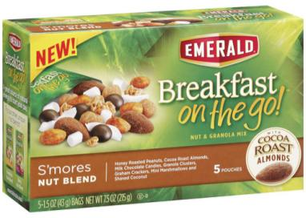

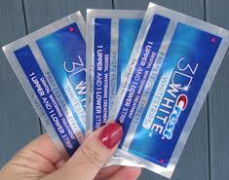

Consumer Behaviors: On-the-Go Examples
Cookies /
Crackers
Baby Food & Formula
Pharma /
Over-the-counter
Coffee
Pet Food
Shaving
Nuts
Juice
Personal Care
Notes:
This is a great slide to depict the tension between consumer behavior and successful recycling.
We are more “on the go” than ever. Which means that we are often buying smaller packages that are not recyclable.
Many of these are:
multi-layered,
have no markets,
or are too small to make it through a recycling facility.

Slide 12
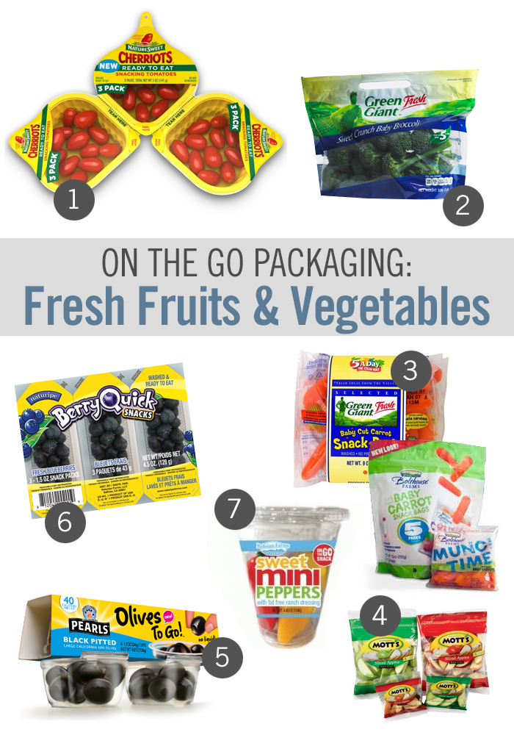
Implications
Less food waste
More custom packaging
More small packaging
More packaging that cannot be recycled in MRFs with existing technology
More packaging with no end markets
Convenience trumps sustainability
Notes:
What are the implications of these trends?
I love this slide because it’s such a contradiction. Recyclers are the recipient of the packaging at the back end….
More custom packaging
More small packaging
More packaging that cannot be recycled in MRFs with existing technology
More packaging with no end markets
But – the upside is that there is less product waste and less foodwaste which is where most of the Lifecycle impacts are. Remember the lifecycle slide….
At the end of the day, the types of materials that we use in our daily lives impact the types of materials collected for recycling. And dare I suggest that we may define sustainability according to what fits our own lifestyles? We are a society that values convenience – often above sustainability.

Slide 13
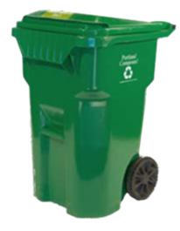
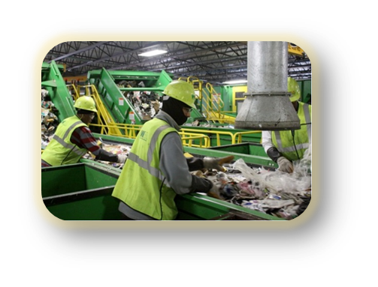
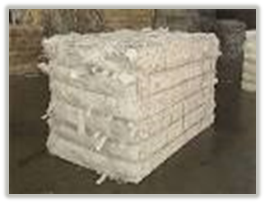
What Makes Something Recyclable?
Collection
Convenience
Size/shape
Public education
All of these are necessary for sustainable recycling
Processing
Identification
Sorting
Size
Processing
End-Market
Demand
Volume
Value
©2015 Waste Management
Notes:
So – lets shift gears. What makes makes something recyclable?
Over the past 2-3 years, recycling markets have constricted while many producers have pushed us to recycle their products.
Here is what we consider before adding a material.
First - can it be collected at the curb?
Frankly, with cart based recycling collection, we can collect just about anything.
Next - can materials be separated for recycling at our recycling facilities?
There are physical limitations to what can be sorted for recycling. Equipment and labor may not be able to identify or separate certain types of materials.
We sort by size and shape. If recyclables are smaller than 2 inches they fall through the screens and end up in the trash. Or if they look or act like other materials, they may end up in the wrong bale. For example, film plastics and pouches look and act like paper at our recycling facilities and end up in paper bales – becoming a contaminant when they get to the paper mills.
Finally – are there end-Markets?
Robust end-markets are critical for sustainable recycling. Markets require a mix of sufficient volume and value to generate buyers for the material. Once materials are added to recycling programs we can’t take them out, so we need reliable multiple markets to make recycling sustainable at our scale.

Slide 14
MRFs in 2015
MRFs are not well matched to current materials/flows. Singles stream MRFs were built to process the mix of recyclables processed in the 1990s.
Inbound material at MRFs is now around 60% paper and 40% containers
The volume in a ton has increased as packaging has become lighter
Glass and residue is a greater percentage of our recycling mix than other commodities with value
These all have implications on the design of MRFs, and increase the cost of recycling. If we design new MRF’s for today’s waste stream – where will we be in 2020 as the waste stream changes?
Notes:
Ironically, MRFs only see the changes in the material mix when it shows up at our doorstep. Historically, we’ve had no line-of-site upstream to anticipate for future changes. That simply has to change.
Our MRFs were built to process 80% fiber and 20% containers, they now receive 60% fiber and 40% containers, with paper percentages continuing to fall.
And the changing waste stream means that we process more volume and less weight - which means higher per ton cost to process.

Slide 15
Increasing contamination
Contamination of loads is an average of 16% of inbound tons.
Contamination can be up to 50% of incoming loads
Contamination cost an average of over $125 per ton
Processing costs continue to increase as markets demand reduced contamination. This drives up cost to customers.
©2015 Waste Management
Notes:
Not surprisingly, the growth of single stream has coincided with increased contamination. We average around 16% contamination at our single stream MRFs – up 3% in the past 5 years.
As more complex types of packaging are used, consumers and commercial customers are confused about what to recycle and they put more non-recyclable items in recycling carts.
Many MRFs have space and technology limitations that make changes to processing infrastructure difficult and expensive.
To add insult to injury, market prices for recyclables are low. This means that quality requirements by end users are high, so our processing costs are up. In fact – we have had times our processing costs exceeded the value of the commodities that we receive.
Quality simply must trump quantity in today’s recycling marketplace.

Slide 16
How do we drive down contamination?
Improve quality and quantity of recyclables collected
Reduce contamination of inbound recyclables
Utilize an data-driven approach to recycling education
Change consumer recycling behavior using clear, specific action items and messages

Slide 17
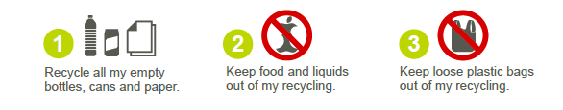
Simple Messages
Simplifying the Message
Accompanying myth busters/FAQs for those who want to dig deeper
Focus on 3 simple behaviors that could greatly impact recycling
Tested and proven approach
Notes:
EPA, KAB, CVP and private industry are focusing on a few key messages.
For example, we have identified the following areas of focus in our messaging efforts:
Recycle more clean paper and plastics –
Keep recyclables clean and dry
Recycle plastics bags at retail locations

Slide 18
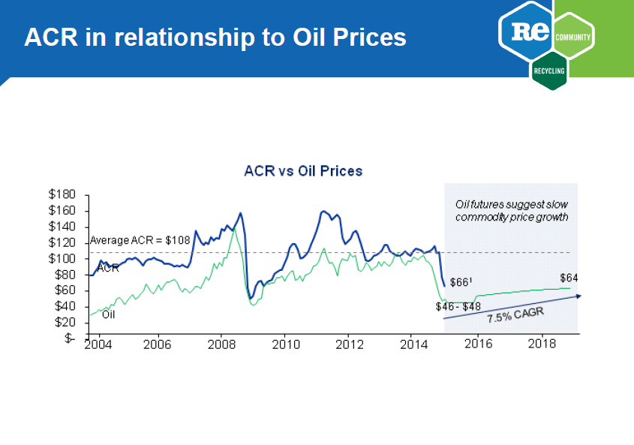
Notes:
Recommunity paid to have this study completed. Average commodity revenue (ACR) value vs oil prices. If oil goes up, then commodity prices go up.
Energy prices decrease so overall price goes down for commodities. Petroleum prices go up, then plastics can be made from virgin material instead of recycled material at a similar price

Slide 19
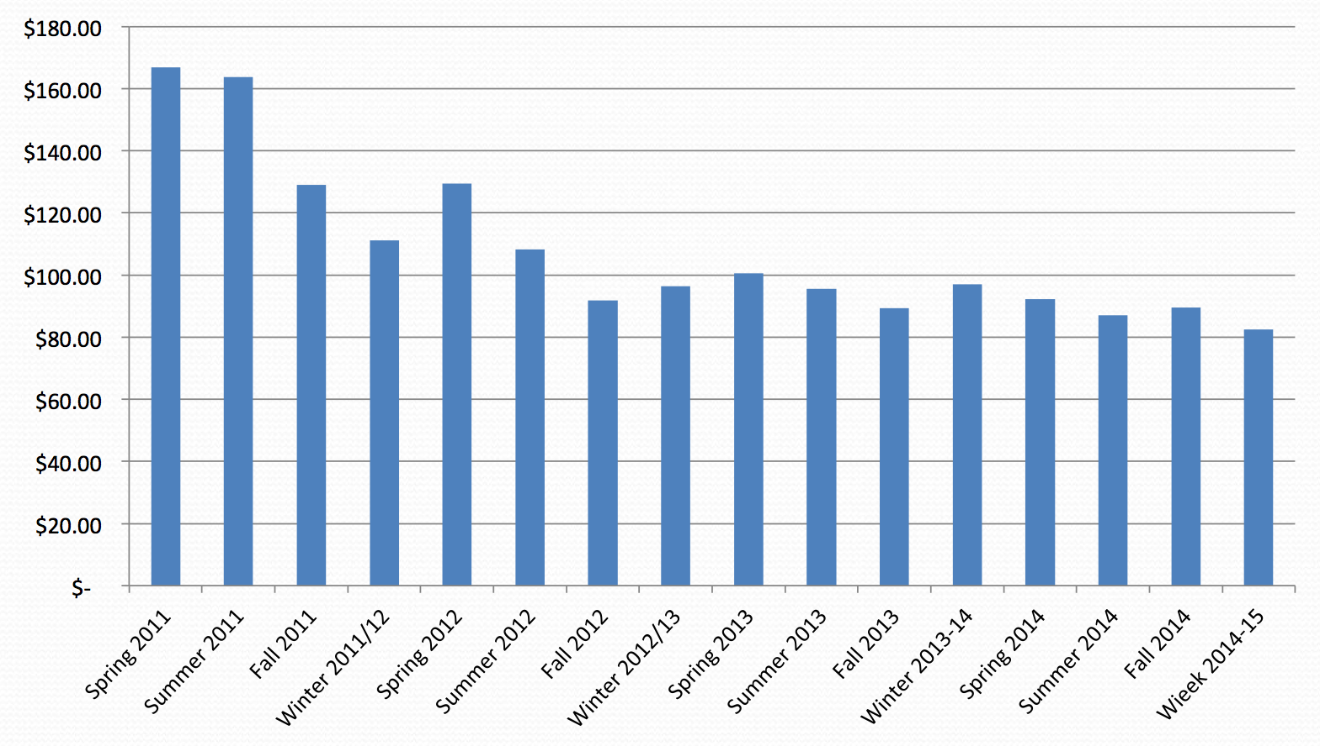
Value of a Commingled ton
Source: North Carolina DNER
Notes:
Here is a great graph from our friends in North Carolina, showing the decreasing value of a ton of commingled recyclables over the past 4 years – with no end in sight.

Slide 20
What does this mean for recycling?
The changing waste stream has increased the cost of recycling
There are more non-recyclable materials in the feedstock - which increases the cost of recycling programs
There are more low-value materials in the recycling stream, which reduces overall commodity revenue.
A lighter recycling stream makes it harder to increase recycling rates
A recent NPR story highlights some of recycling’s current challenges associated with the global economic conditions, the changing waste stream & contamination:
https://thedianerehmshow.org/audio/#/shows/2015-07-07/new-challenges-to-recycling-in-the-united-states/110575/@00:00
©2015 Waste Management
Notes:
At the end of the day, what does this all mean for recycling?
There are more non-recyclable materials in the inbound MRF stream
There are more low-value material in the recycling stream – which reduces overall value.
The changing waste stream has increased the cost of recycling since processing costs are affected by volume, but commodity revenue is based on weight.
We are all using less paper and more, lighter plastics containers which makes it harder to get to our recycling goals – everything just weighs less. According to the last EPA report, even if we recycled everything that we collect in our curbside containers perfectly – we’d only get to 40%. That means we need to recycle more commercial waste and need to recycle organics, carpet, textiles…. A diverse mix of materials.

Slide 21
The Art of Anticipating Change
How do we anticipate change?
How do we design for change?
What should we measure success?
If we build future plants to handle current streams, what will we miss?
MRFs see changes in packaging and consumer trends when the materials showed up at their facilities. The challenge will be to anticipate changes and build flexibility into infrastructure design.
©2015 Waste Management
Notes:
The Art of Anticipating change
We know that change is ongoing – but how do we anticipate and plan for these ongoing changes? The rate of change is fast, and new facilities require significant capital investments. If we build a new MRF today based on today’s waste stream – how long until it comes obsolete?
How do we anticipate future change and how to we adjust accordingly?
A couple of things that we are doing to ensure sustainable, successful recycling in the future:
We are working with manufacturers to understand better what sort of products and packaging to expect in the future. A hint: flexible packaging is a good bet.
We are examining the current economics of recycling to ensure that it is economically sustainable as the waste stream changes
We are rethinking our goals – and how to measure them. Perhaps our programs should be developed based on what makes the most sense from a broad life cycle perspective. Then, instead of measuring recycling percentages, let’s measure how much is thrown away. After all – that’s really the number that matters, isn’t it?
Finally, we are working to improve the quality of recyclables. They simply much be cleaner if we are to ensure that our recycling programs are sustainable in the future.

Slide 22
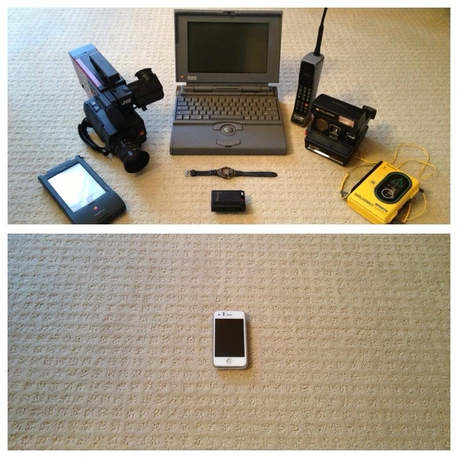
Evolution of Products
Notes:
I’ll end with slide as a reminder of how fast change has occurred, and many of these changes have streamlined our lives and made our work easier.
The key to the future of recycling is to adapt to these changes in the future.

Slide 23



Thank you.
Questions?
©2015 Waste Management

