Slide 1
Georgia Recycling Coalition
August 2015
The Carton Council Recycling Access Campaign in Georgia

Slide 2
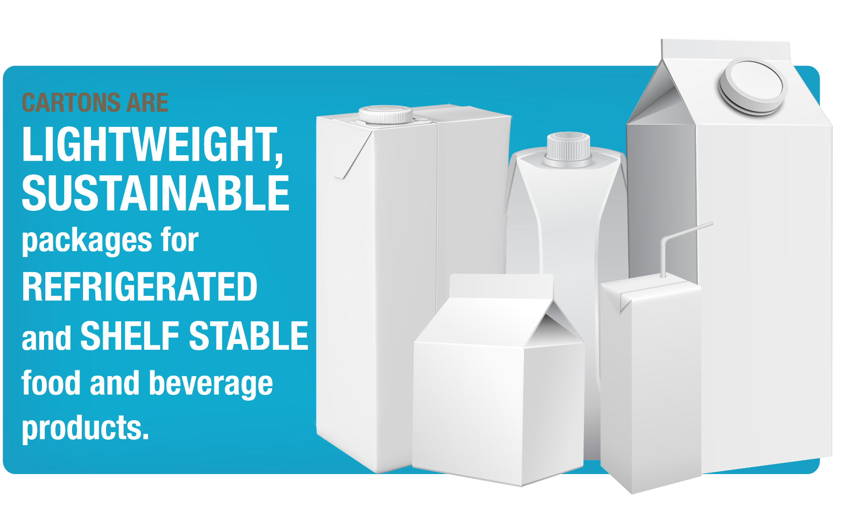
What are cartons?

Slide 3







Who is the Carton Council?
A group of carton manufacturers united to deliver long term, collaborative solutions to divert valuable cartons from the landfill.
Associate Member

Slide 4
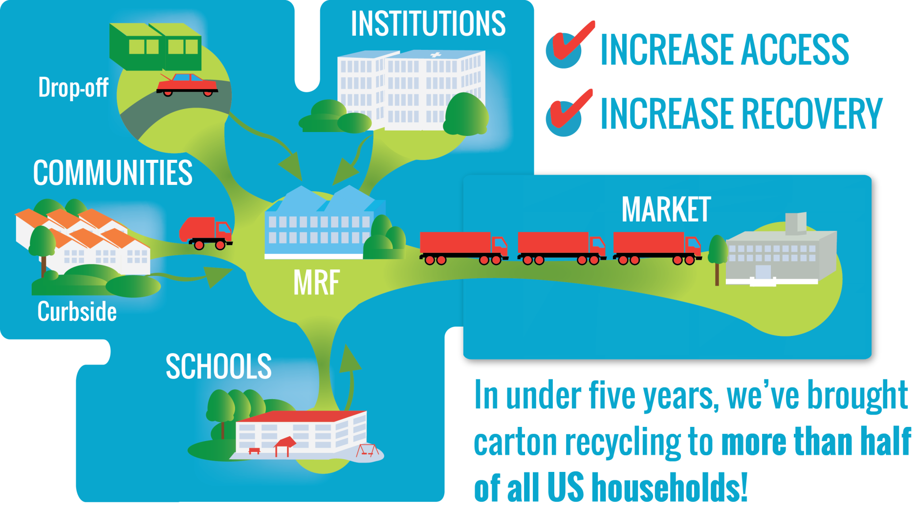
Our Goals & Outcomes
Notes:
NOTE TO FIELD TEAM: PLEASE NOTE THAT THIS SLIDE USED TO SAY “INCREASED RECOVERY” AND NOW SAYS “INCREASE RECYCLING”. RECYCLING IS NOW THE PREFERRED TERM TO USE VS. RECOVERY.

Slide 5
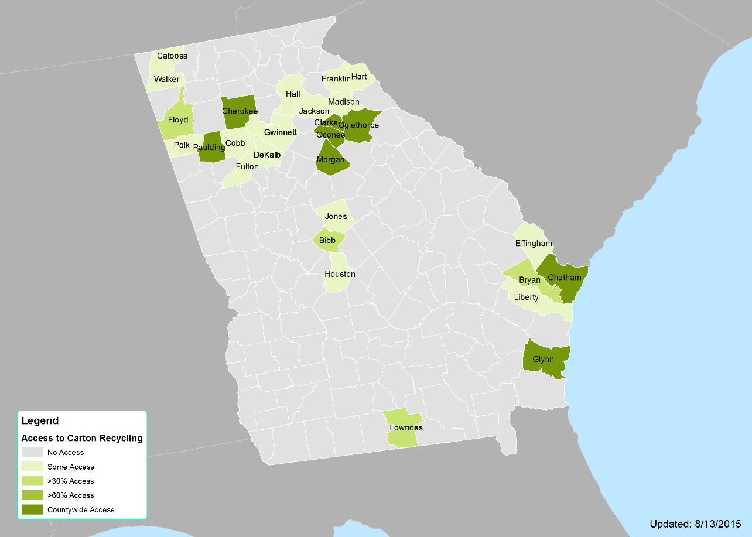
Status of Carton Recycling in GA
29%

Slide 6
Regional Overview of Carton Access
KY – 23%
NC – 58%
TN – 28%
SC
21%
AL
9%
GA
29%
MS
3%
FL
80%

Slide 7
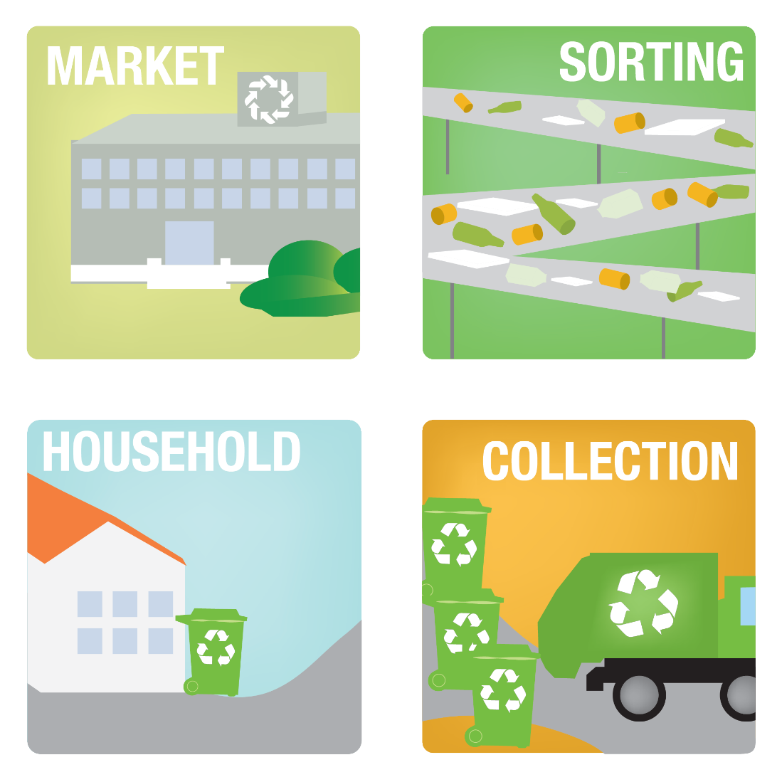
Carton Council Approach
Build sustainable markets
Create sustainable infrastructure
Develop awareness and participation

Slide 8

What’s in Your Way in Adding a Material?
Is there a strong
enough market for it?
Can a facility
sort it?
Can you get enough material
to make it worthwhile?

Slide 9
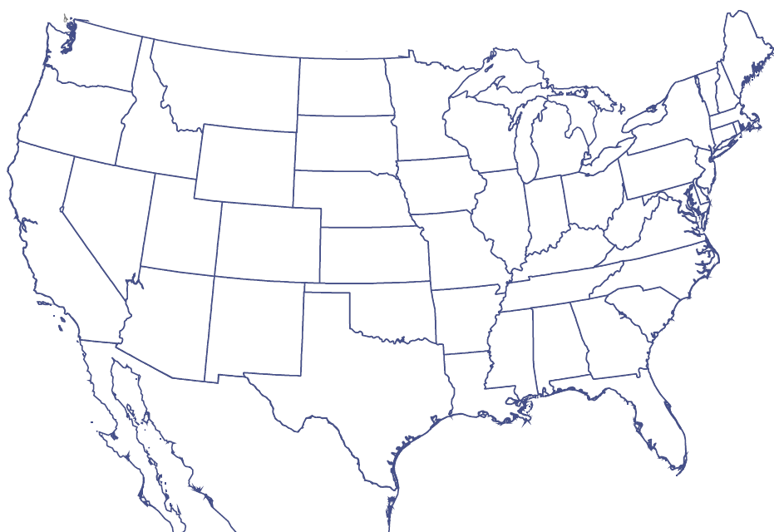








End Markets
From 1 active mill in NA in 2008 to many that are now buying cartons, with more demand in pipeline
Great Lakes Tissue
GET

Slide 10
Broker/Trader Network (8/15/15)
Storelli Recycling Company
Contact: Victor Storelli
Fort Lauderdale, FL
Email: vstorelli@bellsouth.net
vstorelli@storellirecycling.com
Phone: (954) 646-4853
The Paper Tigers
Contact: Nick Halper
Bannockburn, IL
Email: nhalper@papertigers.com
Phone: (847) 282-3029
Potential Industries, Inc
Contact: Tony Fan
Wilmington, CA
Email: tony.fan@potentialindustries.com
Phone: (310) 807-4450
Newport International
Contact: Clark Hahne
Email: chahne@newportch.com
Phone: (714) 986-5105

Slide 11

What’s in Your Way in Adding a Material?
Is there a strong
enough market for it?
Can a facility
sort it?
Can you get enough material
to make it worthwhile?

Slide 12
What’s in Your Way in Adding a Material?
Is there a strong
enough market for it?
Can a facility
sort it?
Can you get enough material
to make it worthwhile?

Slide 13
Recent Developments in GA
Carton Council welcomes Pratt to carton recycling!
  Adding cartons at Conyers facility
Pratt customers to receive information about adding cartons to outreach materials
New opportunities in the region to add cartons
  Ask for cartons!

Slide 14
MRFs in the Region w/Cartons

Slide 15
What’s in Your Way in Adding a Material?
Is there a strong
enough market for it?
Can a facility
sort it?
Can you get enough material
to make it worthwhile?

Slide 16
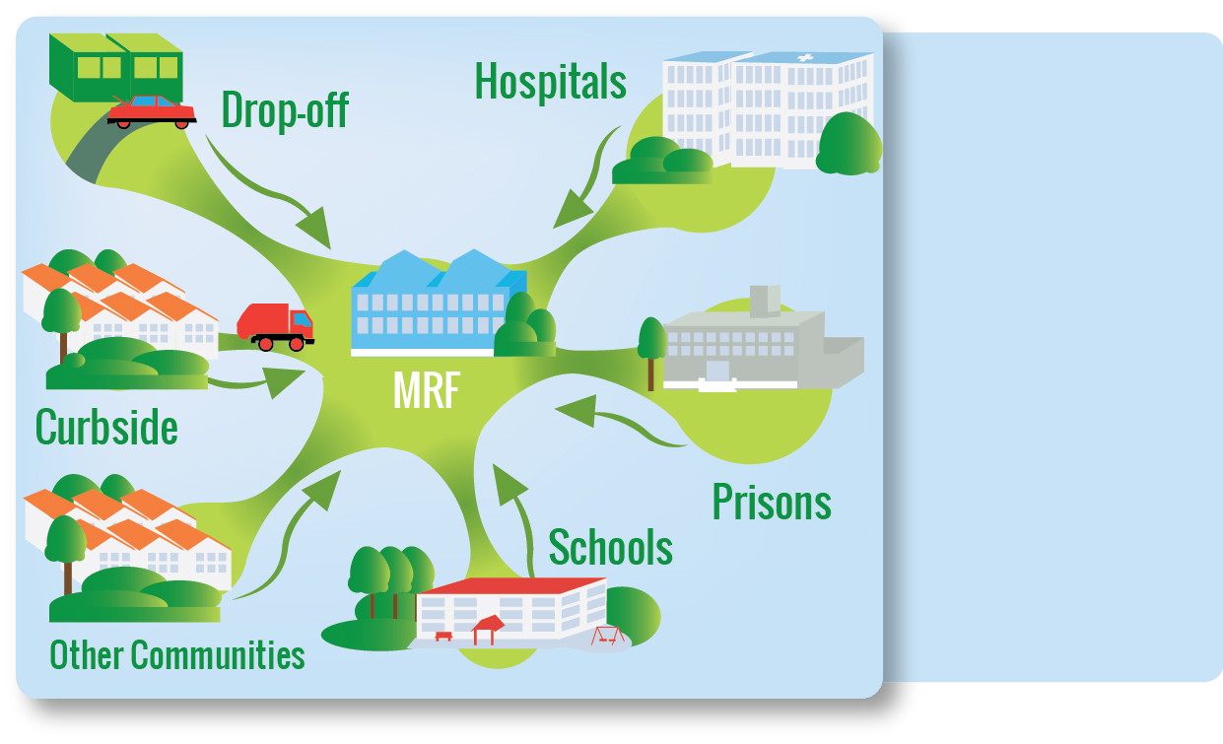
Building Volume
Consider all the potential sources for recyclable materials.

Slide 17
What’s in Your Way in Adding a Material?
Is there a strong
enough market for it?
Can a facility
sort it?
Can you get enough material
to make it worthwhile?

Slide 18
What’s Next?
Communicate and educate

Slide 19

Creating the Recycling Buzz
Increasing visibility of new materials will drive more to the recycling bin, the MRF, and the end markets – keeping the recycle-cycle going!
Use the addition of a new material to your program to help raise awareness for your entire program.
Carton Council can assist you here – tools, grants, and more!
Notes:
Top programs are taking on cartons
Taking advantage of those programs, especially thought leaders in the field – those communities or programs that others look up to that are influencers
Using Social Media
Incentivize creative promotional programs
Grants to generate awareness locally, regionally, nationally

Slide 20
Creating the Buzz – First Steps
Update your website
  People go to websites first
  Carton Council will link to your site from recyclecartons.com
Update your Recycling Guidelines
  May be time sensitive to regular production schedule
Other tools used in your community?
  Events
  Press Releases
  America Recycles Days and Earth Day
Timing: As soon as possible!

Slide 21
Proper Preparation of Cartons
No need to flatten
  Recent study results
Caps ok
Remove straws

Slide 22



Adding School Cartons to the Equation
+
=
Notes:
Can you make this look better using your amazing talents?

Slide 23
Schools are important to the equation
Schools generate large amounts of solid waste every day
Increasing waste costs are a burden to schools
Recycling programs teach students valuable lessons
MRFs need school cartons to move full truckloads of cartons to end markets
Notes:
Please format correctly

Slide 24

Schools Generate Cartons!
One elementary student generates 133 servings of milk/year
That’s 2.5 pounds of cartons per student per year
One 400 student elementary school generates 1000 pounds of cartons/year
Notes:
This data needs to be updated, as do the graphics. Can you make this better?

Slide 25
School Carton Recycling Process

Slide 26
In Summary

Slide 27
Adding Cartons is Definitely Doable
CAMPAIGN KICKOFF

Slide 28
Adding Cartons Across the Nation
78%
17%
66%
71%
27%
68%
61%
1%
75%
30%
35%
52%
20%
76%
73%
96%
10%
37%
43%
100%
58%
38%
73%
78%
81%
24%
11%
52%
89%
32%
44%
22%
100%
23%
87%
43%
58%
19%
28%
49%
16%
21%
3%
9%
29%
5%
27%
80%
HI

Slide 29
Adding it to your programs
Ask for it!
  In your next RFP
  Talk to your service provider and recycling facility
  Create supportive policies/guidelines to support the addition of new materials.
Need help?
  Talk to us!
  Visit our booth.
  Bill Kennedy is your regional representative.

Slide 30
Why? Your Residents Want It
CITIZENS expect their recycling program to COLLECT CARTONS
IN FACT, 77% OF US ADULTS SAY THAT FOOD AND BEVERAGE CARTONS ARE RECYCLABLE

Slide 31
In Summary
Carton Council
Matchmaking to move materials
Capital and education grants
Tool-kits, templates, and carton recycling network of resources
You
Talk to your MRF
Use contracts and policies to support diversion, addition of new materials
Build awareness around carton recycling
Increase recovery through communications and schools programs.

Slide 32

For more information
Online you will find:
Carton recycling information
Information on how to add cartons in your community or facility
“Insider Access” resource library
Carton recycling news and updates

Slide 33



Stay in touch….
Anna Lynott - RRS
alynott@recycle.com
Bill Kennedy – Regional Representative
bkennedy@heritageone.com
Visit RecycleCartons.com
CartonOpportunities.org
Recycle Cartons
Recycle Cartons
TOOLS . RESOURCES . GRAPHICS FACTS . WHITE PAPERS . SUPPORT

