Slide 1
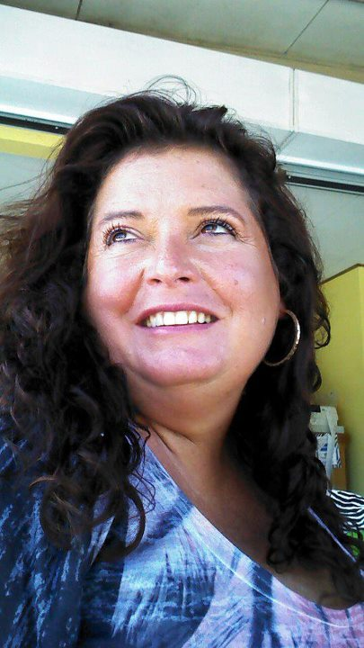
Connie Burns Scholarship

Slide 2
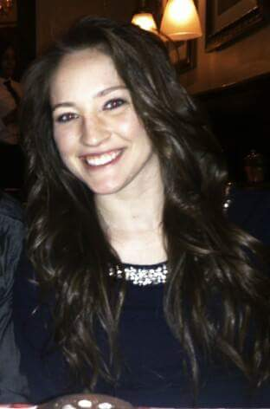
2015 Recipient
Makayla Graves
Kennesaw State
University

Slide 3
Note from Makayla
"It is very unfortunate that I cannot personally be here to accept this award. I am extremely grateful to have won and would love to be able to see the faces of those who granted me this gift. This was my second time applying, so I take pride in being this year's recipient.
College seems to get more expensive as the semesters go by, so in receiving this scholarship, I will be able to use it for books and other supplies I may need for the semester. I'm taking courses that include organic agriculture, beginning apiary, sustainable facilities and design, and even have the opportunity to work on Kennesaw State University's farm. This award will help prepare the great journey ahead of me.

Slide 4
Growing up, I never knew what I thought I wanted to do as a career. It seemed like I knew everything I didn't want to do, but couldn't figure out how to incorporate the three things I loved the most- food, the environment, and helping others. There was no degree that I could choose from at the time that allowed me to practice all three of those things (until back in 2012, the year I graduated high school). Kennesaw State offered a new Bachelor's degree in Culinary Sustainability and Hospitality. To make a long story short, this is the degree I'll be walking away with in the spring of 2017.

Slide 5
No matter where I may end up in life, this degree allows me the biggest window of opportunity to choose any career in my field that I may desire. I love helping others, providing customer service, protecting our plants and animals, and learning about the science of food. Throughout the next few years and beyond, I plan to volunteer at food banks and places that promote the upkeep of our environment (like Keep Cobb Beautiful), work hard to help those in need and continue implementing my own sustainable living practices that include, but are not limited to, recycling, cutting back on utilities, and protecting our diminishing bee population.

Slide 6
Again, I sincerely thank each and every one of you who played a part in awarding me this scholarship. Although I never had the pleasure of meeting Ms. Connie Burns, I hope I am able to make her and her family here at GRC proud."
God bless,
Makayla Graves

Slide 7
Congratulations Makayla
Award to be accepted by:
Mary Hardin Thornton of
Keep Rome Floyd Beautiful

