Slide 2
What is e-Waste?
E-waste, or electronic waste, is a term for electronic products that have become unwanted, non-working or obsolete, and have essentially reached the end of their useful life. Because technology advances at such a high rate, many electronic devices become “trash” after a few short years of use.

Slide 3
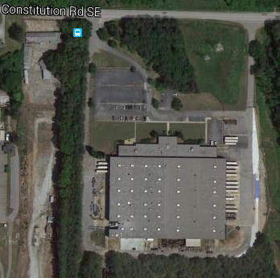
Who are we?
2012 PlasMet purchases 200,000 sq ft facility in Atlanta
Our first two years focused on research and development
Received first certification in 2013
PlasMet e-Solutions becomes fully operational in 2014

Slide 4
What makes us different?
We accept more items than other leading e-waste recyclers
Sophisticated shredding and classification line

Slide 5
Some examples of household e-waste

Slide 6
Printers

Slide 7
CRT TVs

Slide 8
Computer Tower (PC)

Slide 9
How much e-Waste was generated in 2014?

Slide 10
93,632,000,000 lbs (93 Billion!!!!)

Slide 11
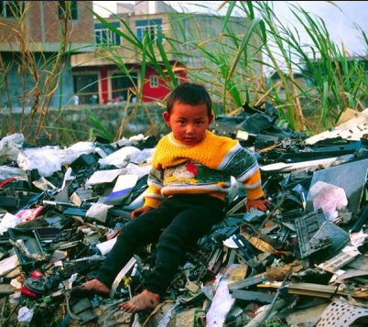
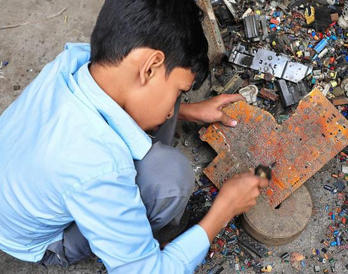
Environmental Impact
Informal recycle markets affect human health
Air, water, and soil pollution
Child labor practices

Slide 12
Certified Recycling
R2
RIOS
ISO 14001
ISO 9001
OHSAS 18001
ISRI Member

Slide 13
For more information
Contact us at:
Phone – 770.RECYCLE
Website – www.plasmet.com
Twitter - @PlasMet_eSol

Slide 14
Thanks for listening and, as always, keep RECYCLING!!

