Slide 1
A Vision for the Brave New World
Presenter:
Kathy Reed, Executive Director
Keep North Fulton Beautiful

Slide 2
"Development that meets the needs of the present without compromising the ability of future generations to meet their own needs."
Notes:
http://www.worldbank.org/depweb/english/sd.html

Slide 3
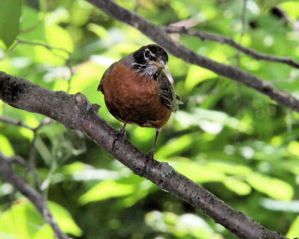

Slide 4
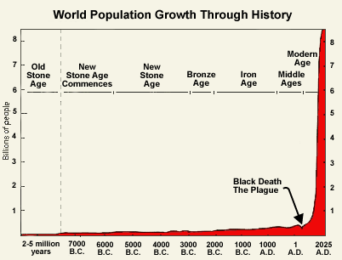
Notes:
http://www.prb.org/Publications/Lesson-Plans/HumanPopulation/PopulationGrowth.aspx

Slide 5
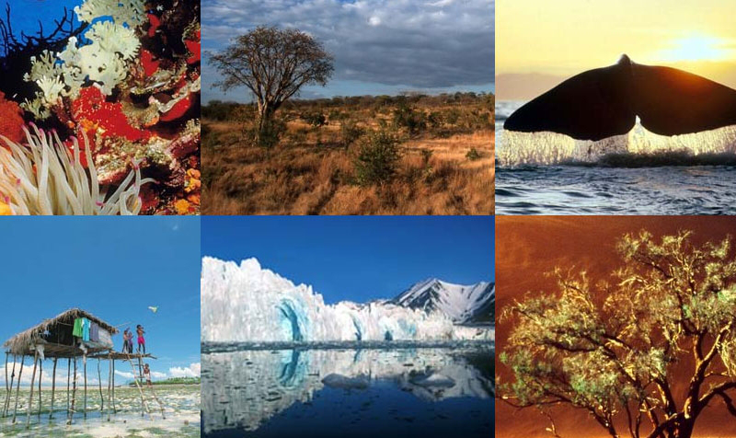

Slide 6
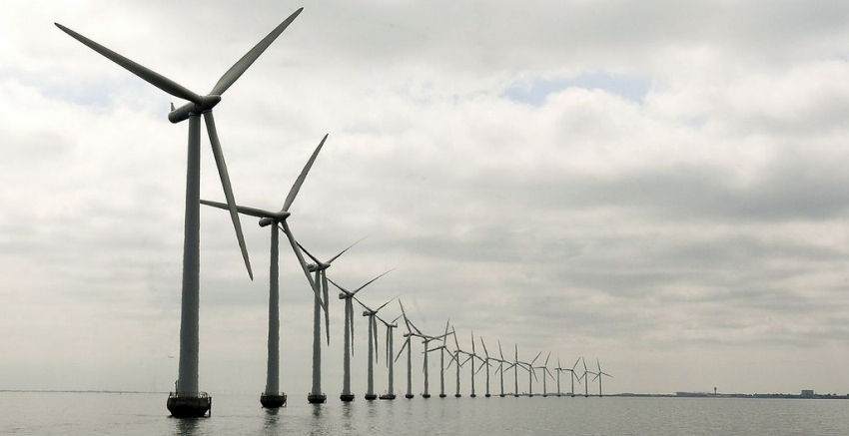

Slide 7
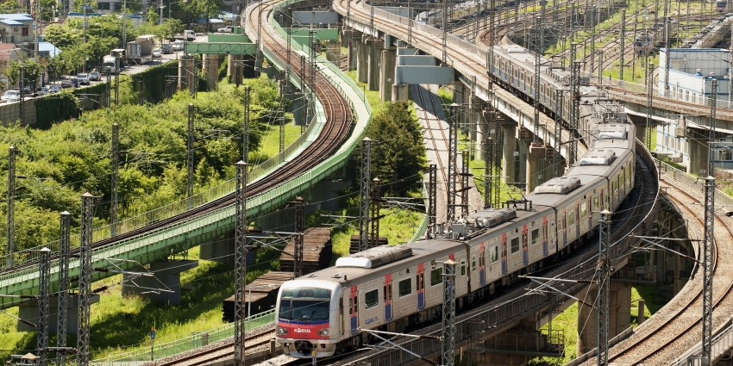

Slide 8
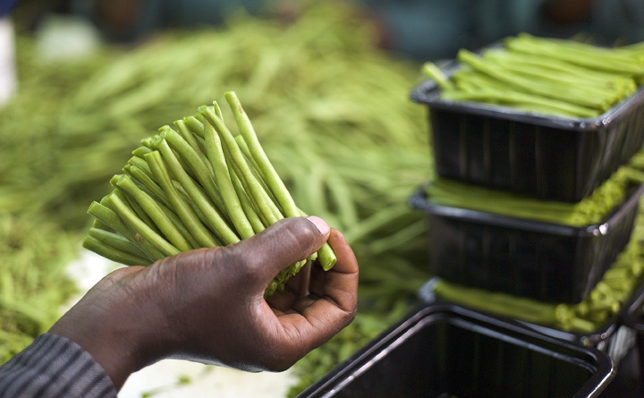

Slide 9
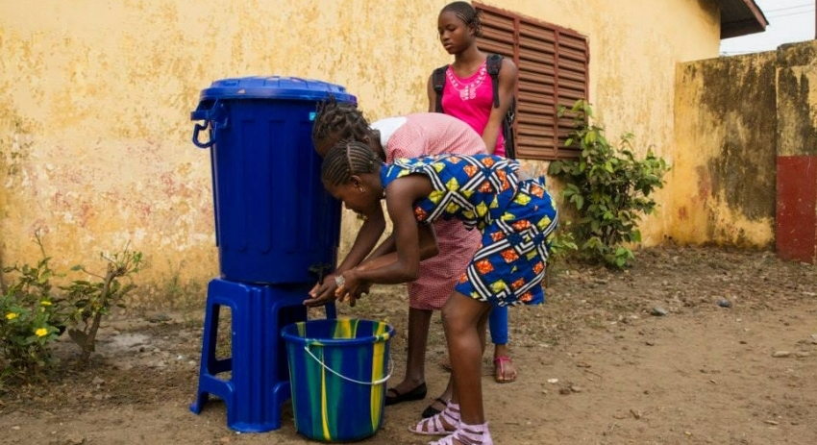

Slide 10
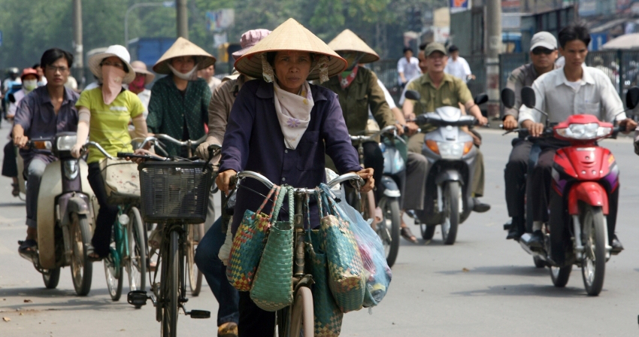

Slide 11
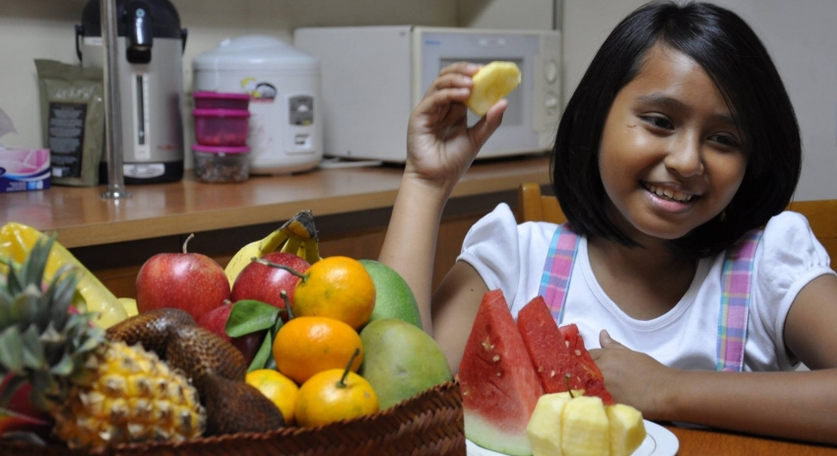

Slide 12
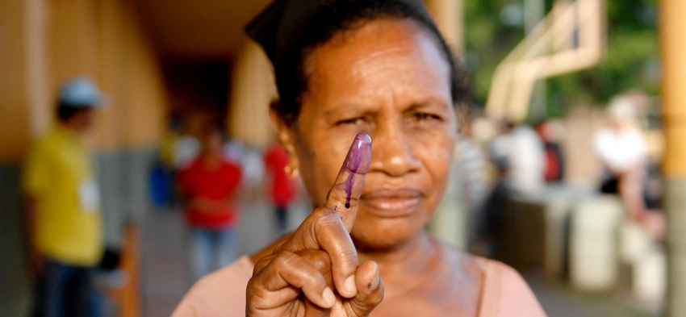

Slide 13
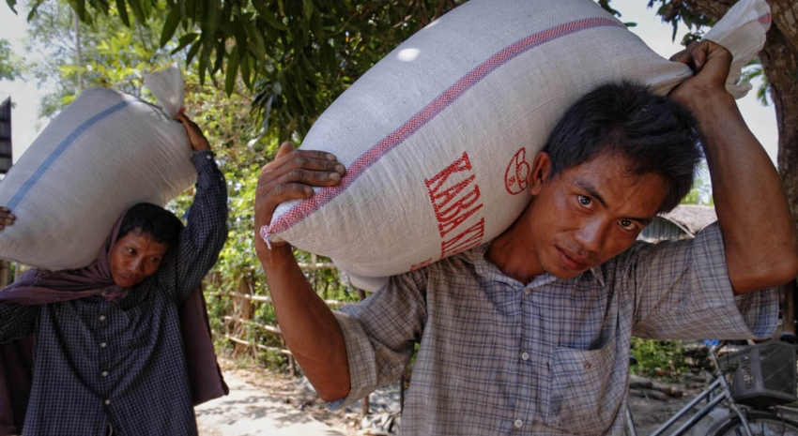

Slide 14
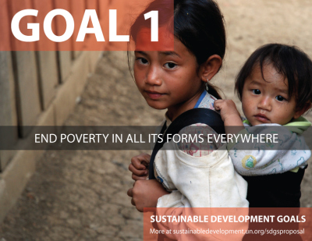

Slide 21
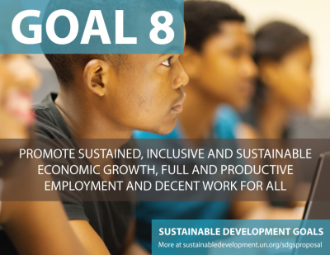

Slide 22
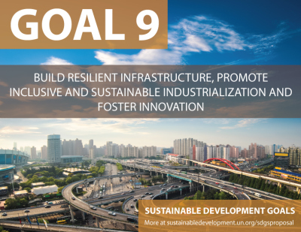

Slide 24
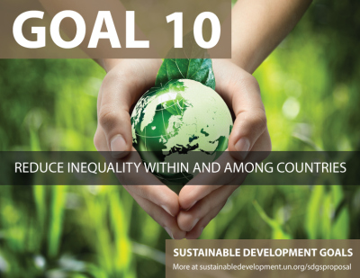

Slide 25
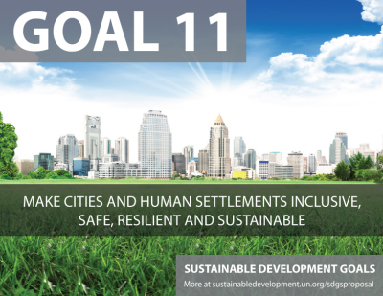

Slide 26
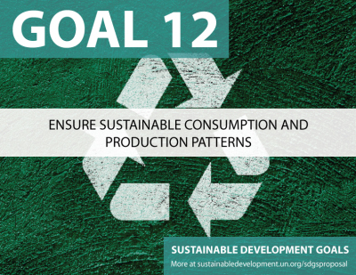

Slide 27
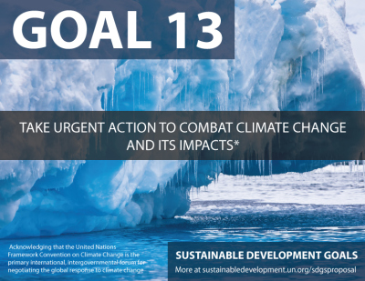

Slide 28
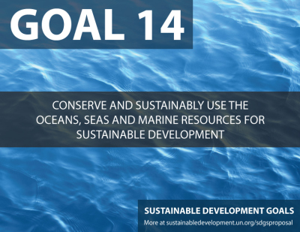

Slide 29
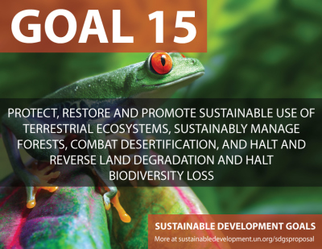

Slide 31
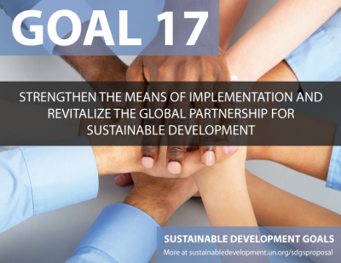

Slide 32
"The ultimate test of man's conscience may be his willingness to sacrifice something today for future generations whose words of thanks will not be heard." — Gaylord Nelson co-founder of Earth Day

Slide 33
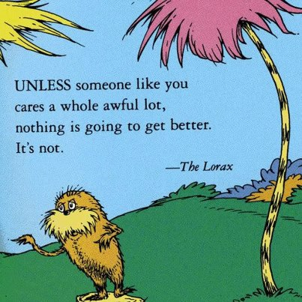

Slide 34
UN.org/sustainabledevelopment

