Slide 1
Sustainability &
World Without Waste
Nicole Smith, Sustainable Packaging Director
Coca-Cola North America
Notes:
Thanks for having me here today to share an overview of our new vision for a World Without Waste

Slide 2

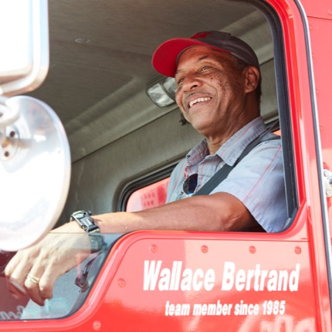
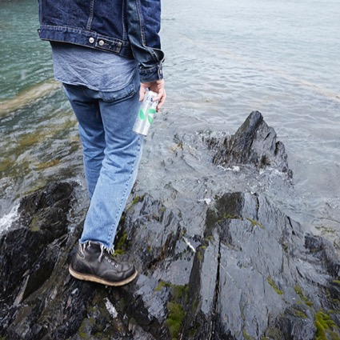
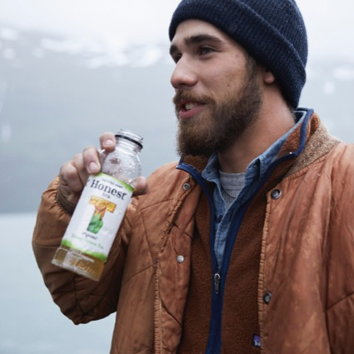
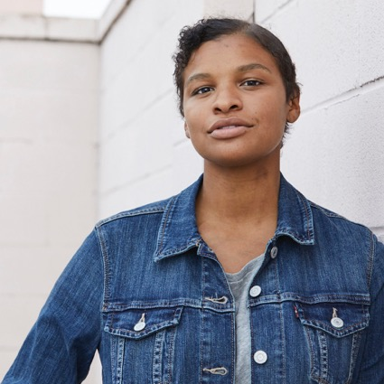
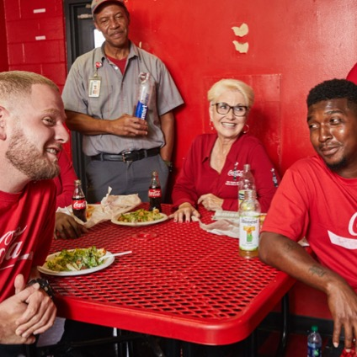
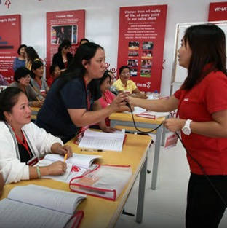
CREATE A WORLD WITHOUT WASTE BY HELPING COLLECT AND RECYCLE A BOTTLE OR CAN FOR EVERY ONE WE SELL BY 2030 AND WORK TO MAKE ALL OF OUR PACKAGING 100% RECYCLABLE.
OUR COMMUNITY COMMITMENTS
RENEW JOBS
Creating and stimulating
economic opportunities
across all 50 states.
RENEW WATER
Giving every drop of water we
use back to communities and nature, including America’s most critical watersheds.
RENEW OUR PRODUCTS
Continually evolving our offerings
to reflect peoples' changing
tastes, needs and their desire
for more information.
RENEW OPPORTUNITY
Supporting the next generation
of leaders through education
and training programs that
help them reach their
full potential.
RENEW UNDERSTANDING
Championing diversity and
inclusivity in the workplace
and our communities.
RENEW EMPOWERMENT
Supporting female entrepreneurship across
America.
Notes:
As a global company that operates locally, we can look around our communities to see where we have opportunities to make the most impact.
Each community has different needs and challenges, but The Coca-Cola Foundation and The Coca-Cola Company have identified these six commitments as the core areas in the U.S. where we can leverage the scale of our system together with our local insights and expertise to make a difference. These commitments, known as Coca-Cola Renew, demonstrate The Coca-Cola Company’s commitment to bringing good to communities across America.
These commitments also demonstrate how we deliver on one of the three core promises of the Coca-Cola Commitment: helping our customers engage their local community. Our work in communities can also be an example of how we create engaging local activation for our customers – another pillar of the Coca-Cola Commitment. Let me walk you through each community commitment and share some specific examples.
First, we’re renewing jobs by completing the largest refranchising initiative in the history of our business. Our 68 independently owned, local bottling partners drive economic opportunity in communities across all 50 states.
Second, we’re renewing water. Clean water is essential to our communities and to our business. That’s why for every drop we use, we are giving one back to communities and nature.
We’re also renewing our products. That means continually evolving our offerings to reflect peoples' changing tastes, needs and their desire for more information. I’ll talk more about that in a minute.
We’re also renewing opportunity. We are supporting the next generation of leaders through education and training programs so they can reach their full potential.
Equally important is renewing understanding. Through our brands and our people, we champion diversity and inclusivity in all that we do — at our workplace; in service to our communities; in support of our associates; and in our marketing.
Finally, we’re renewing empowerment. Women are a powerful force in their local economies and communities. We support entrepreneurial and job skills training programs for women throughout the country.
At the end of January, the company announced a global goal to create a world without waste by helping collect and recycle a bottle or can for every one we sell by 2030 and continue to work toward making all of our packaging 100% recyclable. This is part of Renew our Products.
And now we’ll take a look at two Coca-Cola Renew TV spots that you may have seen recently…

Slide 3
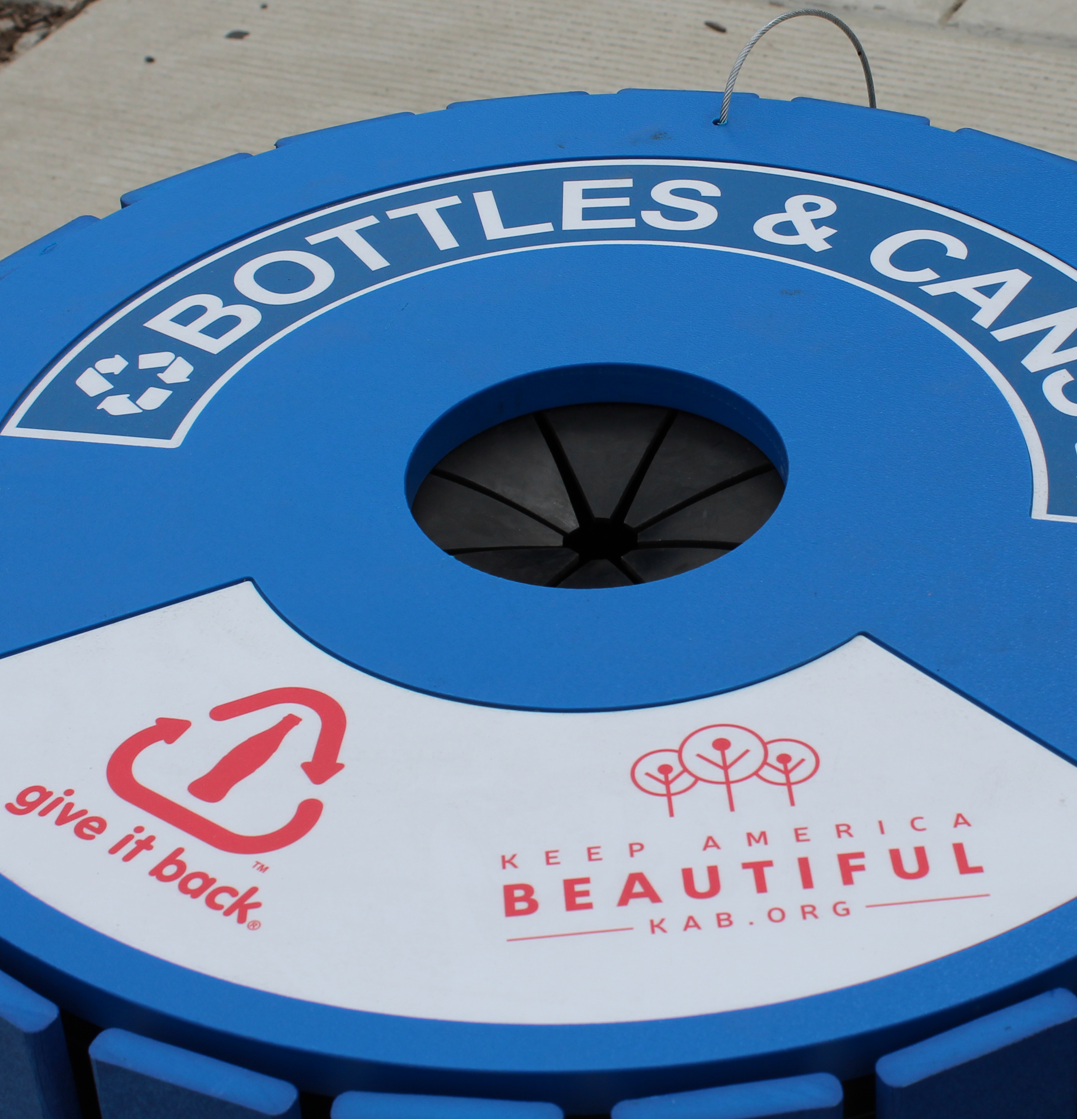
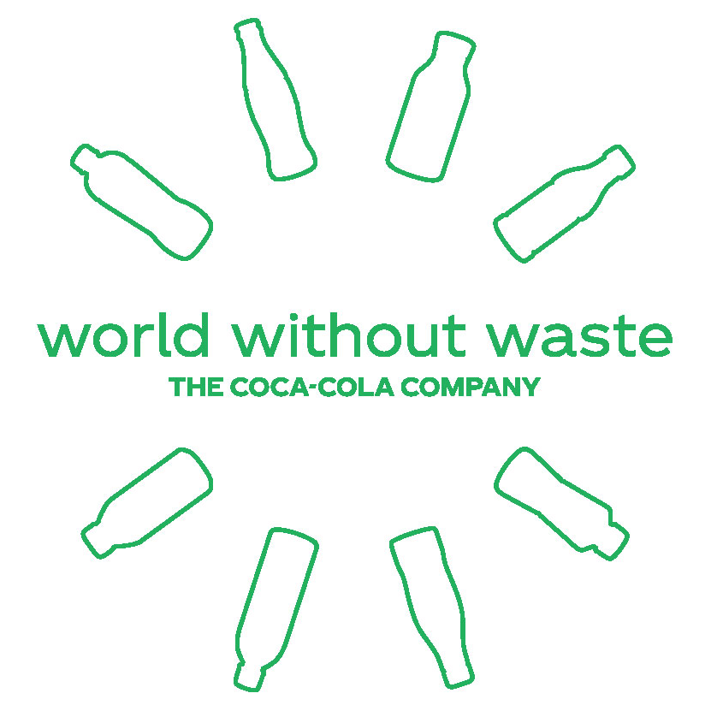

PACKAGING AND RECOVERY
GOAL:
Work to create a world without waste by collecting and recycling a bottle or can for every one we sell, making all of our packaging 100% recyclable and making bottles with an average of 50% recycled content by 2030.
Notes:
Food and beverage packaging is an important part of our modern lives, yet the world has a packaging problem. Like many companies that make products we all love, our packaging has contributed to this global challenge.
We have a responsibility to help solve this problem. By investing in our planet and our packaging, we can help make the world’s packaging problem a thing of the past.
To do this, The Coca-Cola Company is leading the industry with a bold, ambitious goal: to help collect and recycle a bottle or can for every one we sell, make all of our packaging 100% recyclable and make our bottles with an average of 50% recycled content by 2030.
This is part of our larger strategy to grow with conscience by becoming a total beverage company that grows the right way. It’s the right thing to do for our planet, our communities, and our business. Let’s talk about what we’re doing to invest in our planet and our packaging.

Slide 4
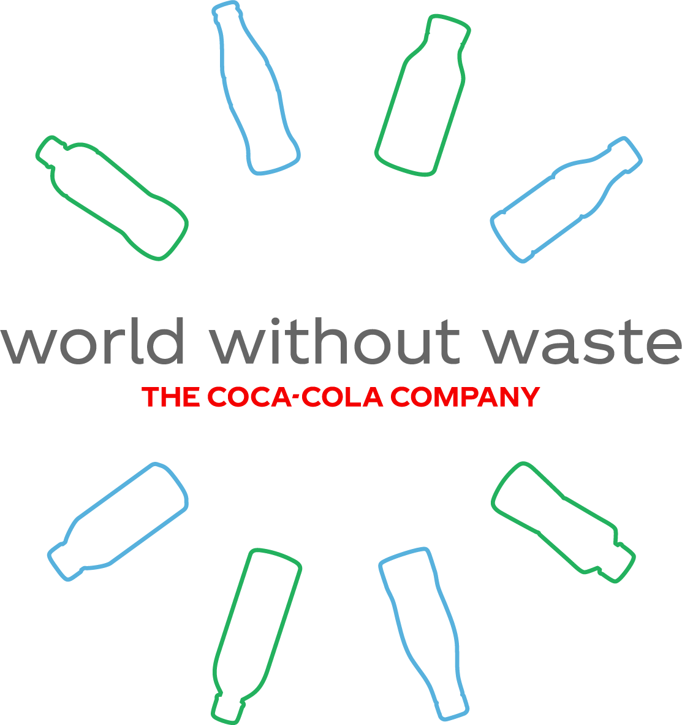
100% Recovery
100% Recyclable
50% Recycled Content
Notes:
At our CEO’s direction, we are leading the way towards a new vision for a World Without Waste.
To get there, we will invest in our packaging and in our planet to help make the world’s packaging problem a thing of the past.
The centerpiece of our new packaging strategy is an ambitious goal to help collect and recycle a bottle or can for every one we sell by 2030.
Saying that this will be a challenge is an understatement. In the U.S. today, only 36% of bottles and cans are recovered for recycling.
But before a package can be recycled, it has to be recyclable. To that end, we are committed to making our packages 100% recyclable.
While we do pretty well at this in the U.S. where 99% of our packages are recyclable today, these few remaining challenges will require significant technical advancements to overcome.
To close the loop and help support a circular economy, we aim to use an average of 50% recycled content in our packages.
Ultimately, we want to build better bottles whether by using more recycled content, advancing plant-based resins, or reducing the amount of material used in each container.
Through this new strategy, there will be no more single-use packaging – every package we produce will be recovered and recycled into something else.

Slide 5
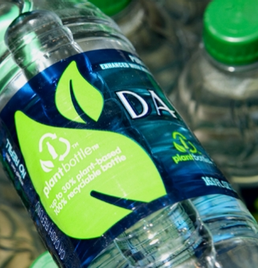
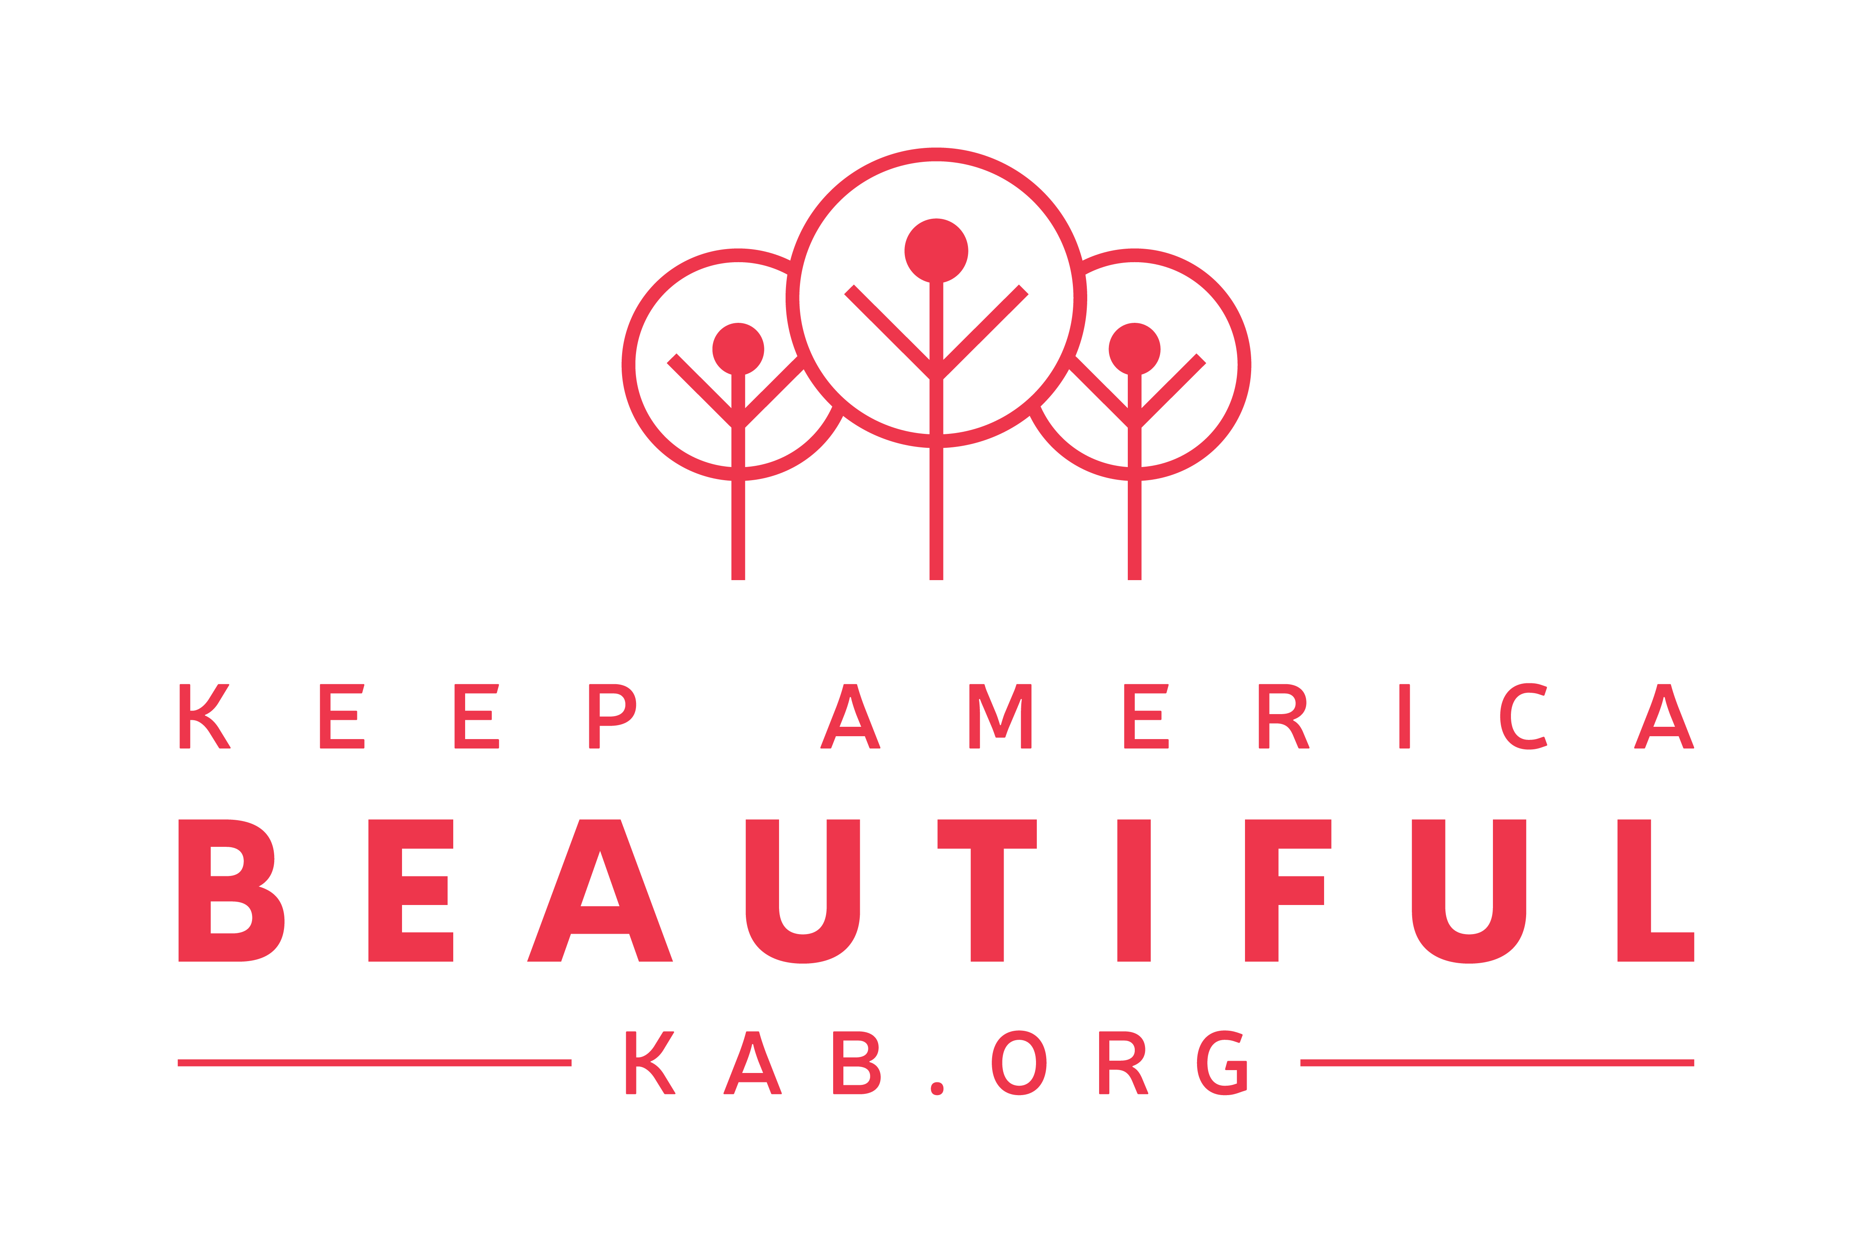

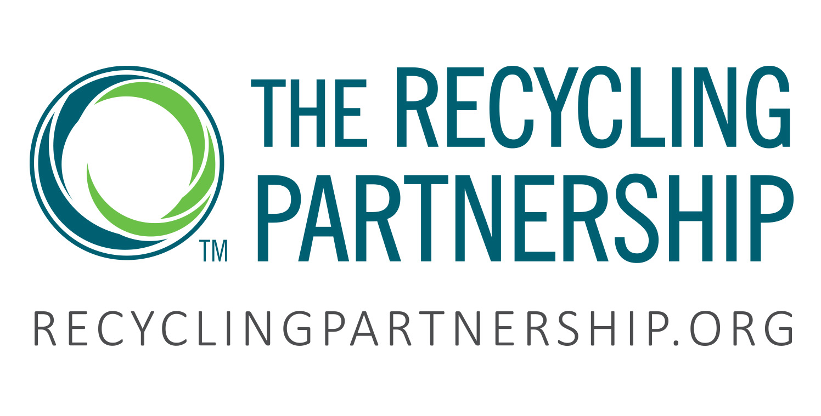

PACKAGING AND RECOVERY
INVESTING IN OUR PLANET
Invested $13 million+ in partnerships with The Closed Loop Fund, Keep America Beautiful, The Recycling Partnership, SERDC and other community organizations
Together we placed 1 million recycling bins in more than 1,000 communities across the U.S., diverting ~730 million pounds of recyclables from landfills annually
INVESTING IN OUR PACKAGING
99% of our U.S. packages are fully recyclable
Created PlantBottle™, the first fully recyclable PET plastic bottle made with up to 30%
plant-based materials
Notes:
Investing in our planet
We’re working to bring people together to help us collect and recycle a bottle or can for every one we sell.
By 2030, for every bottle or can we sell globally, we aim to help to take one back so it has more than one life.
In the U.S., we are working with partners to help ensure recycling programs and infrastructure exist in every community we serve.
We have invested more than $13 million in innovative partnerships that bring curbside recycling programs to communities, help educate people on where to recycle, and support large-scale recycling infrastructure. Through our innovative partnerships with The Closed Loop Fund, The Recycling Partnership, Keep America Beautiful and others, we have helped support the placement of 1 million recycling bins diverting an estimated 730 million pounds of recyclables from landfills annually.
Investing in our packaging
By designing for recyclability and innovating with renewable and recyclable materials, we’re working to build better packaging.
In the U.S., nearly all – 99% – of our packages are recyclable. Aluminum cans, PET plastic bottles and glass bottles, including the caps we use on our bottles are all recyclable.
We’ve also recently redesigned the label and handle of our Simply 89 oz. bottle to be fully recyclable – a packaging feat for the industry.
In 2009, Coca-Cola introduced PlantBottle™ packaging, the first fully recyclable PET plastic bottle made with up to 30 percent plant-based materials. PlantBottle™ packaging is made by converting the natural sugars found in plants into a key ingredient for making PET plastic. It reduces dependence on fossil fuels compared with traditional PET. We use PlantBottle™ material in about 30% of our PET plastic portfolio in the U.S. including a variety of brands such as DASANI, smartwater and Simply juices.

Slide 6
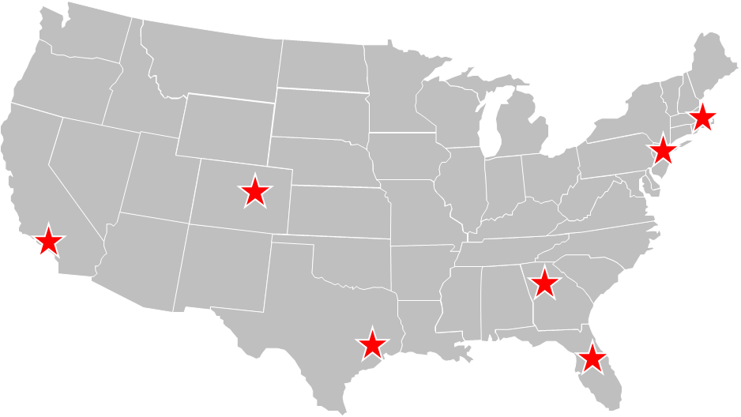
Catalyzing a World Without Waste in Model Markets
PACKAGING AND RECOVERY
Prove best practices that can be replicated in other communities.
2018-19 Model Markets
Atlanta, GA
Boston, MA
Denver, CO
Essex County, NJ
Houston, TX
Long Beach, CA
Orange County, FL
Advance Recycling Infrastructure
Inspire a Recycling Culture
Support Trash-Free
Waterways
Pilot Recycling & Packaging Innovation
Notes:
Our Model Market work is broken into 4 key work streams: Advance Recycling Infrastructure, Inspire a Recycling Culture, Support Trash-Free Waterways and Pilot Recycling/Packaging Innovations.

Slide 7
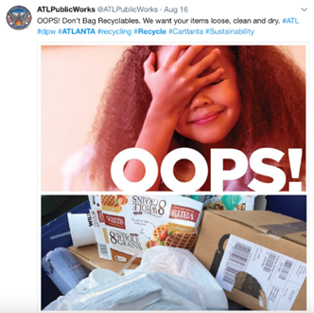
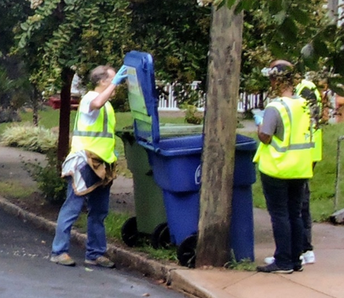
PACKAGING AND RECOVERY
Advance Recycling Infrastructure
Notes:
For example here in Atlanta we are launching a Feet on the Street program, which helps to educate how to recycle right. In a pilot done in the past couple years, we saw a decrease in contamination (like bags in the recycling bin, tanglers or bowling balls), and an increase in recyclables in the bin, show that education works. So, all of the City of Atlanta will see the program roll-out this fall, to ensure all households recycle right.

Slide 8
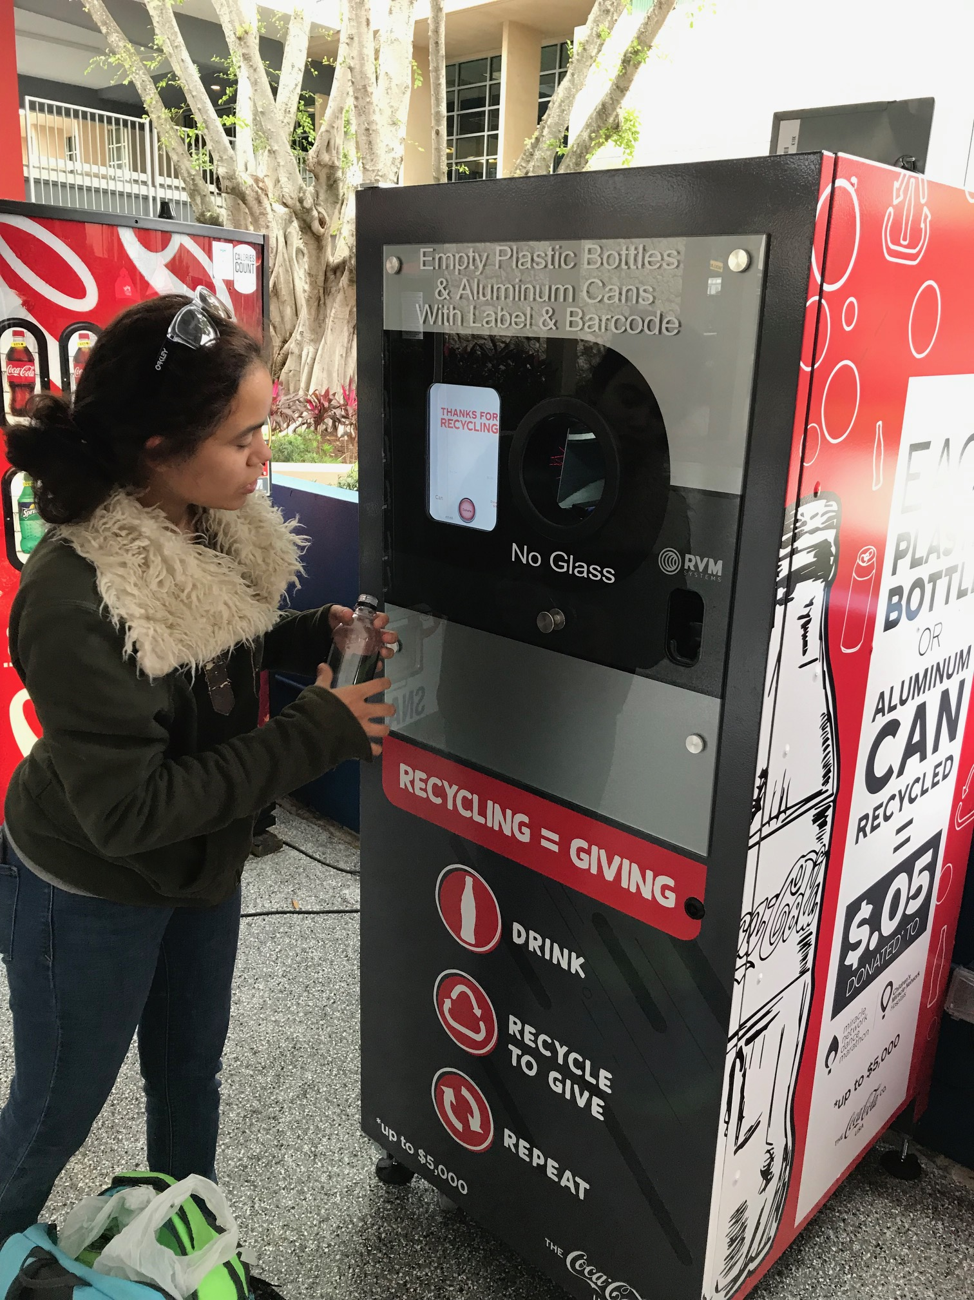
PACKAGING AND RECOVERY
Inspire a Recycling Culture
Notes:
Recycle & Give is an opportunity to engage your visitors/customers, it’s a unique spin on leveraging Reverse Vending Machines (RVM’s) to incentivize recycling and for every bottle/can recycled, donating 5 cents to a cause/charity. We are also exploring models that would reward. These are great for public spaces that see lots of foot traffic, and spaces that want to recycle but see a lot of contamination, and want a solution to ensure only recyclables are going in (the technology in the equipment scans the barcode on the label, scans the package.

Slide 9
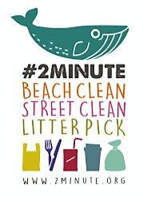
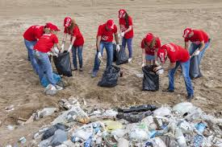


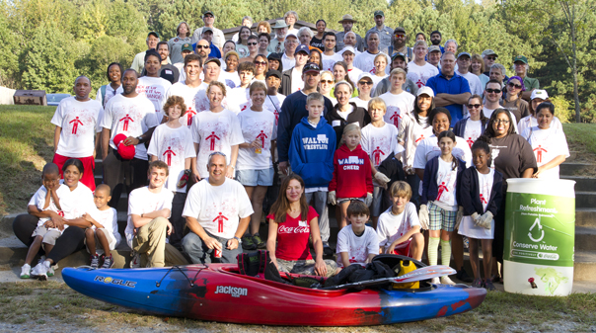
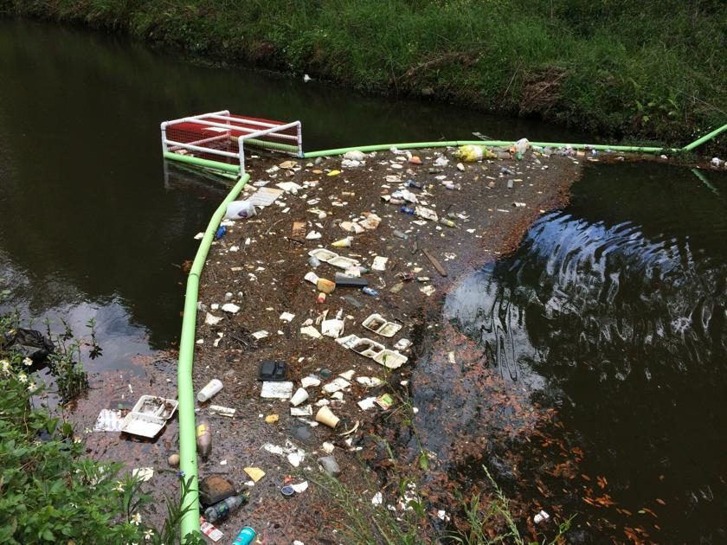
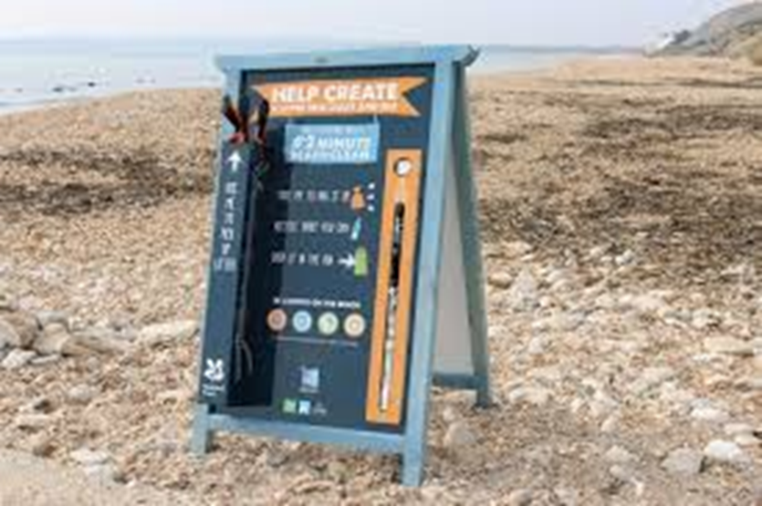
PACKAGING AND RECOVERY
Sept 21st
Support Trash-Free
Waterways
9
Notes:
Coca-Cola has been a sponsor and supporter of Ocean Conservancy, the International Coastal Cleanup (Sep 21st this year) and Trash Free Seas Alliance since 1995! 10’s of thousands of employees volunteer every year to clean up beaches and water ways in their communities.
One of our partners, Living Lands & Waters, is focused on cleaning up the Mississippi through engaging activations like Alternative Spring Breaks, and Barge Parties, and they recycle everything they can that’s pulled from the river!
And a long standing partner, Keep America Beautiful, has local affiliates that can help us coordinate local clean-ups together, any time of year. We would love to engage our employee’s and yours to jointly cleanup our communities!

Slide 10

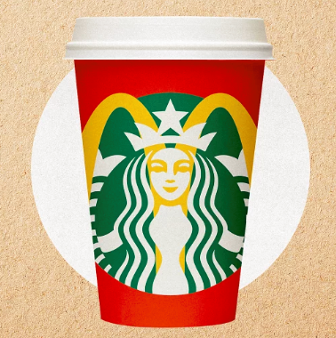

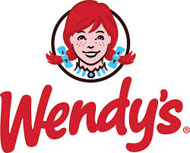

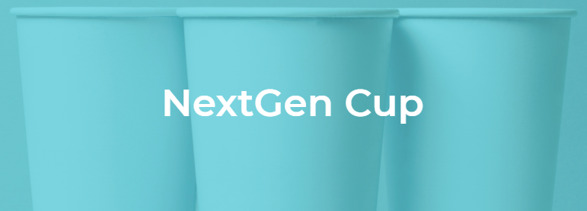
PACKAGING AND RECOVERY
NextGen Cup Challenge
Through an innovation challenge and accelerator program, the companies aim to:
Identify and commercialize existing and future recovery solutions for environmentally friendly single-use hot and cold paper cups
Ensure disposable cups are recaptured with the highest material value through recycling and/or composting
Minimize raw material use
Encourage reusability
Pilot Recycling & Packaging Innovation
Notes:
In July 2018, Closed Loop Partners announced a new fund that was created with support from McDonald’s and Starbucks donating $5M and $10M respectively. This NextGen Cup Challenge aims to drive new innovation in vessels for foodservice with a competition and prize funding for suppliers.
Through an innovation challenge and accelerator program, the companies aim to:
Identify and commercialize existing and future recovery solutions for environmentally friendly single-use hot and cold paper cups
Ensure disposable cups are recaptured with the highest material value through recycling and/or composting
Minimize raw material use
Encourage reusability
We will have an opportunity to pilot new innovation cups in late 2019/2020, and in parallel we are working closely with the recyclers that are currently recycling cups, to help explore how to get more widely available recycling of cups in communities around the country.

Slide 11
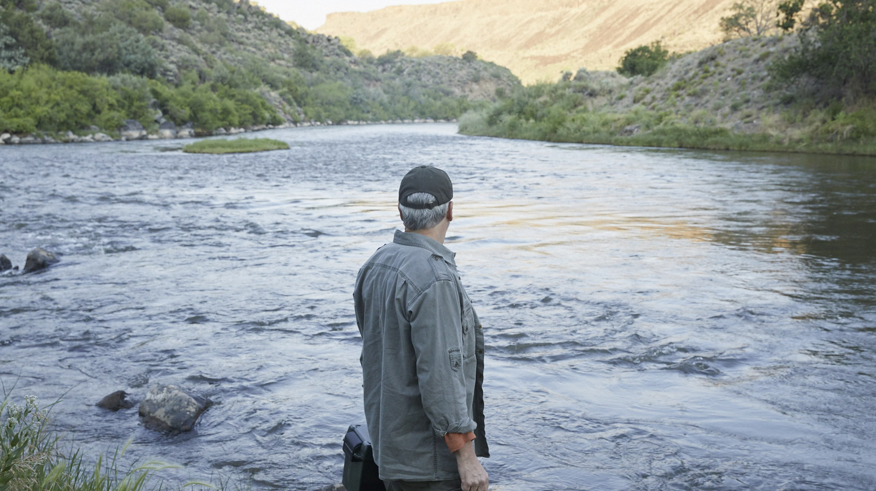

THANK YOU
FOR MORE INFORMATION, VISIT: coca-colacompany.com/sustainability
Notes:
Thank you for your time. For more information, please visit
www.coca-colacompany.com/sustainability.

