Slide 1
April Carlock
September 16, 2019

Slide 2
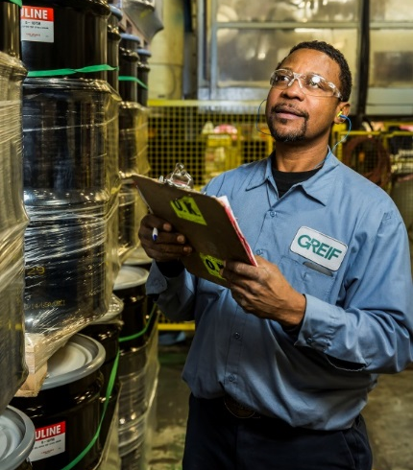
Greif At-A-Glance
Founded in 1877 with a rich culture and legacy
17,000 colleagues
Organized into four business segments:
  Rigid Industrial Packaging & Services
  Paper Packaging & Services
  Flexible Products & Services
  Land management
290 locations in over 40 countries
  15 Paper mills and 19 Recycling plants

Slide 3
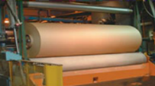
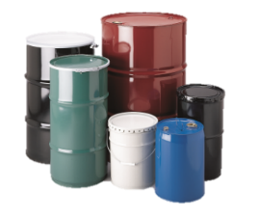
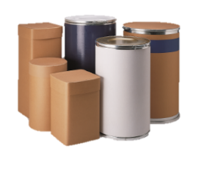
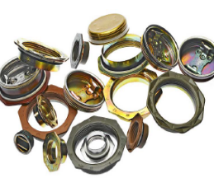
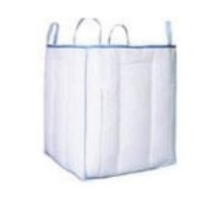
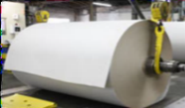

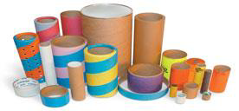
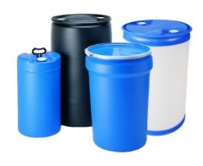
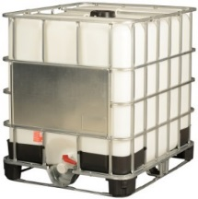
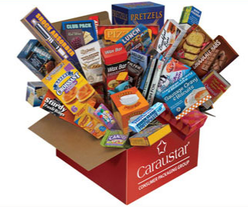
Leading Positions Worldwide
Upstream Operations
Industrial and Consumer Packaging
Steel
Fibre
Closures
Flexible IBCs
#1
Uncoated Recycled Paperboard (URB)
#3
#1
#1
#1
#1
Coated Recycled Paperboard (CRB)
Tube & Core
Plastic
Rigid IBCs
CPG
Top 10
Recovered Fiber Group
#1
#2
#3
Leading producer
Note: Ranking denotes standing in global market. Based on company estimates.

Slide 4

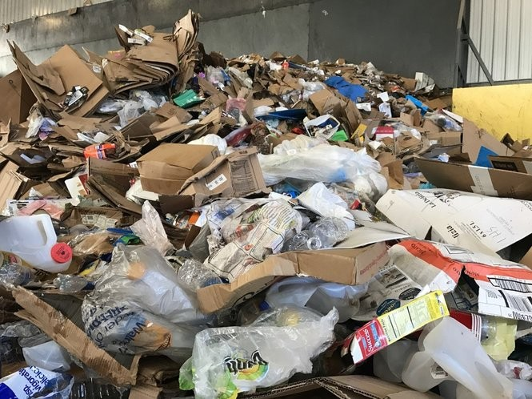
Current Condition
Demand is down Domestically and Globally
Contamination

Slide 5

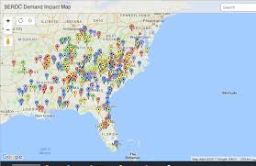
Infrastructure
Damaging infrastructure?
End market demand

Slide 6
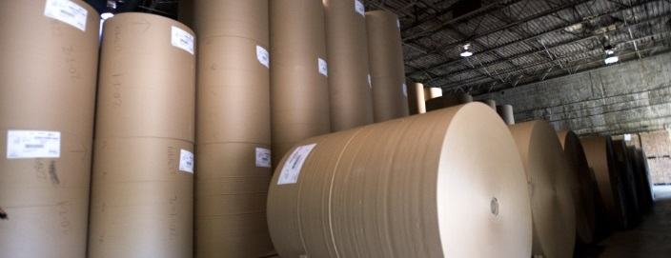
New capacity
New mill capacity announcements in US
  VA, WV, KY, AL, SC
  1.8 Million tons a year

Slide 7
Thank You
April Carlock
Southeast Sales Manager
706-463-2878
April.carlock@greif.com

