Slide 1

CITY OF ATLANTA RECYCLING Reeling In the Public Outreach & Education

Slide 2


City of Atlanta Recycling Program
Promotes Waste Reduction
Evaluate Existing Waste Reduction Methods
& Recycling Programs
Provide Recycling Opportunities &
Education
Notes:
- Increase Landfill Diversion
- Give Recyclables A Second Life
Introduce New Recycling Initiatives
*4 YEARS AGO COA HAD LITTLE TO NO RECYLING EDUCATION

Slide 3

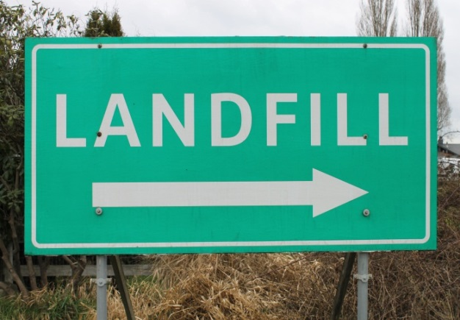
Recycling Objectives
Increase Recycling Participation
Reduce Contamination
Increase Education
Increase Communication
Notes:
Overall Goals
Recycle more
Increase participation
Educate on proper recycling
TO ACHIEVE THESE RECYCLING GOALS , the COA has implemented the following initiatives (next)

Slide 4
CURRENT INITIATIVES
Residential
Weekly Collections of ~96,000 Homes
CARTLANTA- Distributed 96 gal Bins to All Residence
Community Collection Events
Viable Partnerships- KAB and CHaRM
Incentivized Recycling (Sept. 2015)
Notes:
CARTLANTA distribution To all residence
3rd Saturday Mall West End (tires, Paper, Textiles, e-waste)
PARTNERSHIP:
KAB – Keep Atlanta Beautiful (KAB director with duel reporting to support the board, community and COA)
Charm-Center for Hard to Recycle Material – Operated by LIVE THRIVE

Slide 5
CURRENT INITIATIVES
Internal
Desk-side Recycling Container
Recycling Competitions
96 gallon Bins to All City Facilities
Monthly Recycling Event @ City Hall
Internal Recycling Ambassador Program
Notes:
IN PROGRESS-
-Remove all desk-side trash cans and replaced them with recycling bins.
-96 gallon Bins Distributed to City Facilities – Courts, Police Fire, Parks and DWM
-Floor By Floor Competition – to recycle the most. The winner received a dessert social, plaque and recognition during 2015 Earth Day Celebration
- Monthly Recycling event- Featuring one type of acceptable recyclable material per month- reuse options
-Internal Recycling Ambassador Program- Each department selects an ambassador to champion internal recycling
and assist in bin distribution and education

Slide 6
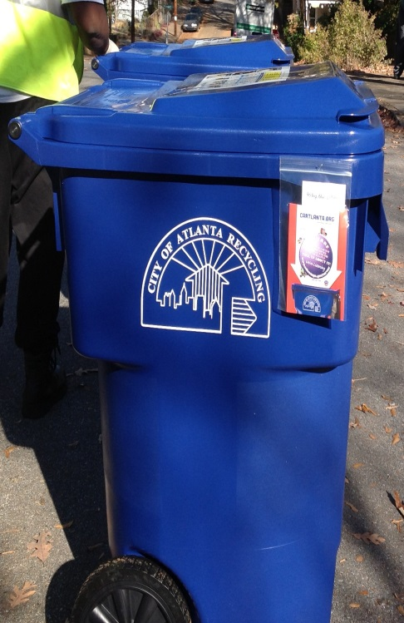
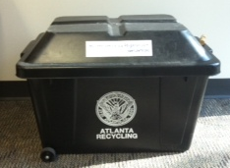
CARTLANTA
2009- Pilot Program 10,000 Carts
2012- Distributed Carts to Remaining Residence
Originally Distributed by Request Only
Blanket Distribution In a Short Timeframe
18 gallons vs. 96 gallons
Notes:
One of the COAs Most Notable Recycling Initiatives was CARTLANTA-
Distributed 96-gallon blue recycling bins the (2 months) September 1st 2012 and October 30, 2012.
PLAN: Outreach and Education Efforts
Press Conference, Press Releases, Press Kit, Social Media/Online, Educational materials, e.g. brochures,
Promotional Items, e.g. recyclable bags
Issue: Blanket distribution of 96 gallon bin cause total confusion.
lack of communication, led to Increased Contamination

Slide 7
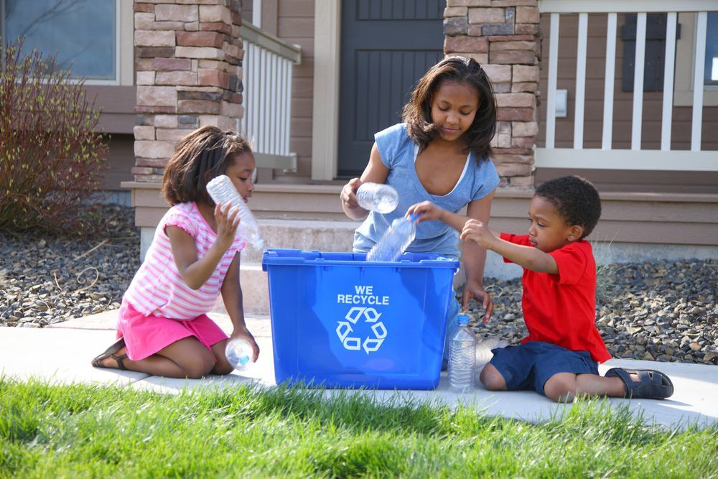
Recycling Issues
CARTLANTA Blanket Rollout
Lack of Education
Contamination
Participation
Enforcement
Data Tracking
Notes:
CARTLANTA Launch- Blanket Distribution, Poor Communication , education
Contamination -
Lack of Education- citizens were not adequately informed on the importance of recycling properly
Data Tracking- Poor tracking of internal number, no clear system for reporting multi-family recycling tonnage
Bin Locations not documented made for difficult data tracking
Enforcement – unable to enforce contamination, no fines, unclear ordinances
Issues
▪ High level of contamination in recycling carts/used as trash cans in certain areas of the city
▪ City Code for recycling is lacking enforcement and concrete repercussions
▪ City support is needed to educate more residents in the targeted areas
Objectives
▪ Identify and educate residents who have contaminated recycling
▪ Utilize a variety of messaging vehicles to reach residents in targeted areas
▪ Continue to educate all city of Atlanta residents about the recycling program and its benefits
Communications
▪ Door Hangers and Violation Stickers
o Solid Waste Operators will issue courtesy tickets (via door hangers) to notify residents of contaminated recycling. Courtesy tickets will also educate residents on proper recycling.
▪ City Code/Citations
o Revise City Code to reflect enforcement of community service initially, then fees after repeat notices
o SWEET Officers will visit residents who have previously received a courtesy ticket for contaminated recycling
▪ Volunteer Recycling Ambassador Program
o Ambassadors will continue to be educated about CARTLANTA and trained to speak with residents about proper recycling and its benefits
▪ Community Blitz - Police and Fire cadets, DPW (Worker’s Comp employees), and SWEET Officers will be utilized to be ambassadors to reach

Slide 8
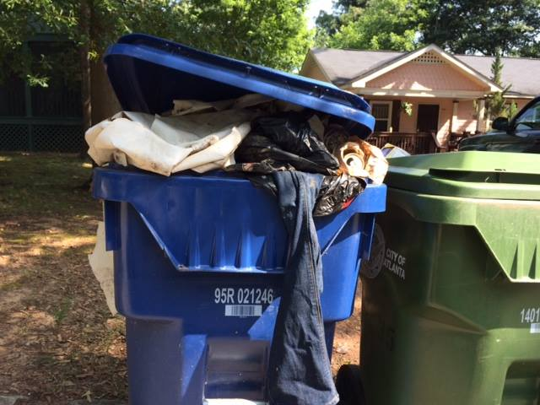
Contamination!#*%
Notes:
Those that recycle properly, recycle and LOVE IT. Passion
Others Use recycling bins for 2nd trash can
Increased contamination = Increase disposal cost

Slide 9
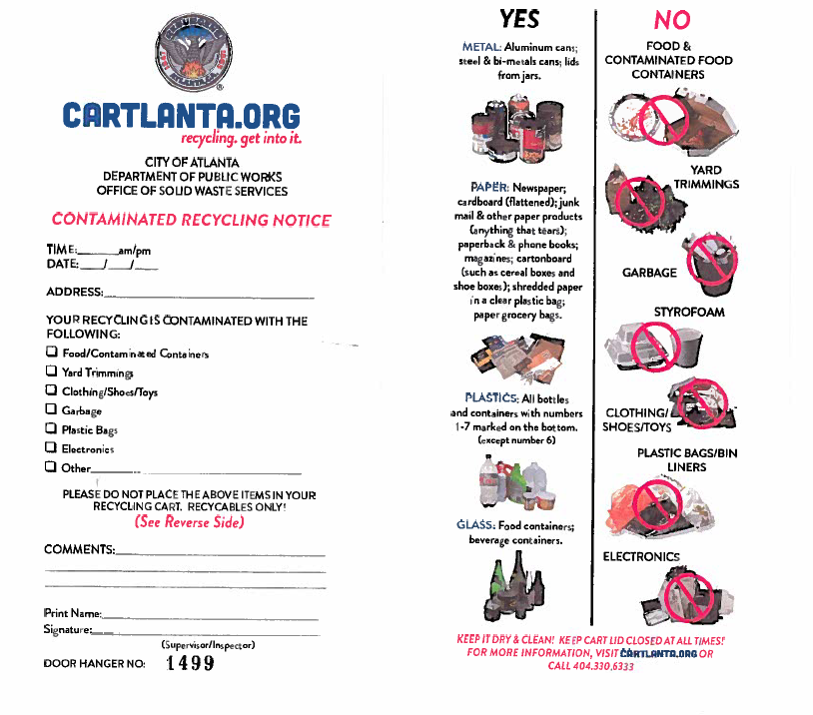
Notes:
In an attempt to identify and track high contamination areas
Collectors communicate with Code Enforcement who issues “Contamination Notices”
Type of violation
Date, address
Outlines Acceptable & Unacceptable Items
Informs Citizen that Contaminated Loads will be Collected the following Friday.

Slide 10
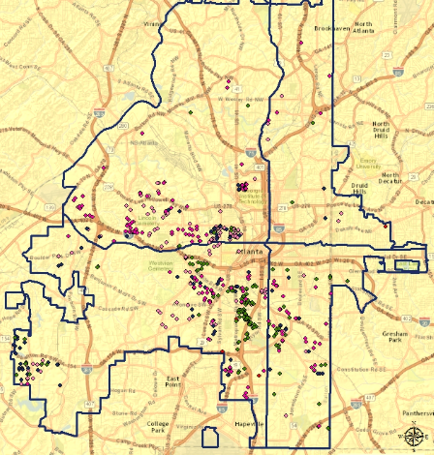
Notes:
**Contamination Map
Contamination Notices are then tracked on a monthly basis
This Information is used to focus education
Recycling team and other collection staff, Hand delivers recycling information to each home that has been TAGGED for Contamination

Slide 11
Contamination Notices
Notes:
Quarterly reports are created for Management review and
Strategic planning

Slide 12
Addressing Recycling Issues
Provide Ongoing Education
Issue Contamination Notices & Tracking
Provide Clear Recycling Information
Provide Incentives for Recycling

Slide 13
Provide Multiple Recycling Opportunities
Incentivized Recycling (Sept. 2015)
3rd Saturday Monthly Community Events
Attend Neighborhood Planning Unit Meetings (NPUs)
Atlanta Public Schools (APS)
Local Boys and girls Clubs
Library and Recreation Center Visits
Notes:
KAB and CHaRM
Senior Centers
Community Events (Festivals, Back to School, Music),
Neighborhood Association Newsletters

Slide 14
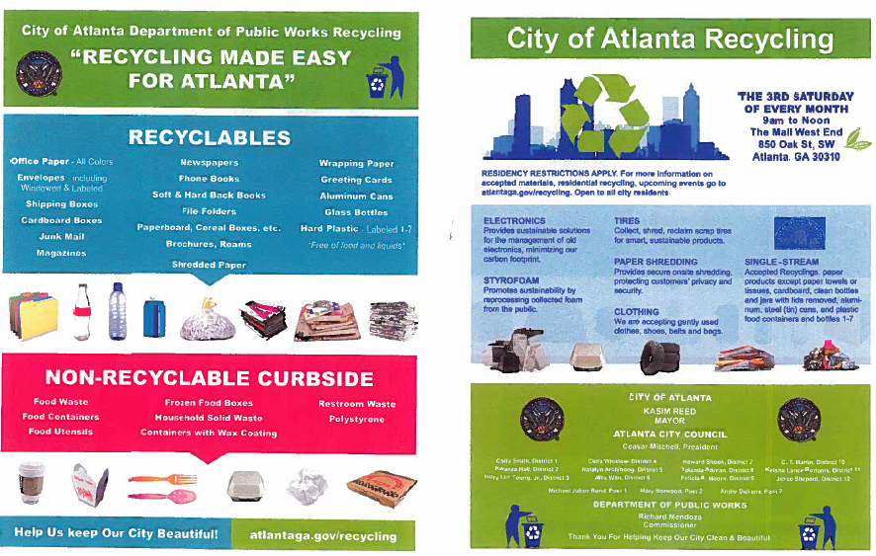
Notes:
Distributed by Recycling Team to Citizens Flagged for having contaminated Loads
-Details Do’s and Don’ts
-Advertise the 3rd Saturday Recycling Event- Mall West End (FREE)
TEXTILES, TIRES, E-WASTE, PAPER SHREDDING,
NO PLASTIC BAGS
CLEAN DRY MATERIAL

Slide 15
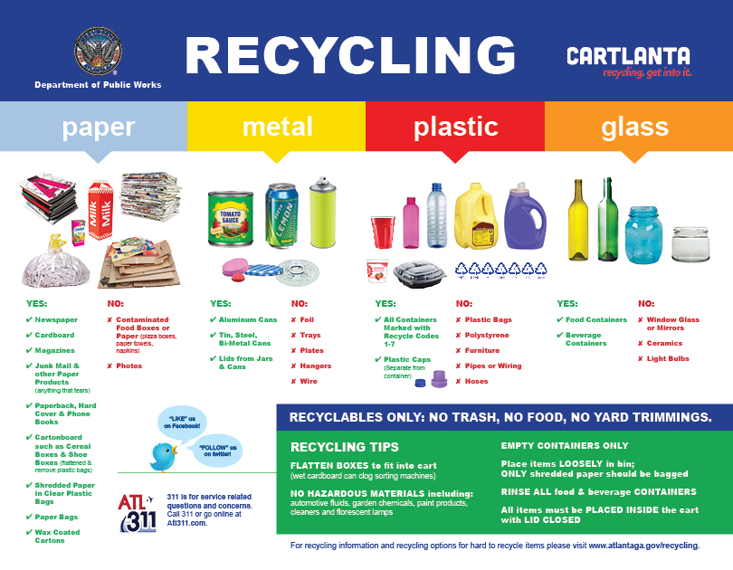
Notes:
Updated recycling Information – Clear, Color Coded recycling Information

Slide 16
Recycling Outreach
Social Media
City Water Bill Insert
City Website
Television & Radio
Recycling Ambassador Volunteer Program
Notes:
Facebook, City Website
TV & Radio- interviews and features
Bookmarks, Handouts
Recycling Event Flyers
Recycling Do’s & Don’ts

Slide 17
Incentivized Recycling Pilot
2009- 2014
Pilot Program for 25,000 Residents
Scattered Distribution
Inefficient Collection Routes
Poor Data Tracking
Notes:
THE MOST CURRENT RECYCLING VENTURE- Incentivized Recycling Program began with a Pilot Program in 2009
Pilot Incentivized Recycling Program- 2009
~25,000 residents in partnership with Coke (paid for containers),
Rebates from recycling helped pay for the containers,
Split around the city in small areas,
Each Council District contained Incentivized routes
Pilot dissolved in 2014 (processor went out of business)
In hopes of reaching citizens that do not currently recycle, COA is Implementing a Citywide Incentivized Recycling program

Slide 18
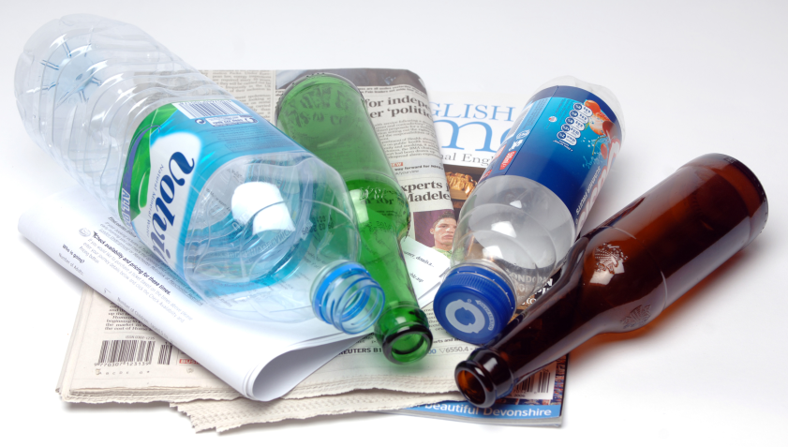

Incentivized Recycling Full Implementation
Recycle Perks- Service Provider
September 2015 Inception
Available to all 96,000 Single Family Residents
Notes:
NEXT STEP-
Citywide Implementation of the Incentivized Recycling Program
All Single Family Residents in Atlanta will be eligible to Receive Incentives for Recycling
Increase Recycling Awareness, Increase Participation- influence non-recyclers to RECYCLE!

Slide 19

Notes:
-Recycle Perks was awarded the contract
-Worked closely to streamline the message, inform COA Citizens
-Next Up Bill Dempsey, President of Recycle Perks

Slide 20
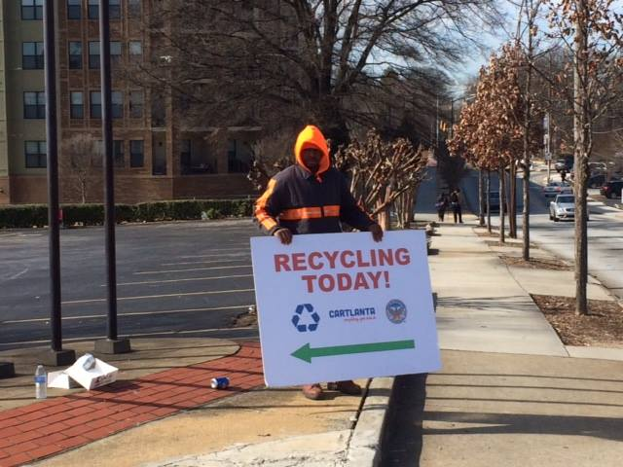
QUESTIONS?

Slide 21
CITY OF ATLANTA
Department of Public Work
Solid Waste Services
www.atlantaga.gov
www.facebook.com/AtlantaPublicWorks
Carla Lipscomb
Public Works Manager Sr.
clipscomb@atlantaga.gov
(404) 330-6240

