Slide 1


Plastics industry efforts to reduce marine debris
Stewart Harris
September 16, 2019

Slide 2
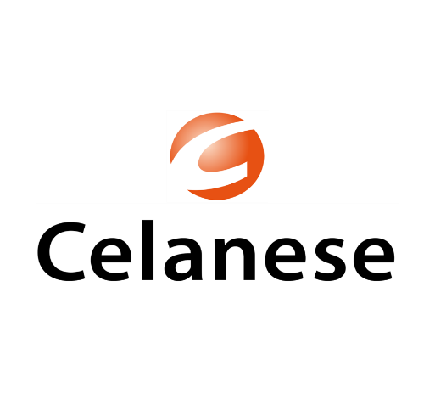




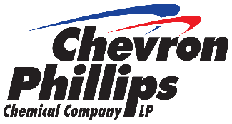


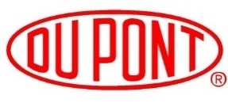









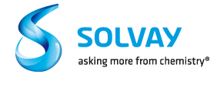

Plastics Division Members

Slide 3

Plastics and Sustainability
Environmental cost of plastic use in consumer goods is 3.8 times less than alternatives
Plastic Alternatives
$533 Billion
Business as Usual
$139 Billion
Trucost, Plastics and Sustainability: A Valuation of Environmental Benefits, Costs and Opportunities for Continuous Improvement, July 2016.
Notes:
In 2015 work was done to update a UNEP Valuing Plastic study to quantify both the environmental costs and benefits of plastic.
The TruCost study showed that the environmental cost to society of plastic in consumer goods sector is 3.8X less than alternative materials due to the greater material efficiency of plastic (for example plastics can help improve fleet fuel efficiency). More efficient packaging technologies that use less plastic could significantly reduce the environmental cost of plastic.
Updated look at the 2014 Valuing Plastics Report done for UNEP
Greenhouse gas emissions are 40% less per tonne of plastic alternative, but greater in aggregate due to the quantity of material needed to replace plastic

Slide 4
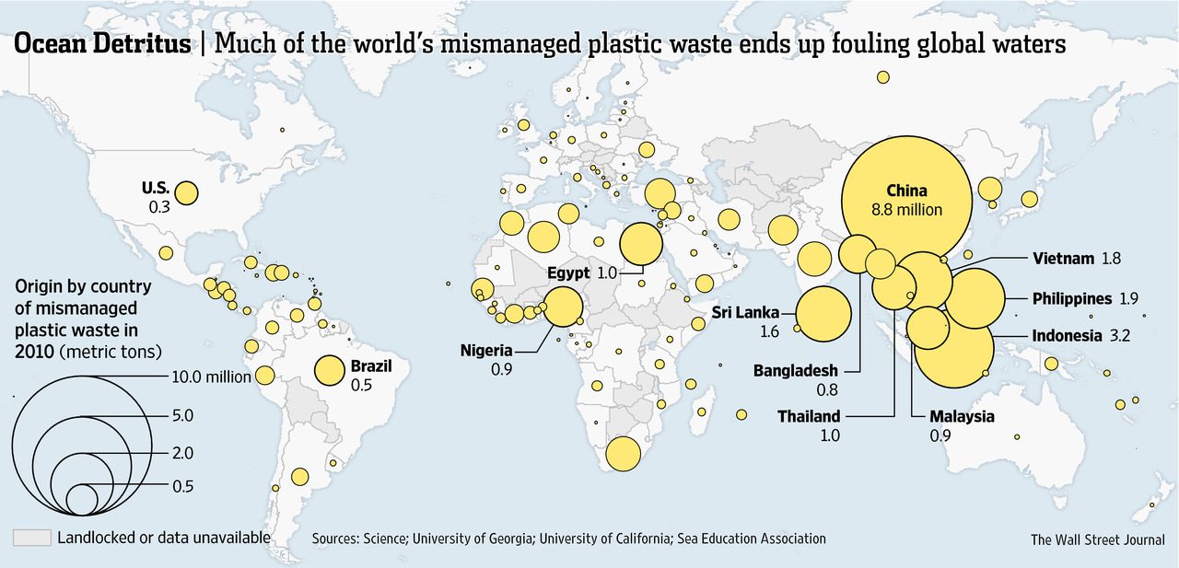
Sources of Plastic Marine Debris
Notes:
Jambeck 2015 study identified lack of waste management infrastructure in 5 rapidly developing Southeast Asian countries
Dr. Christian Schmidt examined rivers as a transport mechanism for mismanaged municipal plastic waste and estimated that 10 rivers are responsible for 88% to 94% of all plastics entering ocean from riverine sources
Reinforces TFSA waste management infrastructure efforts in SE Asia, which has 8 of 10 rivers identified

Slide 5
Rivers Deliver All Waste to the Ocean
The bulk of Indonesia’s challenge to halt marine debris leakage involves addressing its inadequate municipal waste management service provision.
Source: World Bank 2018, INDONESIA MARINE DEBRIS HOTSPOT, Synthesis Report
Notes:
Jambeck 2015 study identified lack of waste management infrastructure in 5 rapidly developing Southeast Asian countries
Dr. Christian Schmidt examined rivers as a transport mechanism for mismanaged municipal plastic waste and estimated that 10 rivers are responsible for 88% to 94% of all plastics entering ocean from riverine sources
Reinforces TFSA waste management infrastructure efforts in SE Asia, which has 8 of 10 rivers identified

Slide 6
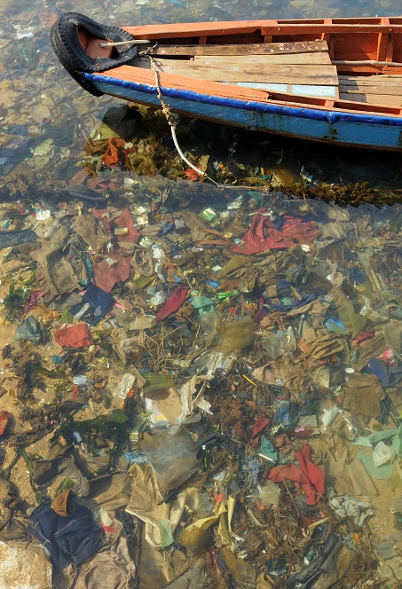

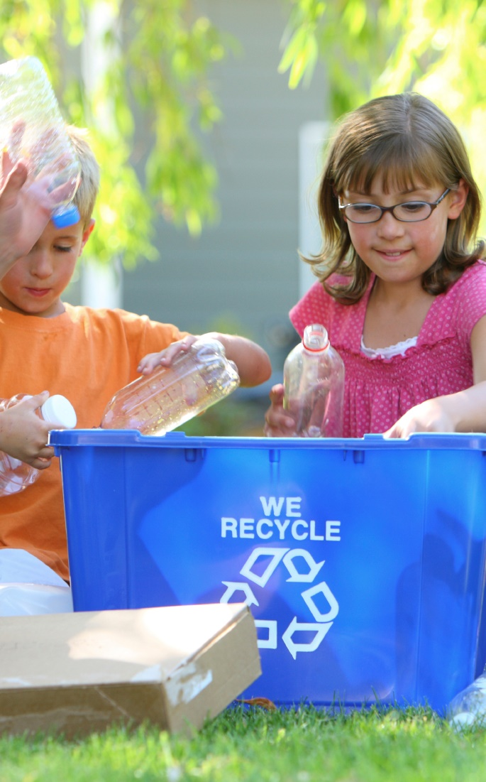
Marine Debris - Our View
Plastic & other litter in the environment is unacceptable
Plastics deliver significant societal benefits
Plastic makers have a role in providing solutions

Slide 7

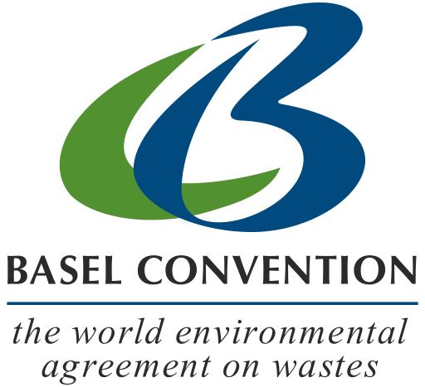

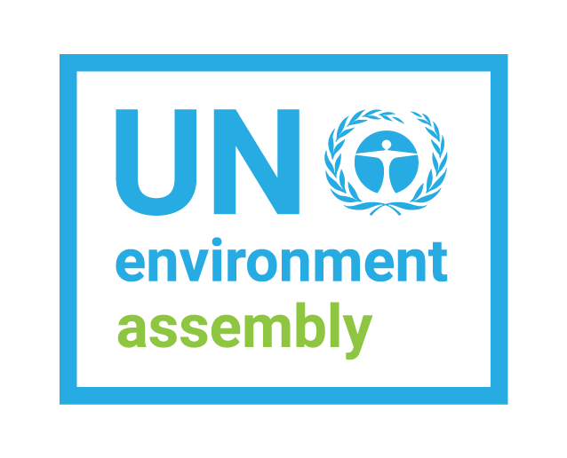



Global Attention on Marine Debris
Nearly every major global environmental forum is considering plastics policy
Conversations around plastic consumption, production, and waste

Slide 8
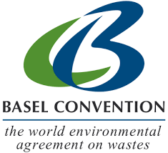
Basel Convention
Presumption regarding international control of plastic waste shipments flipped
Annex Changes for Plastic Waste (effective Jan 1, 2021)
  Annex II
    Most plastic wastes now presumed to be controlled as “Other Wastes“
  Annex IX
    Mixtures of PP, PE, PET, if destined for separate recycling
    Pure polymer streams “almost free” from contamination
OECD implementation

Slide 9

A new CEO led, cross-sector, not-for-profit organization with a clear mission to develop, accelerate & deploy solutions, catalyze public & private investment and engage communities to help end plastic waste in the environment

Slide 10
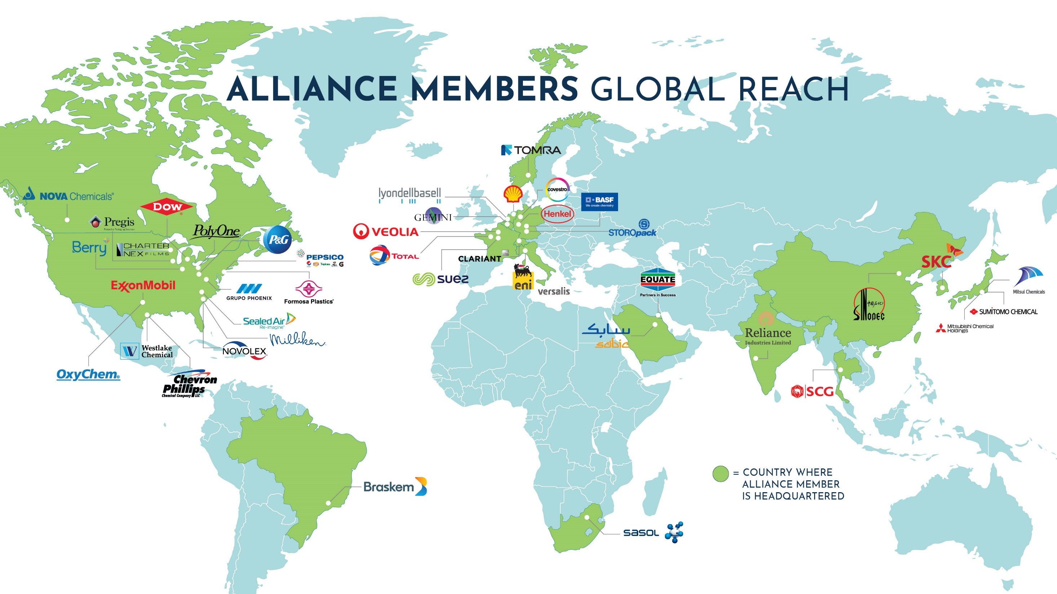

Slide 11








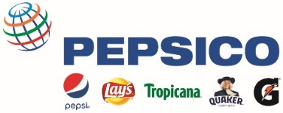



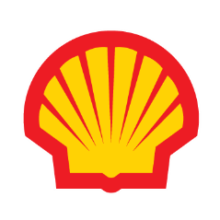
















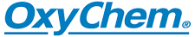










Officers
Executive Committee
Board of Directors
As of
September 2019

Slide 12




Alliance to End Plastic Waste
FOUR PART STRATEGY
INFRASTRUCTURE
INNOVATION
EDUCATION
CLEAN UP
Infrastructure Development to collect and manage plastic waste, and increase recycling in areas of
greatest need.
Innovation to advance and bring to scale new technologies that make recycling and recovering plastics easier and create value from all post-use plastics.
Education and Engagement of governments, businesses, and communities to mobilize action.
Clean Up to help stop plastic waste at its source, focusing on cities and major rivers that carry significant amounts of plastic waste to the ocean.

Slide 13
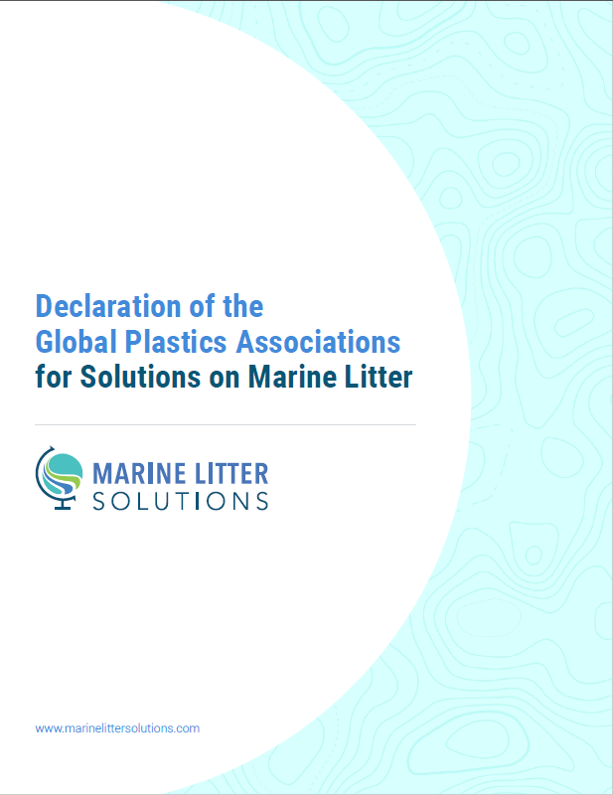
Global Plastics Alliance
Announced at UN/NOAA 5th International Marine Debris Conference, March 2011
Six-point strategy for industry action
Advocates close cooperation with range of stakeholders to create solutions
Transparent progress reports every 2 years

Slide 14

Declaration Contents
We will:
Contribute solutions through partnerships to prevent marine debris
Research to understand scope, origin, impacts
Promote enforcement of existing laws to prevent marine litter
Spread knowledge of efficient waste management systems
Enhance recycling/energy recovery opportunities
Steward plastic pellets from supplier to customer

Slide 15
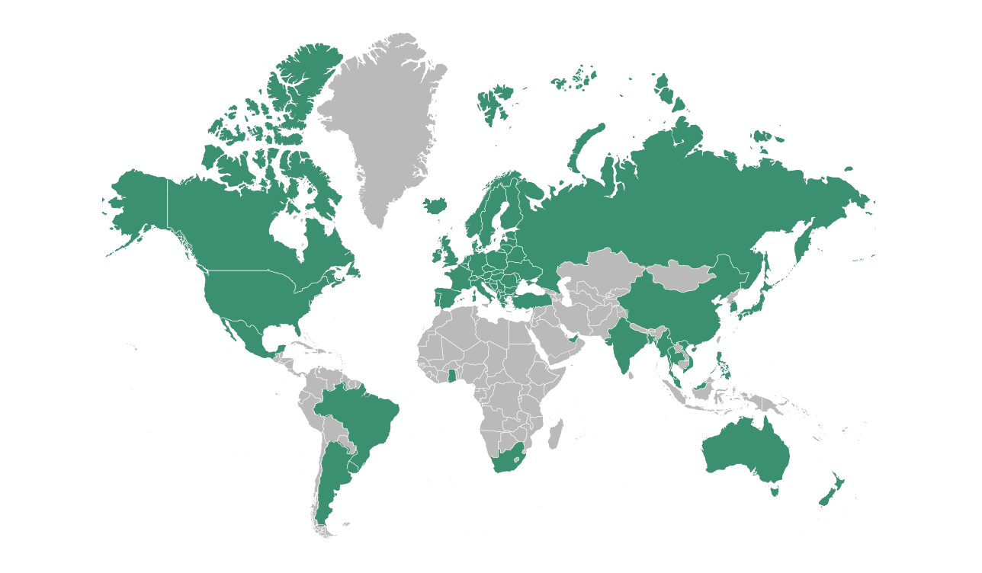
Making Progress
www.marinelittersolutions.com
1st Progress Report-2011
Members | 47
Countries | 27
Projects | 100
2nd Progress Report-2013
Members | 60
Countries | 34
Projects | 185
3rd Progress Report-2015
Members | 65
Countries | 34
Projects | 260
4th Progress Report-2017
Members | 74
Countries | 40
Projects | 355

Slide 16








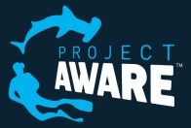

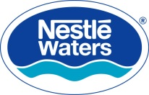




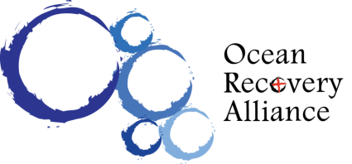




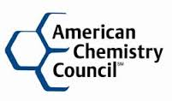


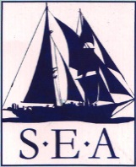




Trash Free Seas Alliance®
Trash Free Seas Alliance ®

Slide 17

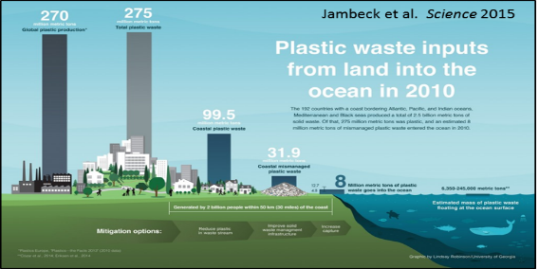
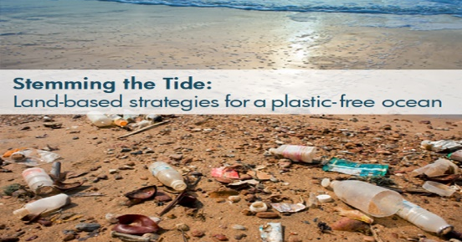
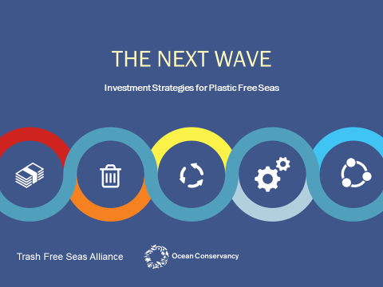

Trash Free Seas Alliance®
Research to understand sources
Which interventions work
Evaluated funding options
Built platform & launch pilots
Notes:
In under three years together we have:

Slide 18
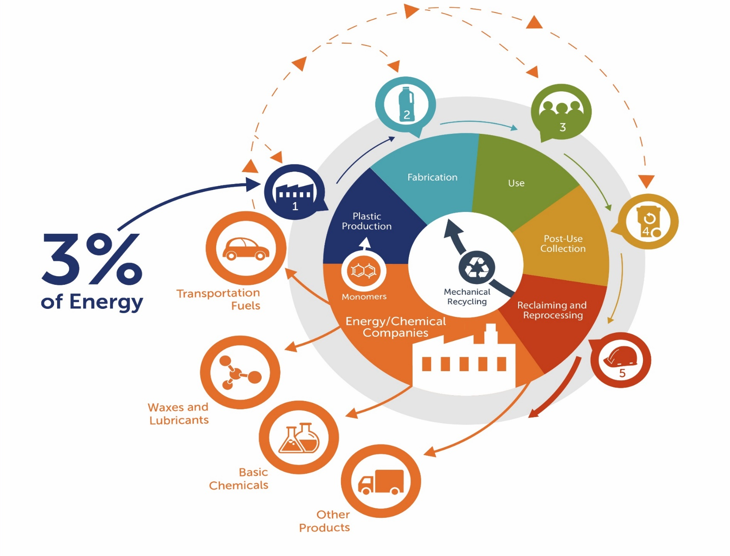
Plastics in a Circular Economy

Slide 19
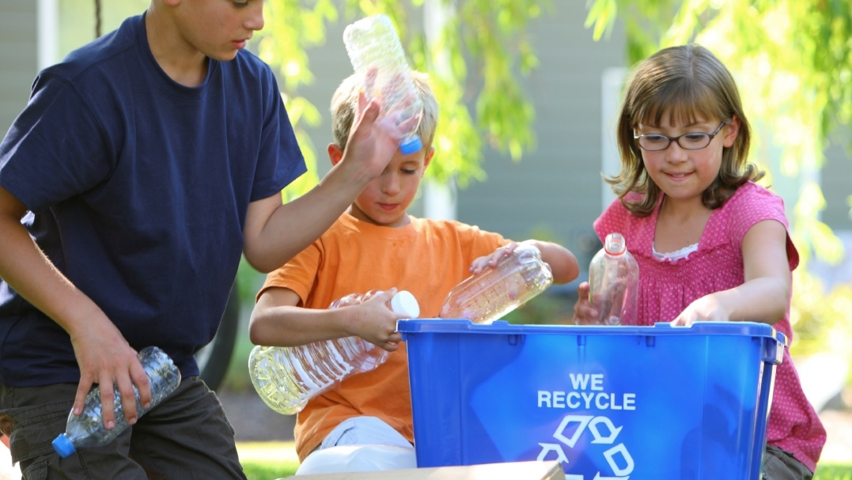
ACC Sustainability Goals
2040 Goal
  100% of plastics packaging is reused, recycled or recovered
Interim Goal (2030)
  100% of plastics packaging is considered recyclable/recoverable
Best practice goal
  100% of Division’s U.S. manufacturing sites participate in Operation Clean Sweep Blue by 2020, with all North American sites by 2022

Slide 20
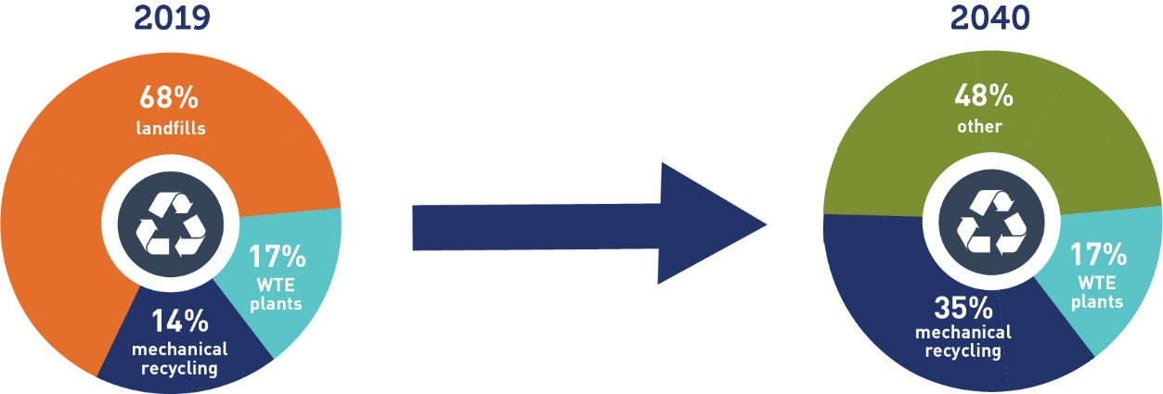
2040 Challenge
Drive sustainable management of plastics packaging by increasing mechanical and chemical recycling, and supporting new collection methods and alternative uses

Slide 21
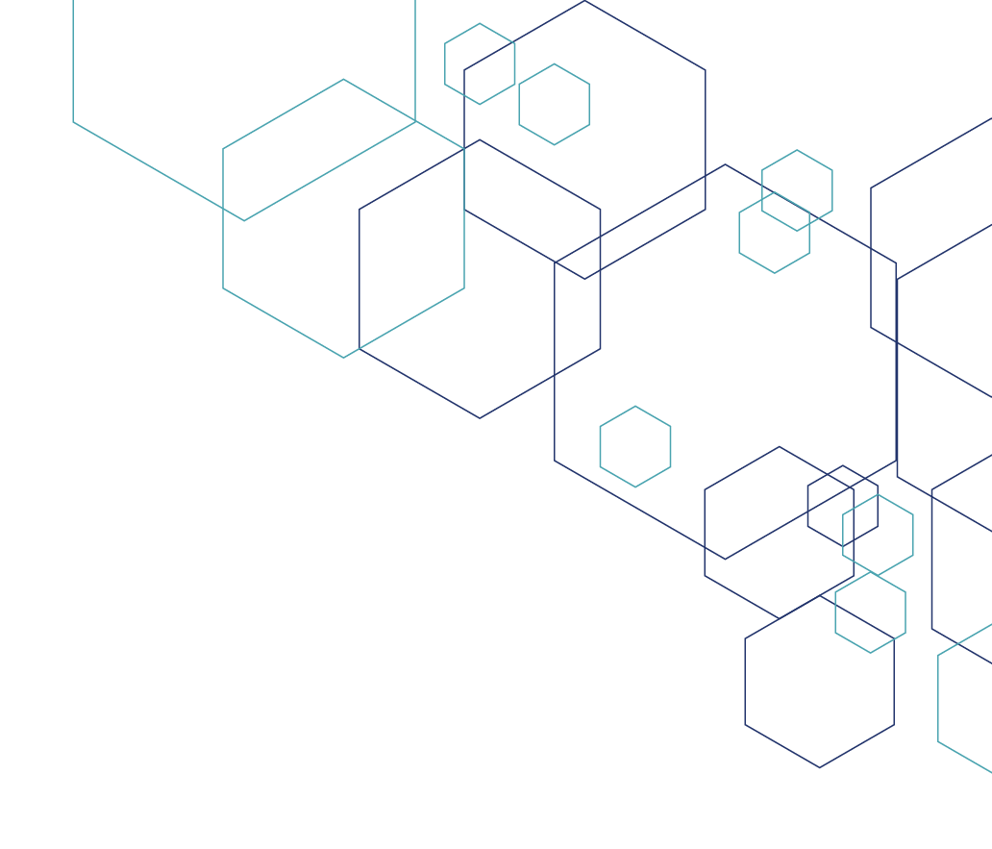




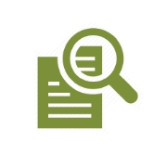

Achieving the 2040 Goal
  100% of plastic packaging is recycled or recovered by 2040
Design & Invent new circular business models
Expand access
Educate consumers and change behavior
Invest in new infrastructure and transformational technology
Create Partnerships with Prominent Orgs and Other Leaders

Slide 22

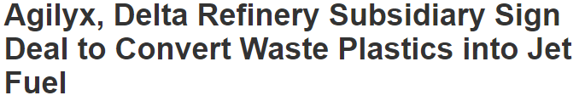

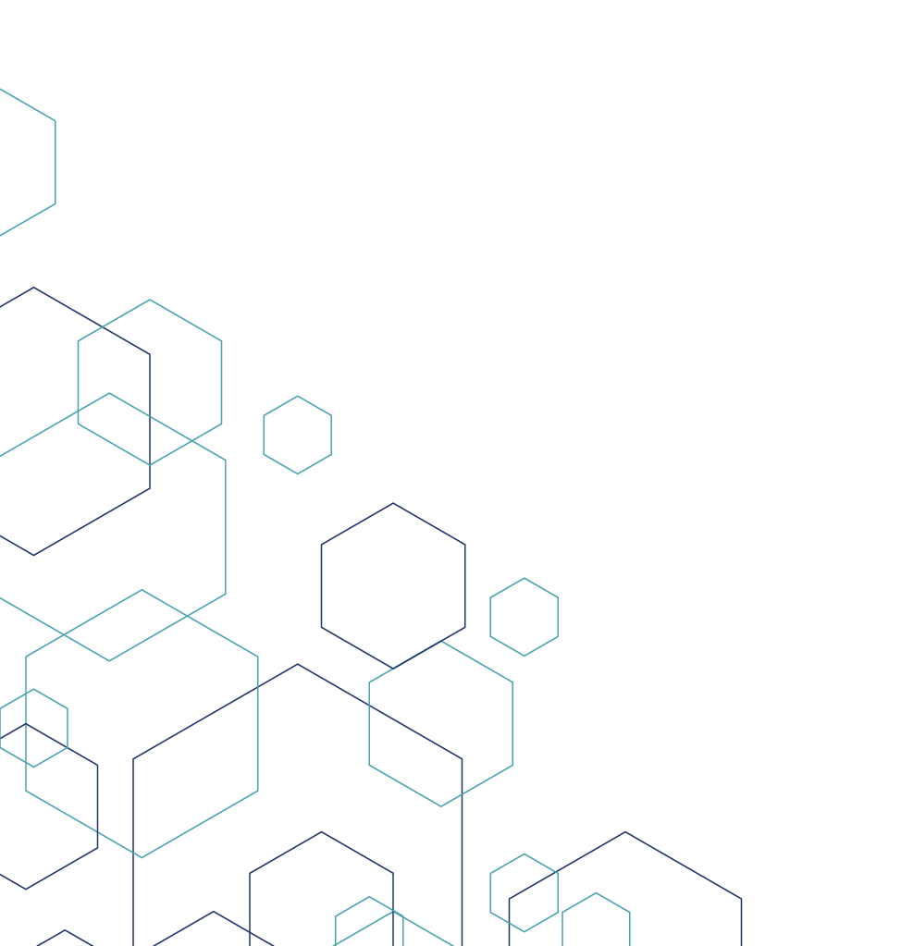

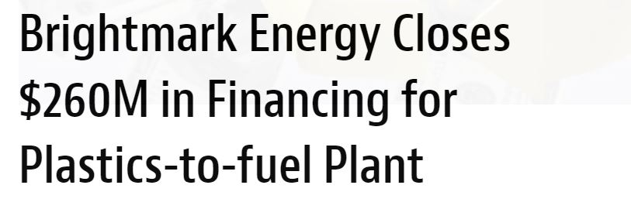
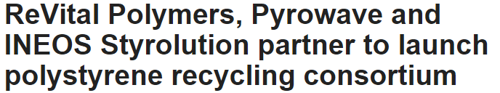
Recent Announcements (U.S.)
3) Increase Access and Infrastructure
1) Define, Inventory, and Target
2) Invent New Circular Business Models

Slide 23
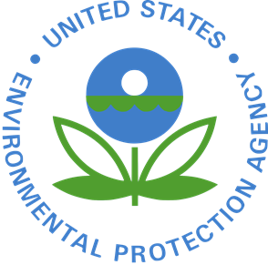
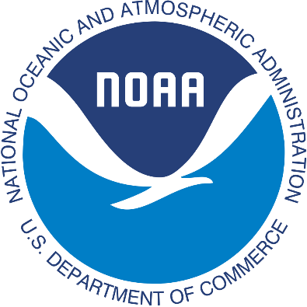






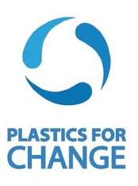




Marine Debris Partnerships
Notes:
EPA Trash Free Waters
NOAA Marine Debris program
Rozalia - Expedition STEM for the Ocean; Marine Debris Education & Outreach
Save The Bay - Shoreline Trash Reduction & Prevention (Warwick)
Clean Virginia Waterways & Longwood University - Beachy Clean
The Meadows Center – Trash Free Trinity
City & County of Honolulu – Hawaii project
NC Aquarium recycling bins project
NJ Clean Communities Council - waterways litter survey

Slide 24



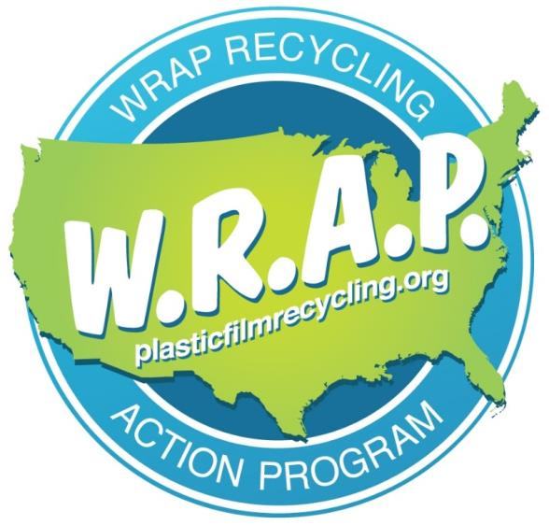
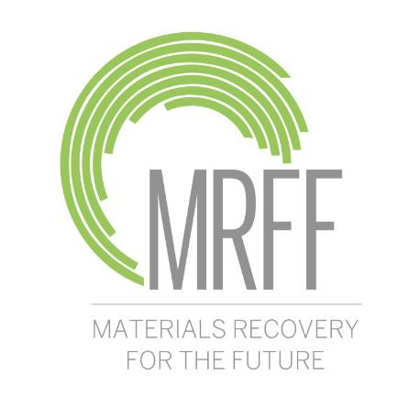
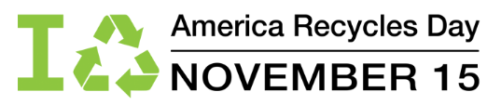
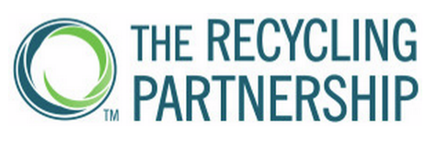
Promoting Recycling

Slide 25
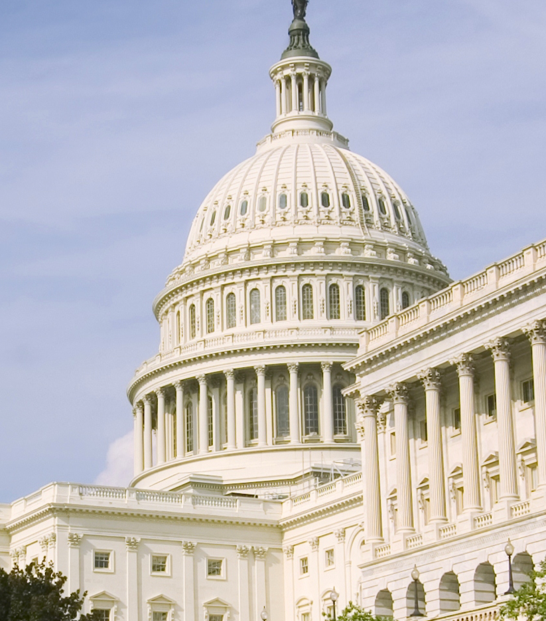
Promoting Policy
  Supported Microbeads Free Waters Act of 2015
  Supported Save Our Seas Act of 2018
  Supporting straws on request policies

Slide 26
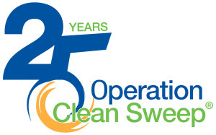
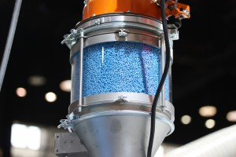
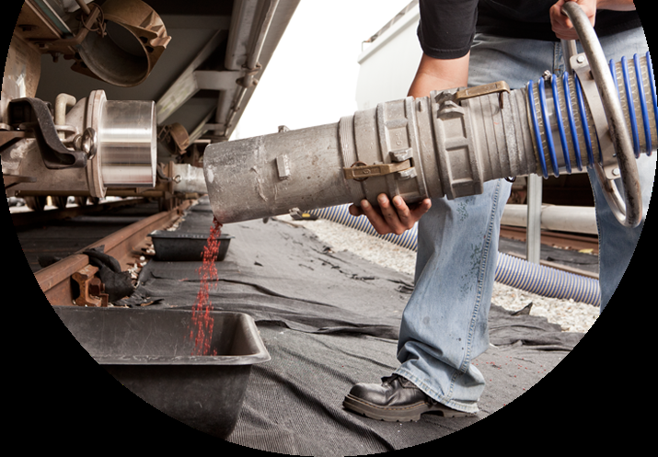

Stewarding Plastic Pellets
Best practices to contain pellets, flakes and powder from loss
Covers manufacturing through transportation and end use
OCS blue – new membership level

Slide 27
Thank you!
Stewart_Harris@americanchemistry.com
202-249-6626
MarineLitterSolutions.com

