Slide 1

Notes:
In the summer of 2018, the Mayor’s Office of Resilience was awarded a grant to partner up with the Natural Resources Defense Council (or NRDC) to map the City of Atlanta’s food waste by sector. And so prior to us, over the last 5 years, or so, the NRDC, with support from The Rockefeller Foundation (who until this summer was funding the 100 Resilient Cities), set out on a first-of-its-kind research to better understand wasted food in cities exploring the intersections between food waste and climate change and just plain hunger-how to get food to people that need it and to inform and inspire cities across the country
to more fully meet the challenge of wasted food and reducing it.

Slide 2
Why it Matters
■ 1 in 5 children in Georgia is hungry.
■ 1 in 7 adults in Georgia is hungry.
■ Feed world’s hungry 4x over.
■ Waste of water and energy.
■ Landfill GHG, 3rd emitter after US and China.
■ Carbon Sequestration.
■ HOUSEHOLD:
$1500 per family
■NATIONAL:
$218 billion
Notes:
-About 21 percent of the water is used to grow food is wasted because of the magnitude of food Americans toss each year. The energy it takes to get food from farms, production plants, and the wild to our plates is huge: It makes up an entire 10 percent of the nation’s energy use. And a good chunk of that energy goes into producing the food that ends up in the garbage.
If we were able to corral all the wasted food in the world we could feed the world’s hungry 4 times over.

Slide 3
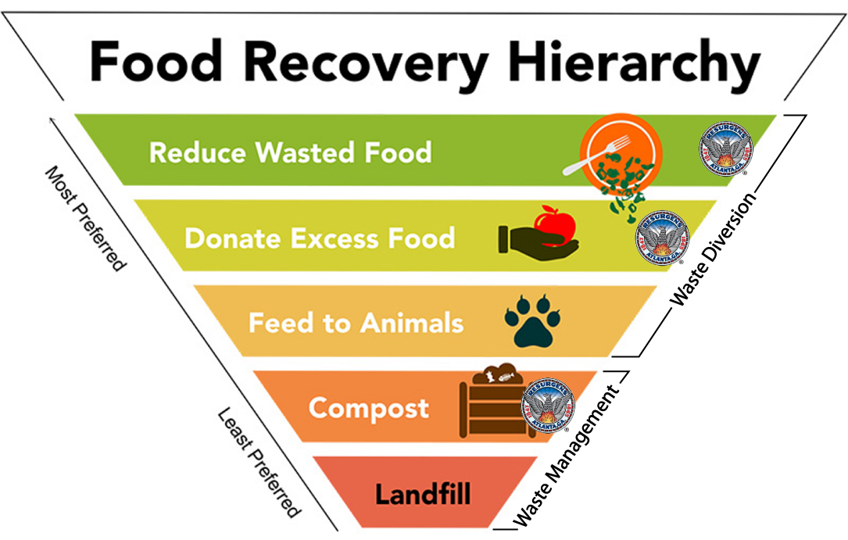
Notes:
Where the City of Atlanta sees opportunity.

Slide 4

Atlanta’s Wasted Food by Sector

Slide 5


Slide 6
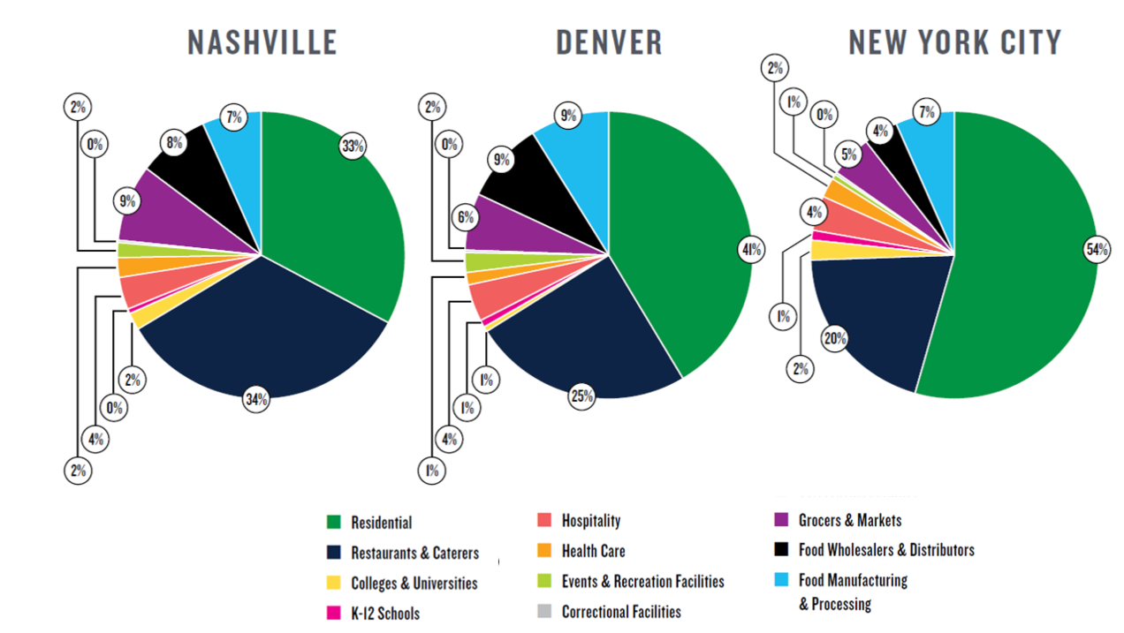
Mapping Wasted Food by Sector
Notes:
Using Nashville, Denver, and New York City as their first test cases they found that an average of 3.5 pounds of food per person was wasted at home every week in all three cities. That’s equal to a day’s worth of meals per person per week and totals $1500 per year per household. Even worse, two-thirds (68 percent) of that was potentially edible. Across the three cities, households and restaurants and caterers are the two sectors generating the most wasted food with other substantial contributors including food wholesalers and distributors, food manufacturing and processing, grocers and markets, and hospitality.
https://kdvr.com/2019/05/02/new-pilot-program-hopes-to-cut-back-on-food-waste-in-colorado-restaurants/

Slide 7



Sister City Challenges
■ 30-day Challenge
■ 55 Restaurants
■ over 30K meals donated
■ AFTER: Ongoing, report twice a year
■ 60-day Challenge
■ 9 Restaurants
■ From 15% to 70% compostable diversion
■ AFTER: Working on 2020 Solid Waste Master Plan to determine if mandated diversion feasible
■ 60-day Challenge
■ 150 Restaurants
■ 800 tons diverted
■ AFTER: Ordinance, businesses generating over 1 ton food waste weekly must divert
Notes:
DEN: most restaurants were made to order so there was no real donation story

Slide 8

30-day Restaurant Challenge
■Hunger Action Month (September)
■Mayor’s Goal: 85% Food Access
■ Mayor’s Goal: 20% wasted food reduction by 2021
■Challenge Goal:
-Reduction
-Recovery
-Recycling
-Regenerating

Slide 9
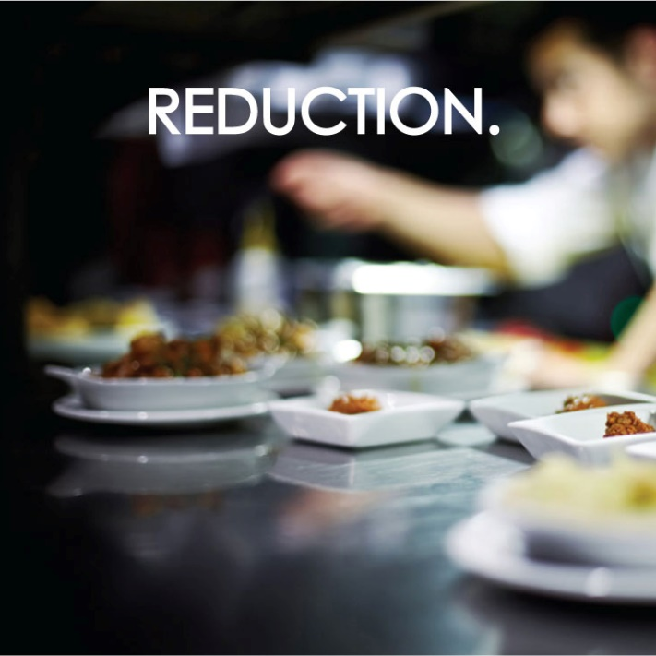
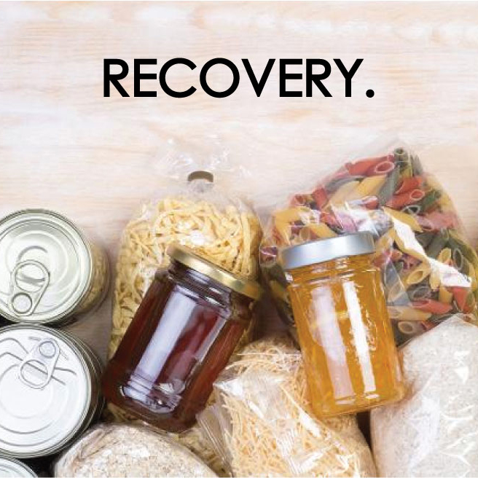

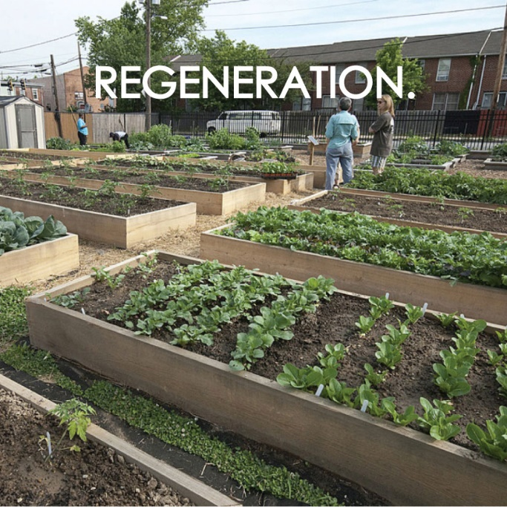
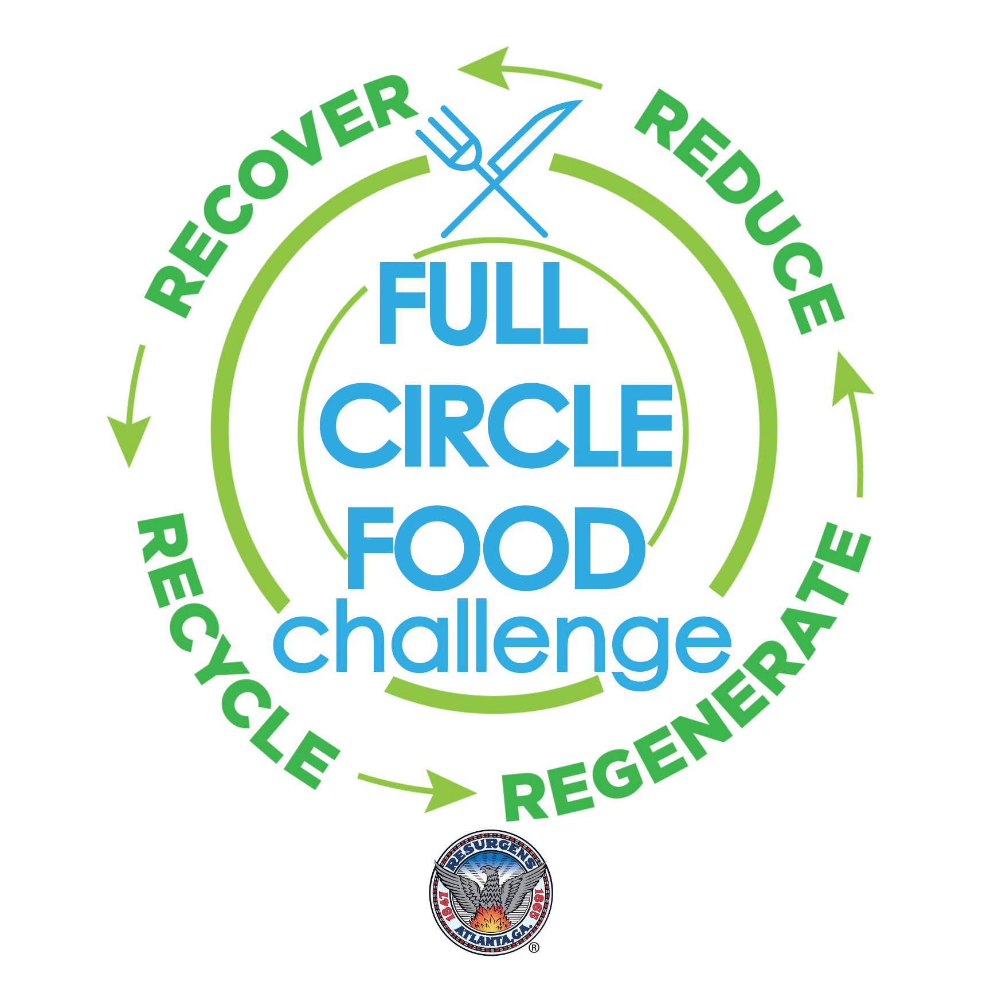
■ Goodr
■ LeanPath tools
■ EPA tools
■ Goodr
■ Food Donation Connection
■ Federal Tax Incentives
■ Liability Protections
■ CompostNow
■ Georgia Organics “Farm to Table” Campaign
Notes:
LeanPath = food waste prevention technology
• Purchasing
• Utilize imperfect fruits and vegetables
• Creatively re-purpose surplus foods and record any new or modified recipes.
• Offer more flexible portions
• Cook in small batches and/or cook to order.
• Make side dishes and bread optional for your customers.
• Actively encourage use of appropriately sized “to-go” containers.

Slide 10
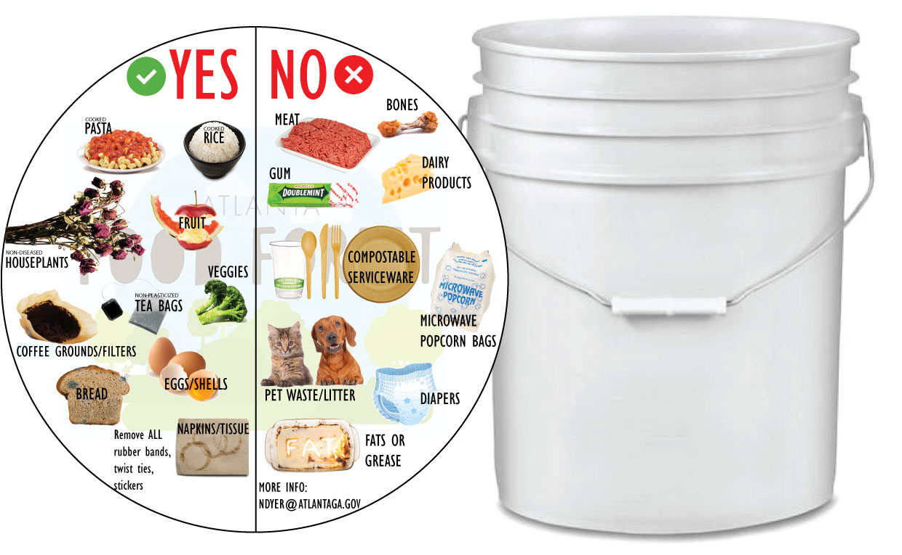
Browns Mill Urban Food Forest
■ Pilot Community Food Scraps Drop Off
■ Community-based Composting
■ Urban Agriculture Grows-A-Lot Gardens

Slide 11
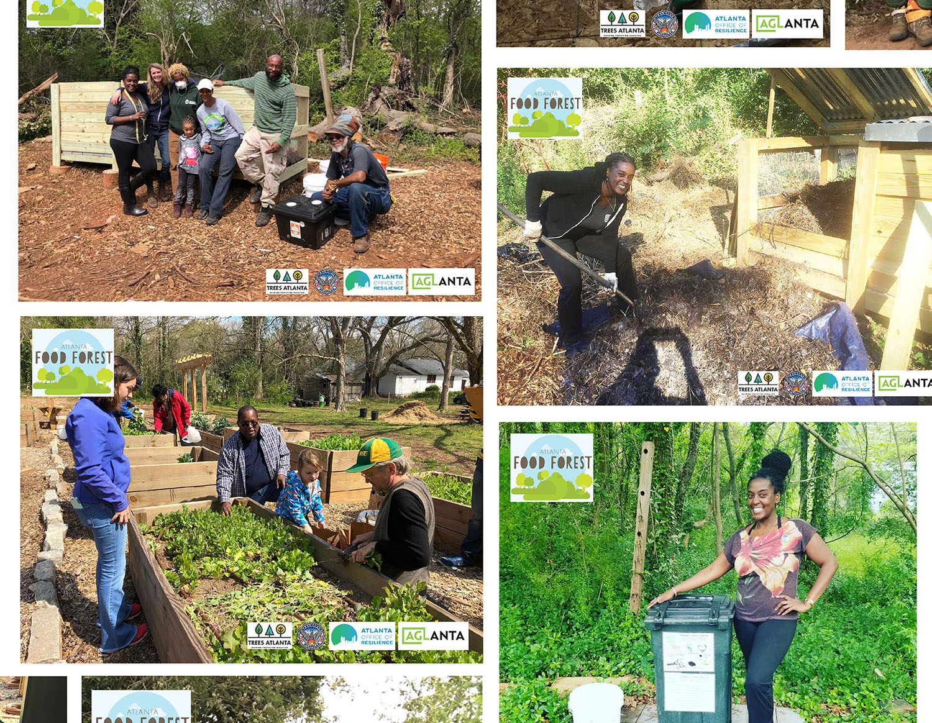
Browns Mill Urban Food Forest

Slide 12
GOAL: Mandates

Slide 14



