Slide 1
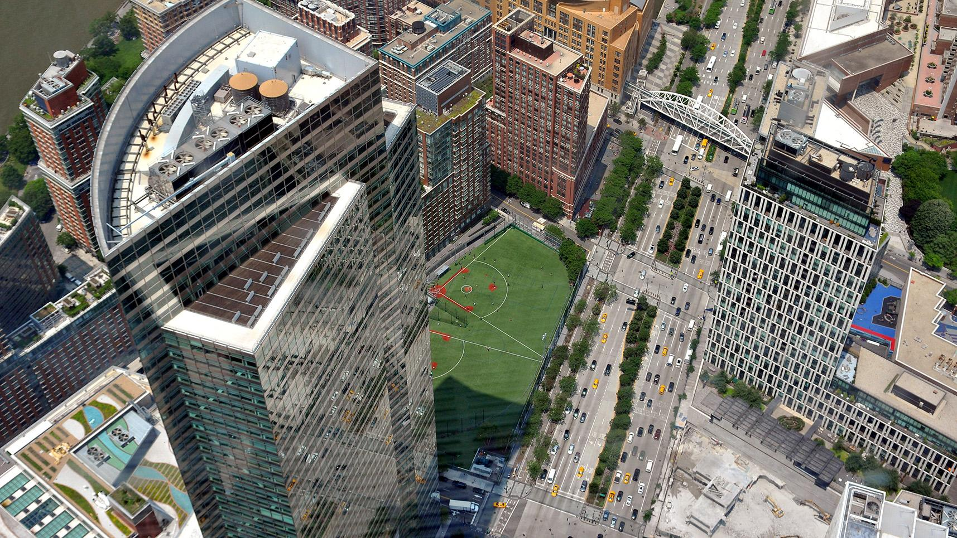
Building Resilience

Slide 2
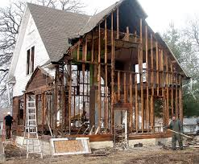
What is Deconstruction?
“The systematic dismantling of a structure in order to preserve the building materials for reuse”.
Notes:
Talk here about the various ways to do decon, its advantages. Asbestos abatement story, hybred decon, …

Slide 3
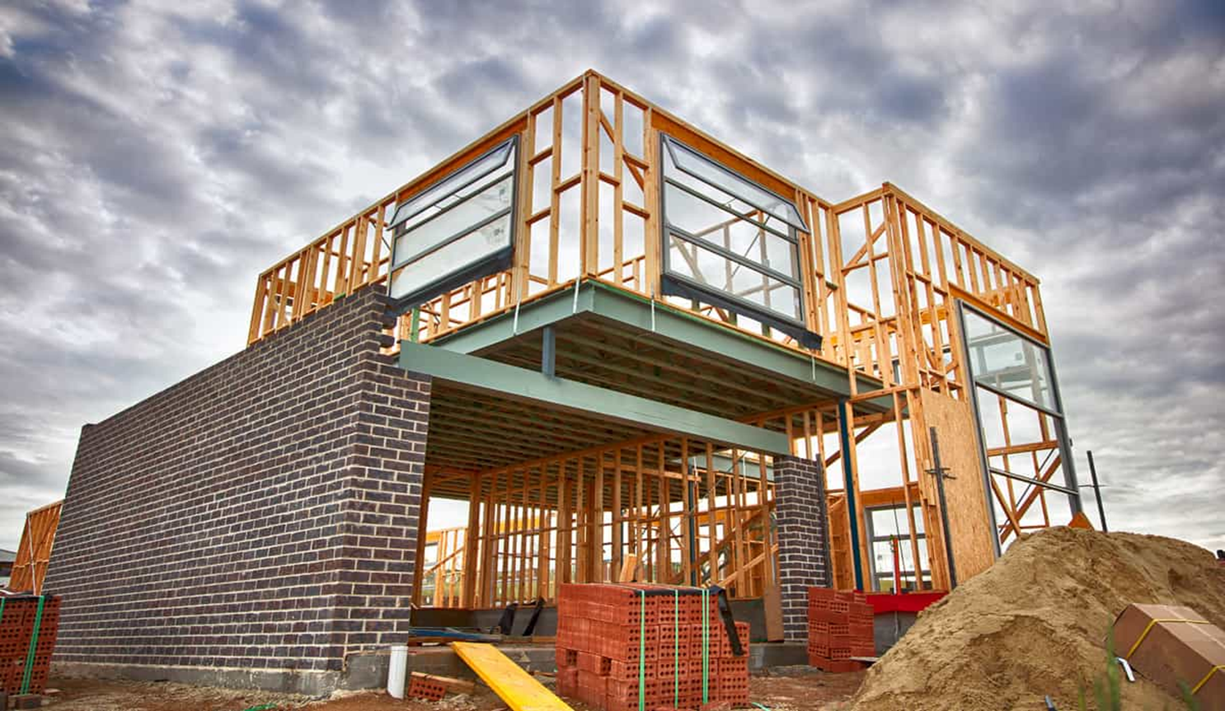
Design
Purpose Planning Intention
Notes:
If waste is a matter of bad design then what is the definition of design?
Design is the first stage, the nucleus of all that follows. The past 70 years of design have follow the post war economics of plenty, and of the “new”. That paradigm was not historic, it was fundamentally dependent upon the access to natural materials and transportations systems that followed the mobilizing of nations to fight a war.

Slide 4
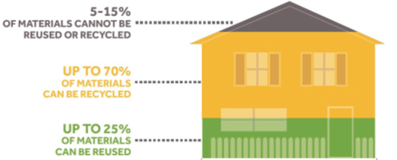

Slide 5
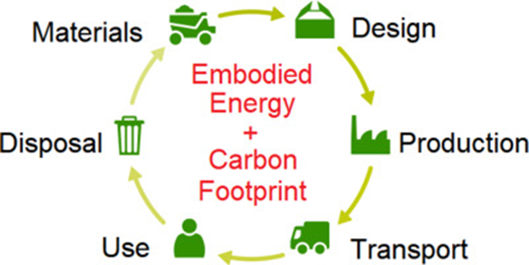
Notes:
If waste is a matter of bad design then what is the definition of design?
Design is the first stage, the nucleus of all that follows. The past 70 years of design have follow the post war economics of plenty, and of the “new”. That paradigm was not historic, it was fundamentally dependent upon the access to natural materials and transportations systems that followed the mobilizing of nations to fight a war.

Slide 6
Why Is Deconstruction Important?

Slide 7
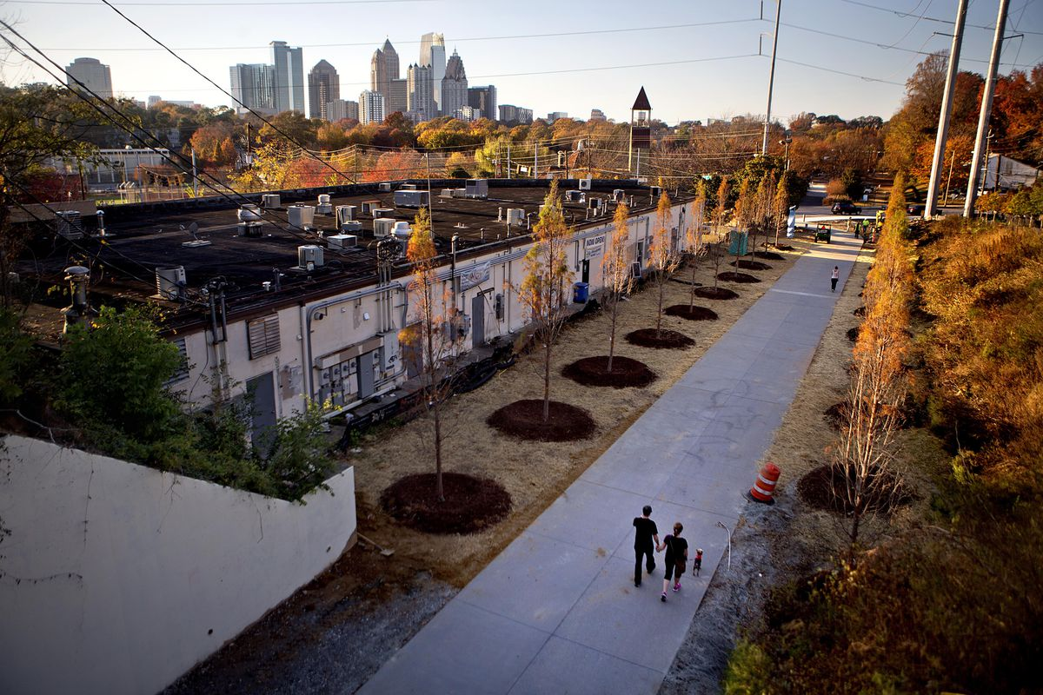
Affordable Housing

Slide 8
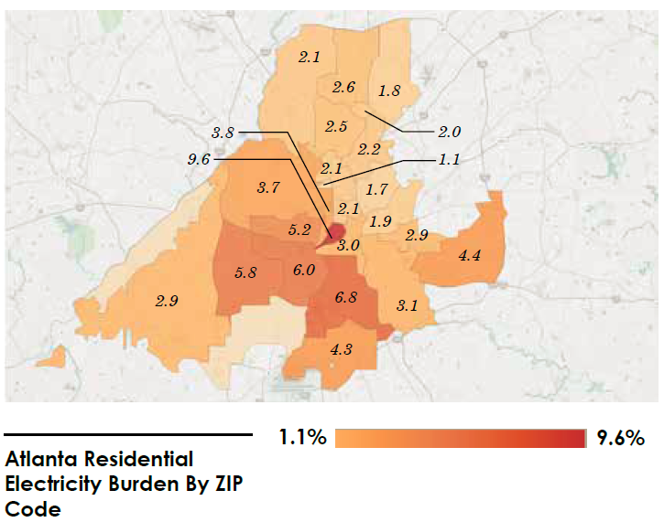
Equity is top of mind for a reason
Atlanta has 4th highest energy burden in U.S. (energy burden = % of household income spent on electricity + natural gas)
National average
is 2.7% of income
Atlanta – up to 9.6% in highest ZIP codes in lower-income, minority areas
Burden highest in low-income neighborhoods
$245/month: monthly utility bill for $26,000 household income (11.3% burden)
$330/month: utility expenses for $90,000 household income (4.4% burden)
Notes:
See “notes” in next slide for full definition of term, which I recommend providing on the next slide.

Slide 9
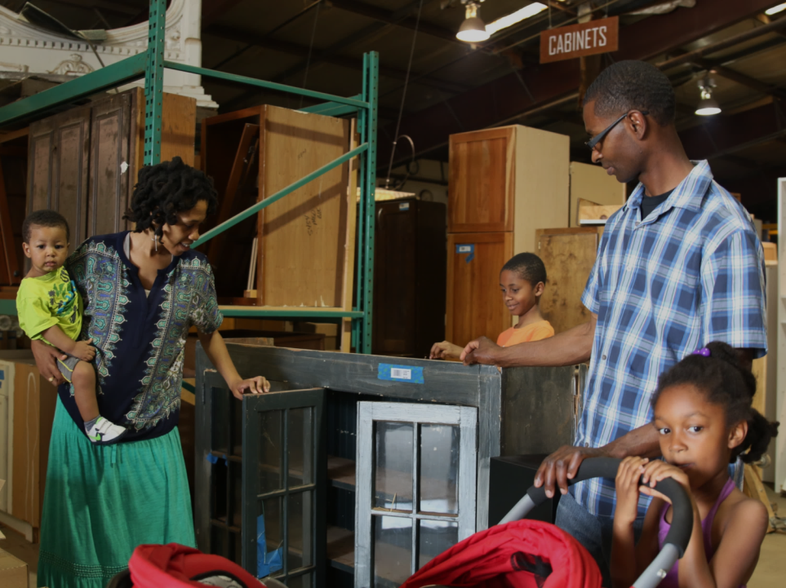
WEATHERIZATION & HISTORIC PRESERVATION SOLUTIONS:

Slide 10
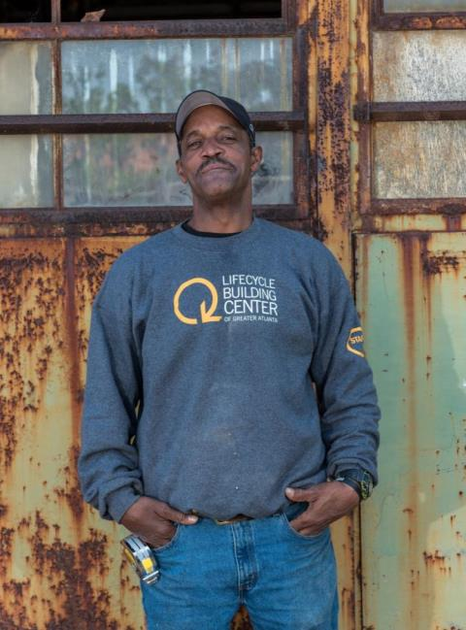
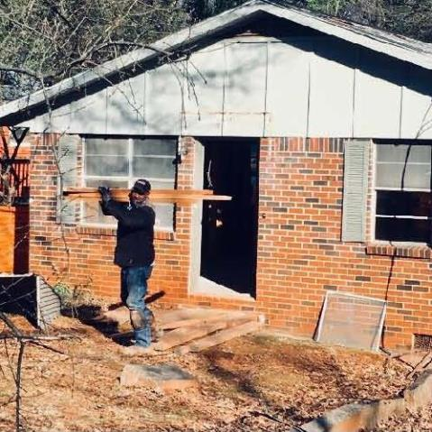
Training
& Job Creation

Slide 11
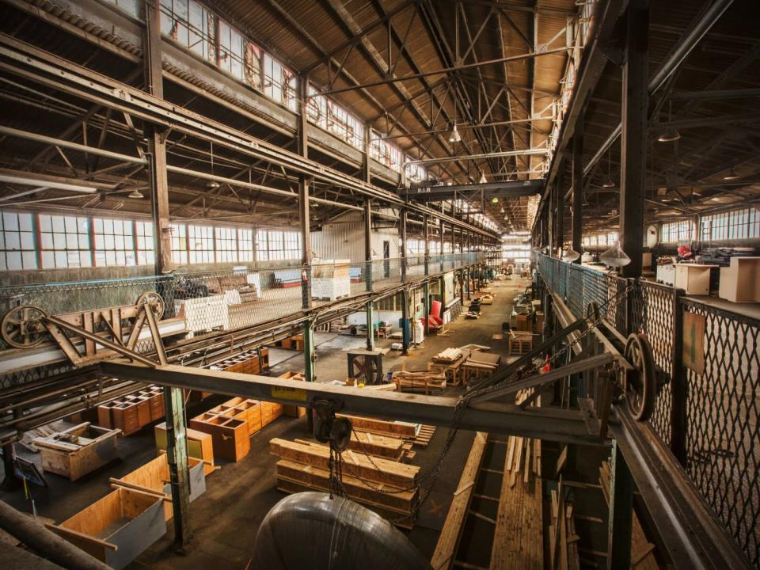
RESILIENCE IN ACTION
LIFECYCLE BUILDING CENTER

Slide 12
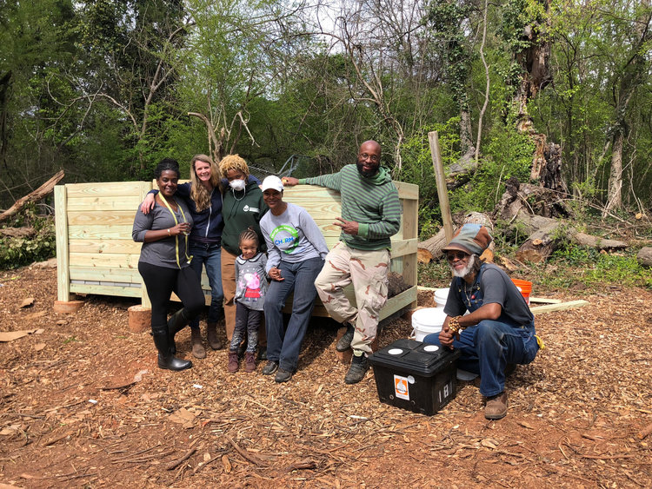
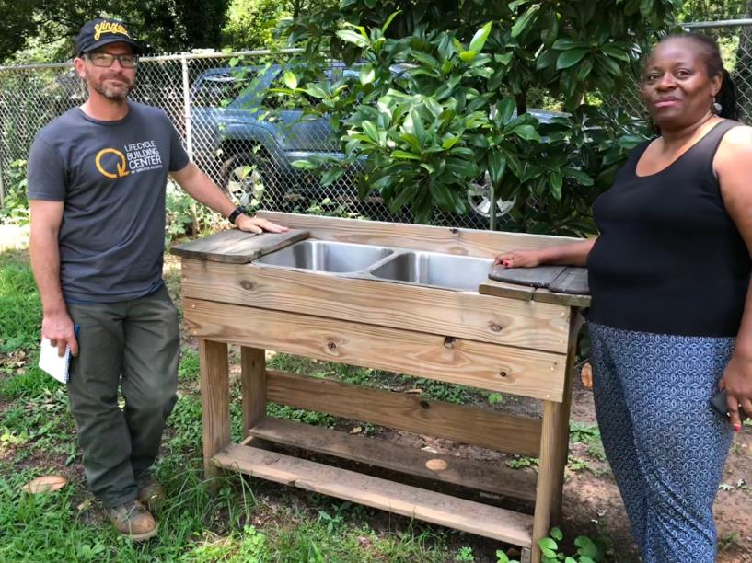
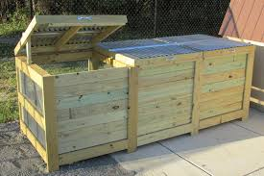
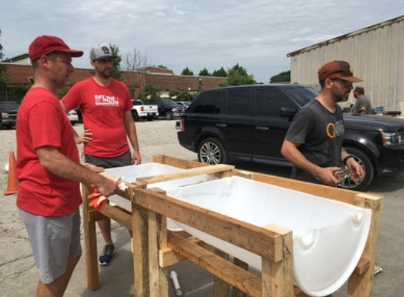

Slide 13
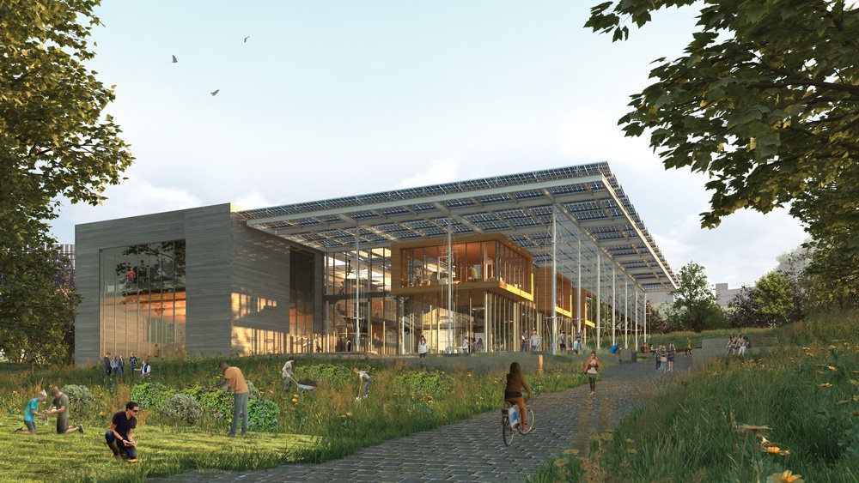

Slide 14
Thank You
Michelle Wiseman
Director Waste Diversion & Outreach
mlwisemanAtlantaGa.Gov
Cell: 404-858-1807

