Slide 1
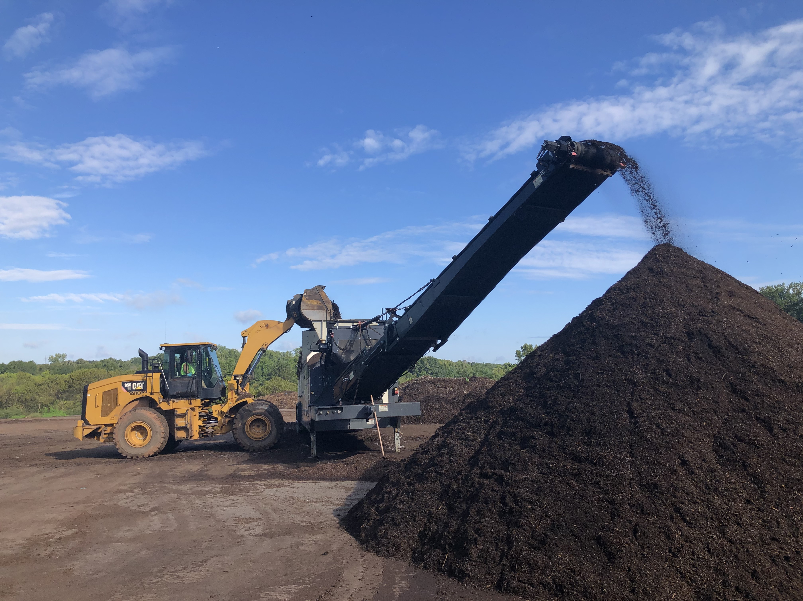
Athens-Clarke Co. Composting
GRC Update 2022

Slide 2
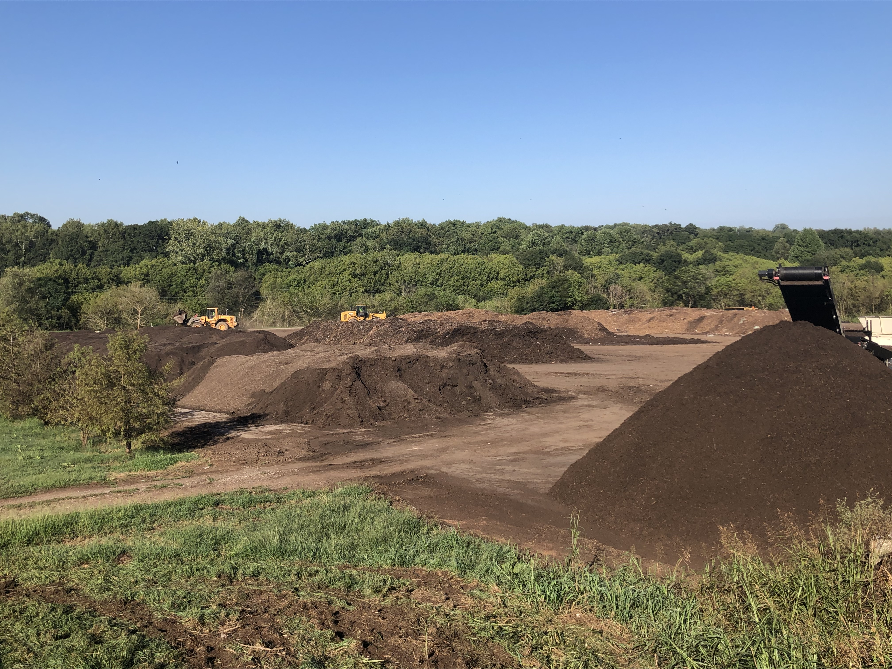
Our Growth (even with the pandemic) Opportunity (esp. in Atlanta area)

Slide 3
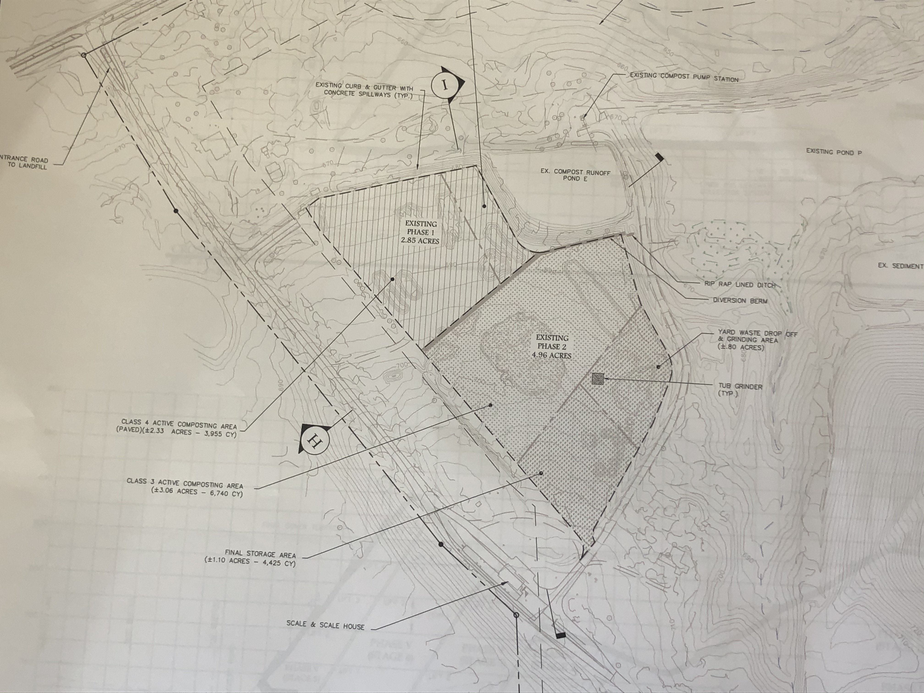

Slide 4
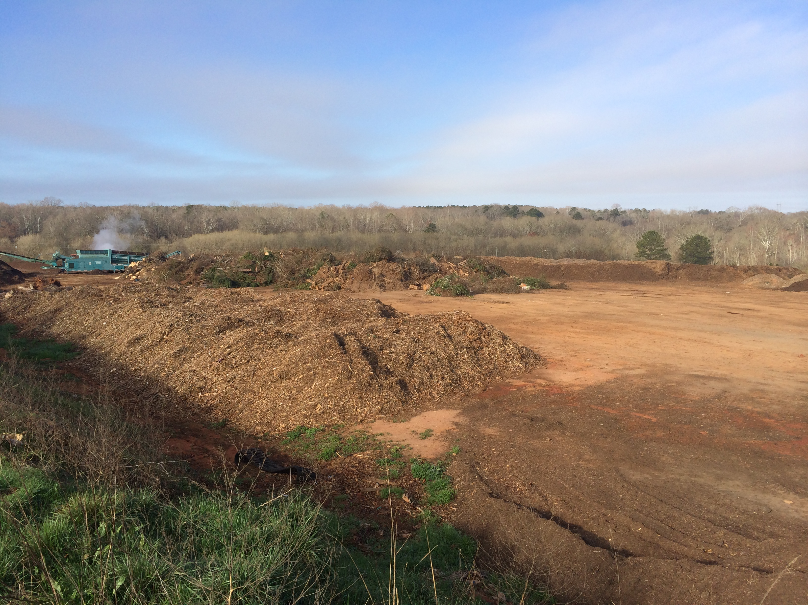
What we do

Slide 5
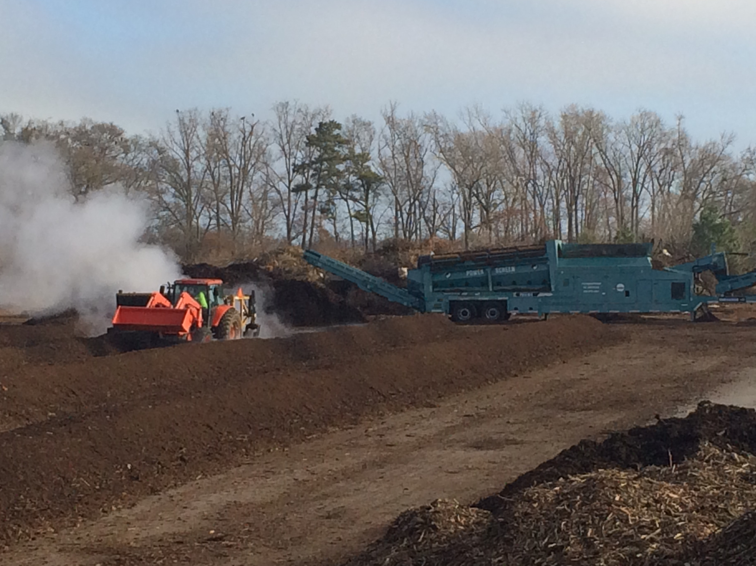
Permitted 2008 Windrows

Slide 6
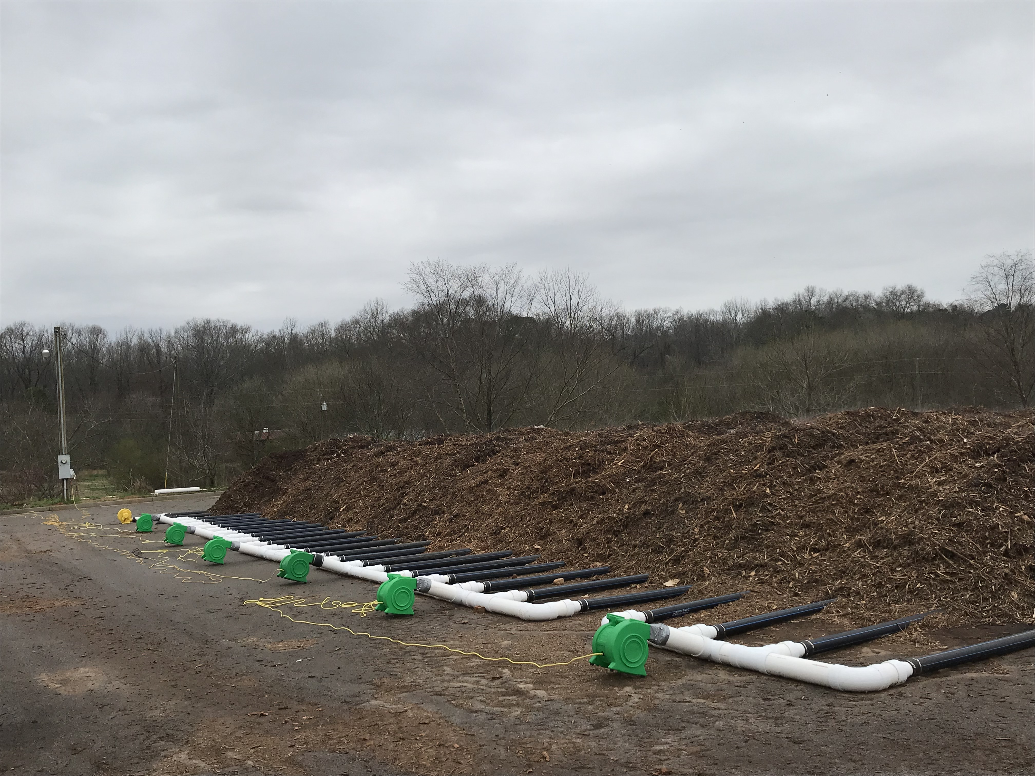
ASP 2019 3,600 tons biosolids, 130 tons of food

Slide 7
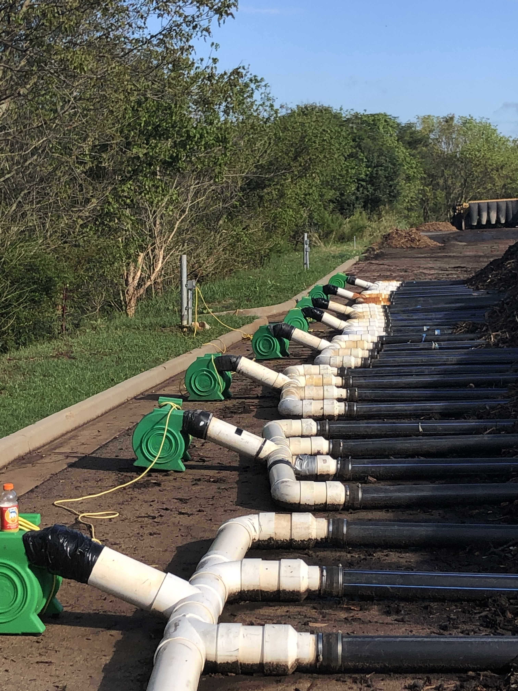
ASP 2022 6,000 tons biosolids 3,000 tons of food

Slide 8
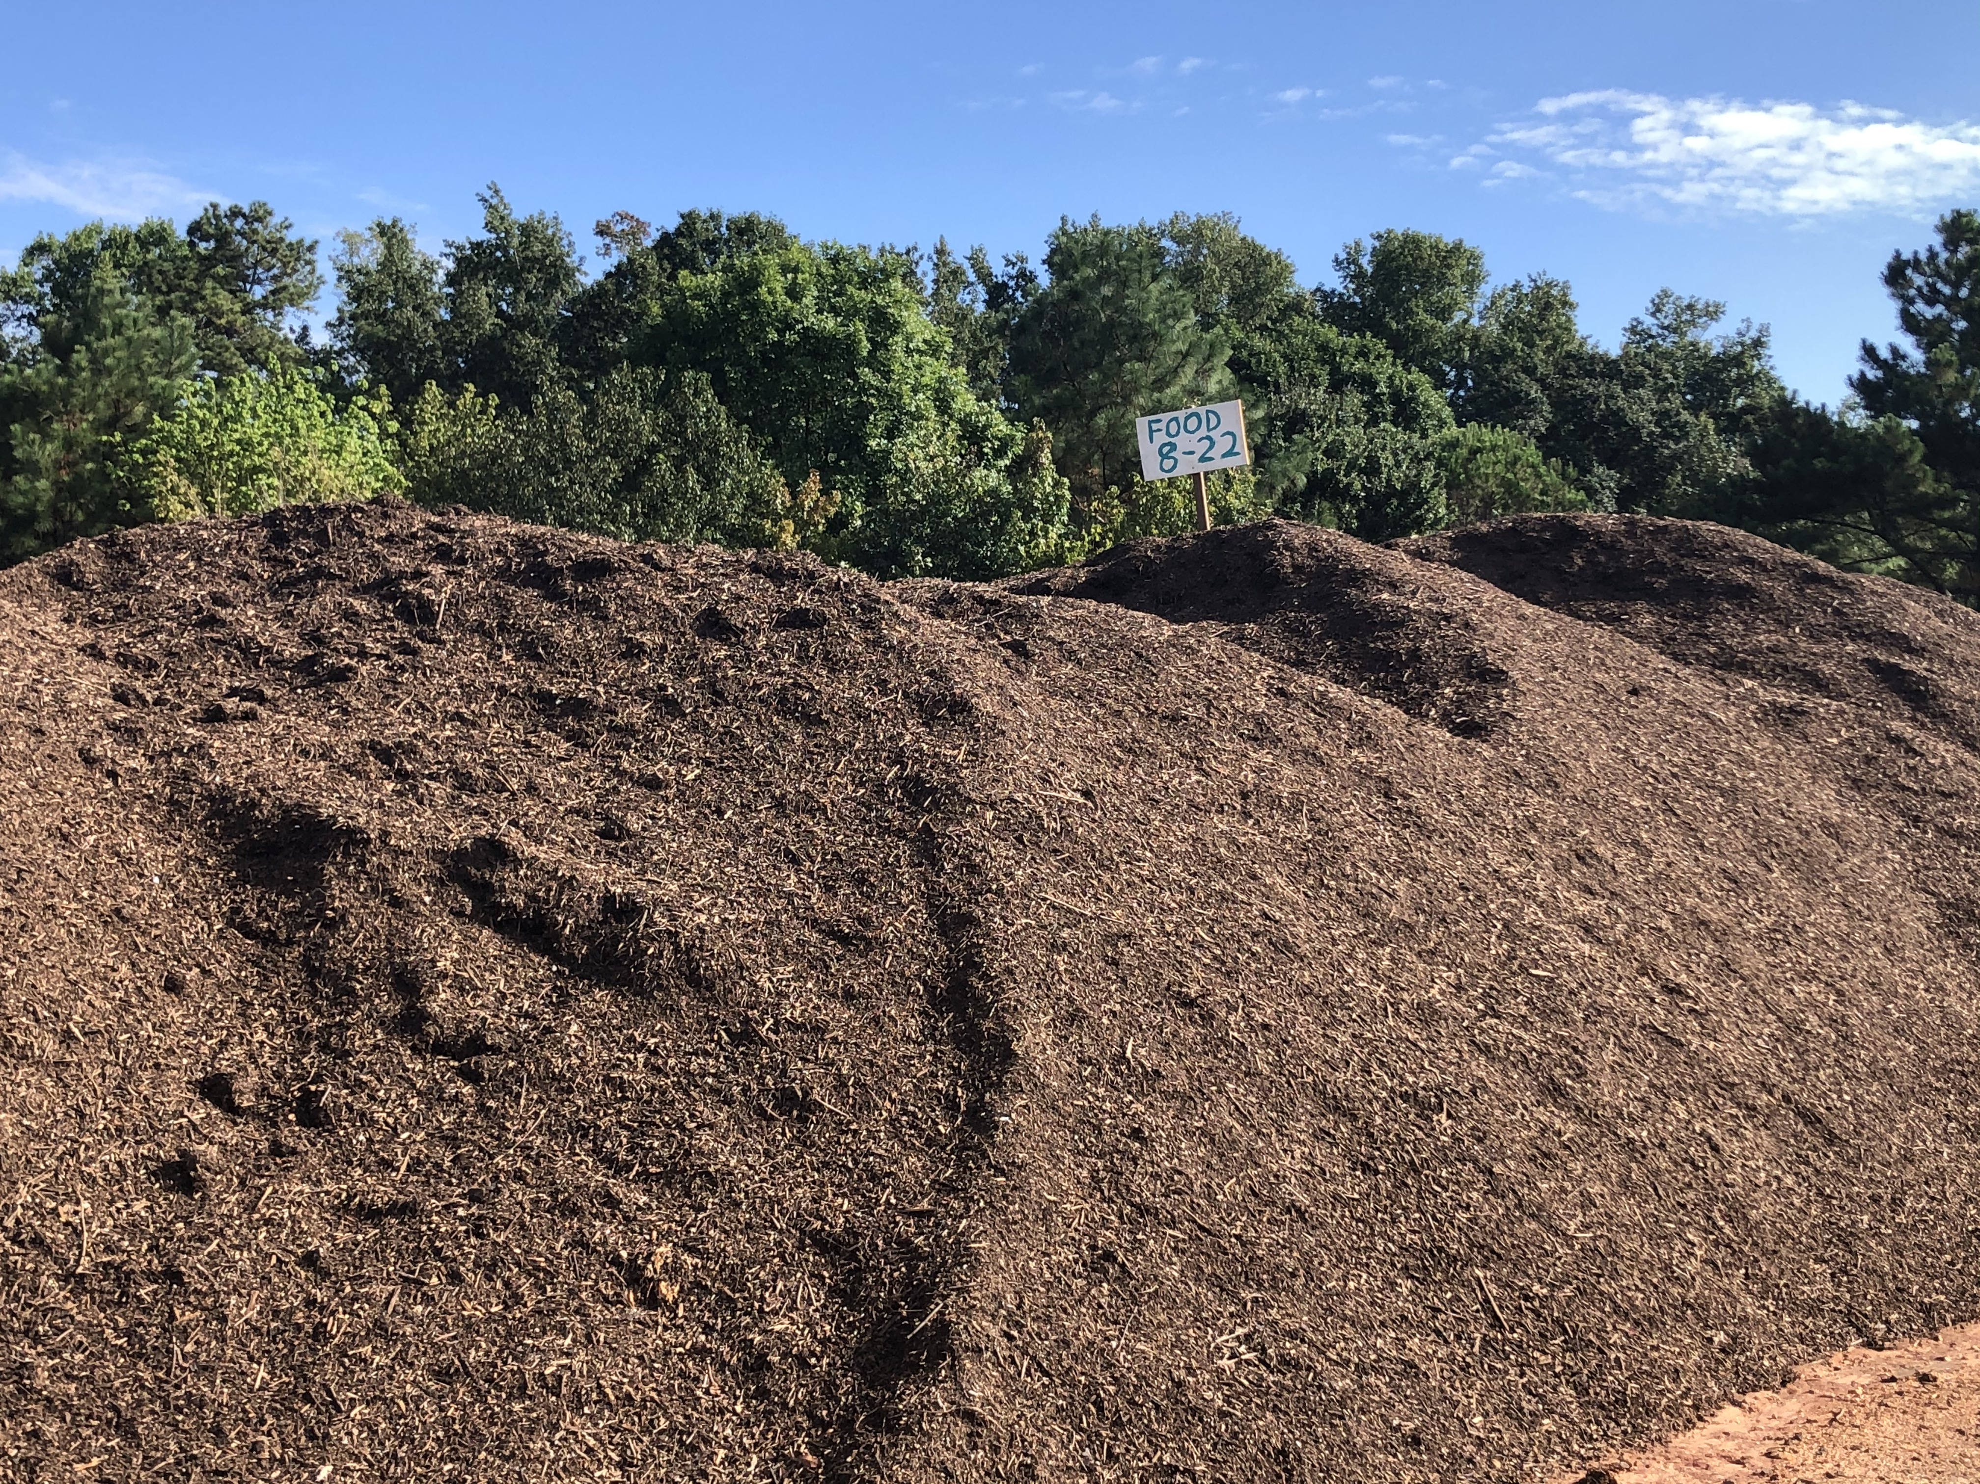

Slide 9
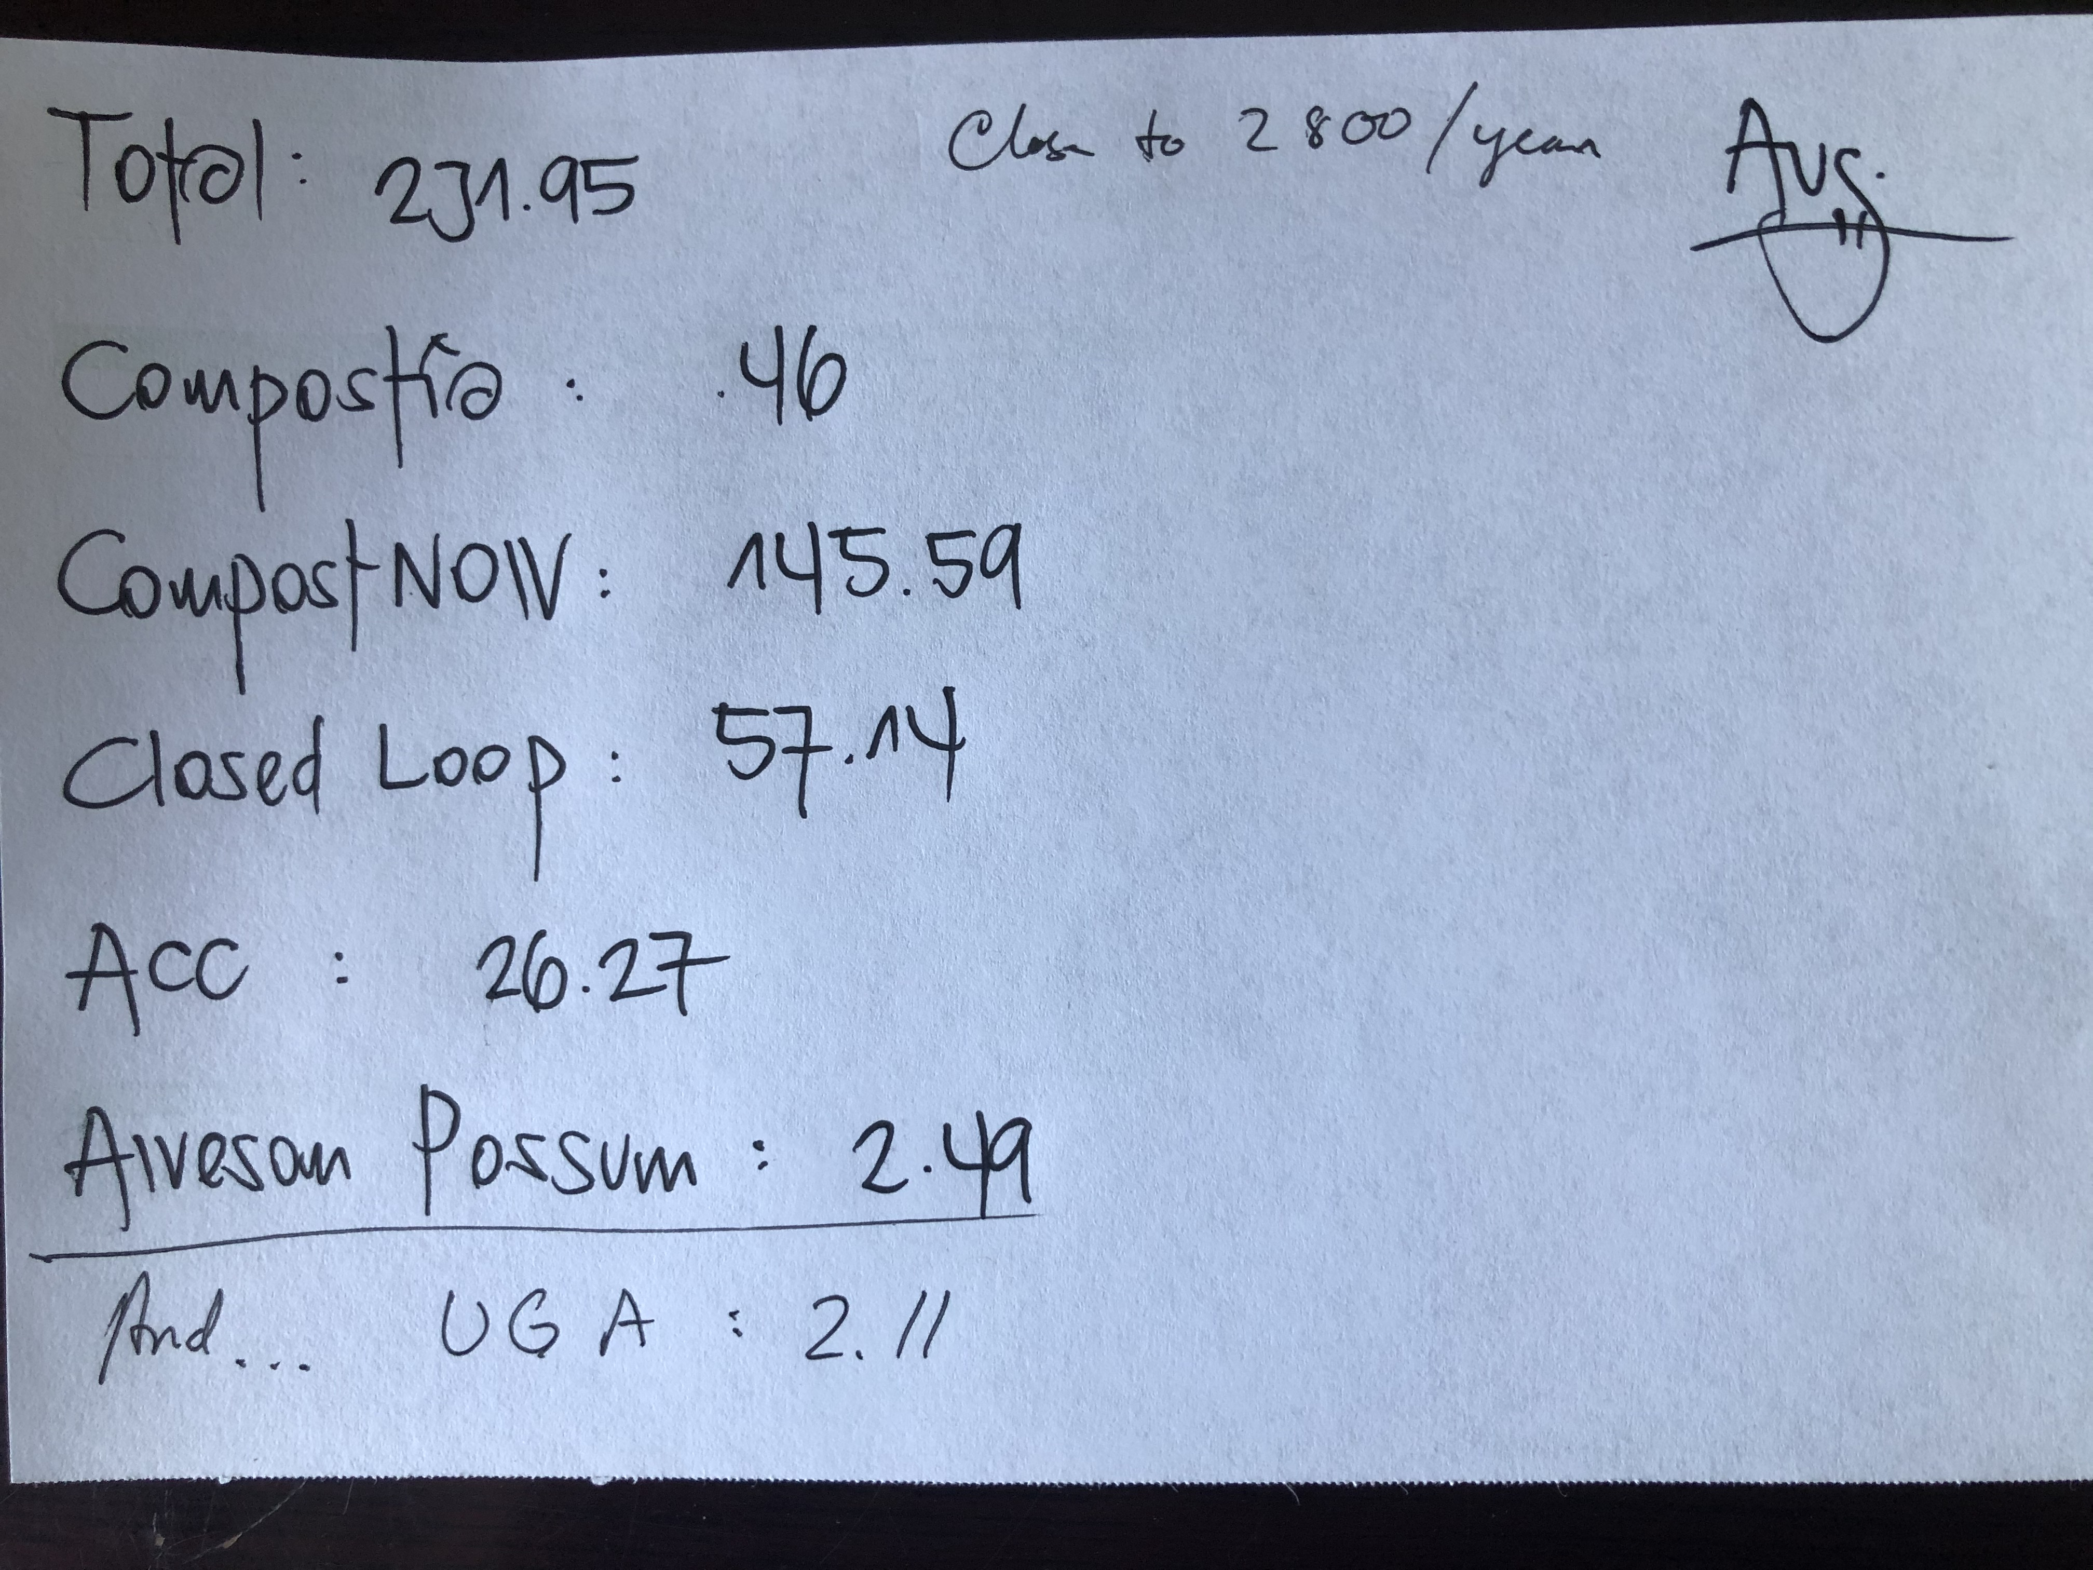

Slide 10
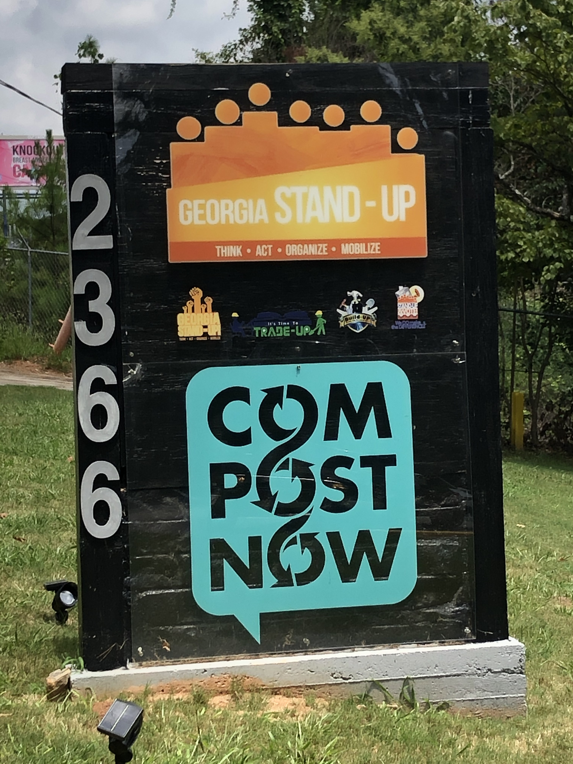

Slide 11
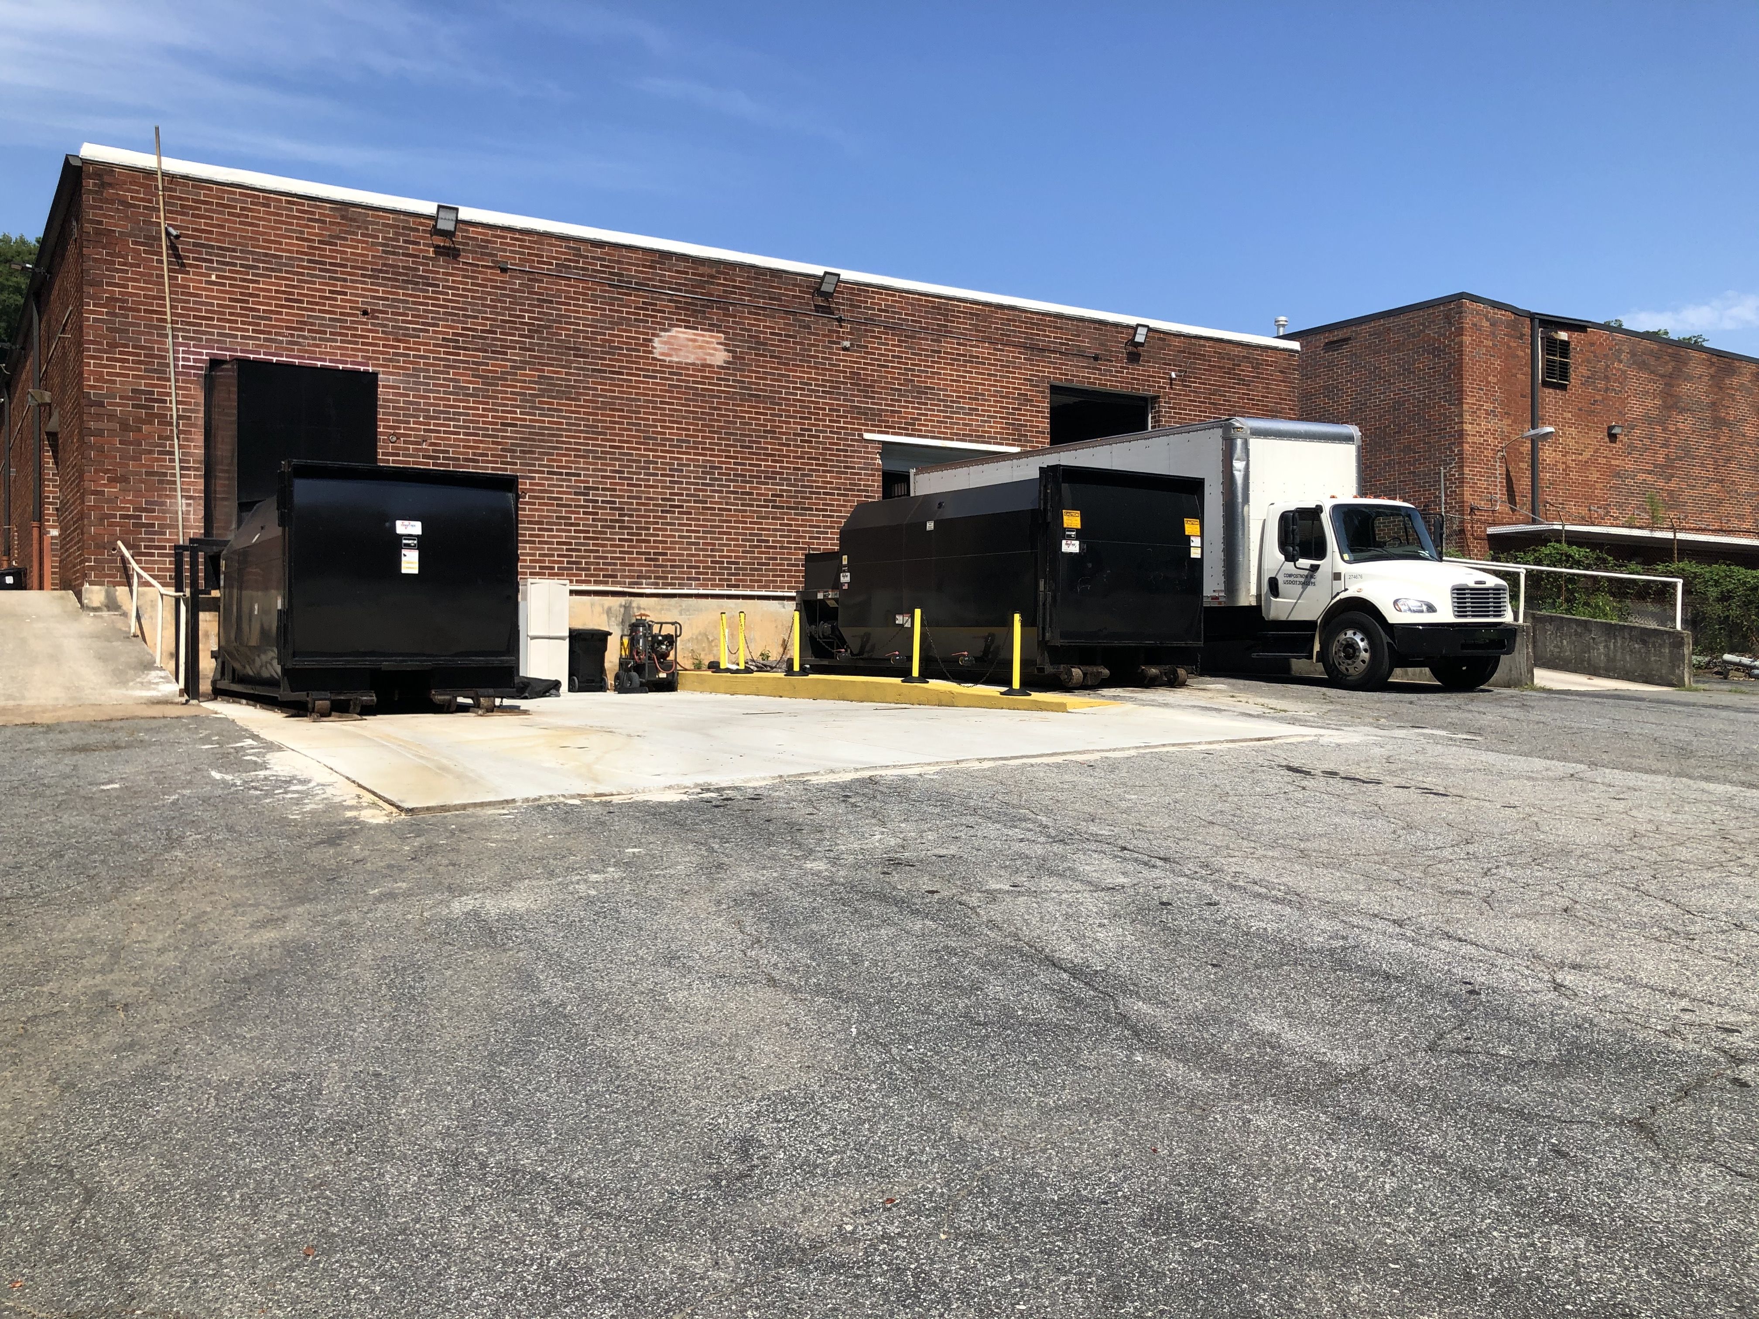
Compost Now Atlanta Facility

Slide 12
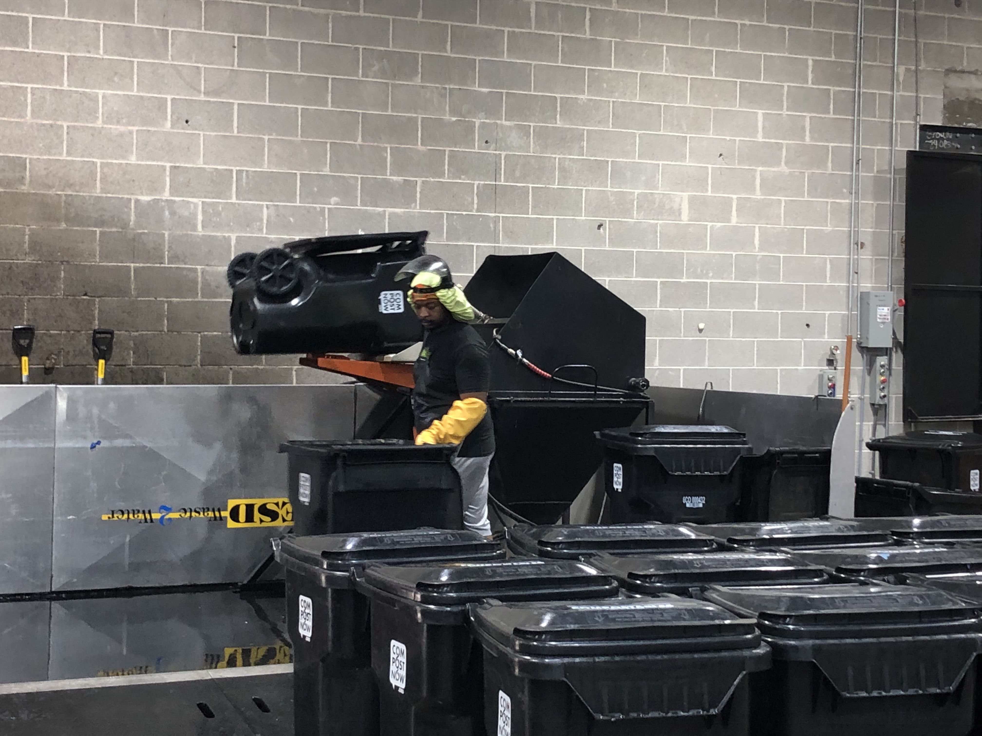
Container Cleaning

Slide 13
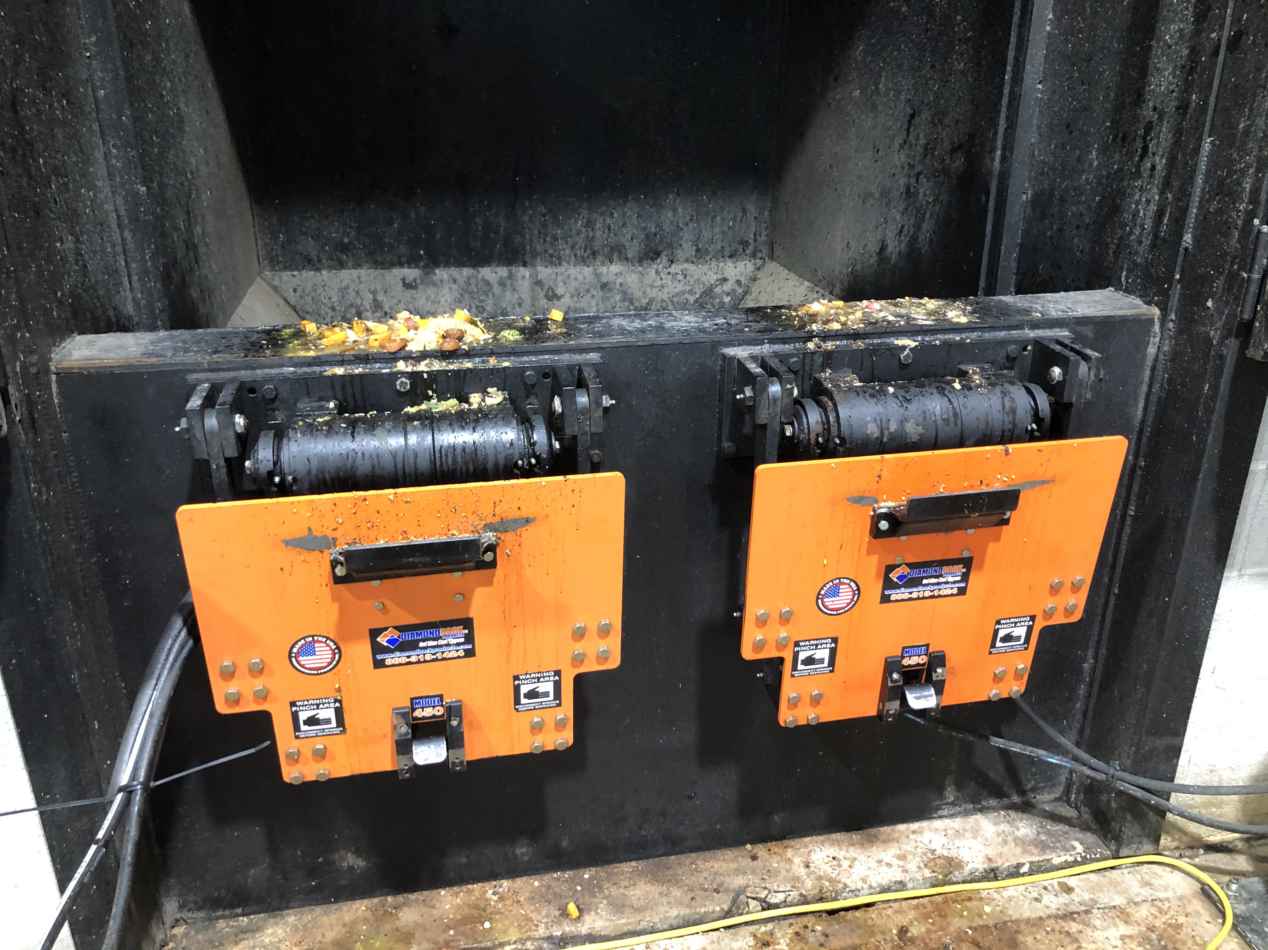
Roll Cart Tipper

Slide 14
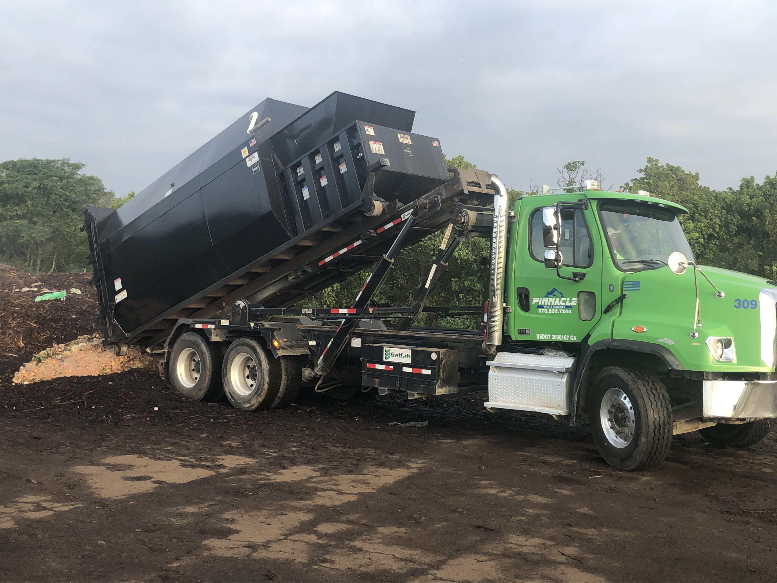

Slide 15
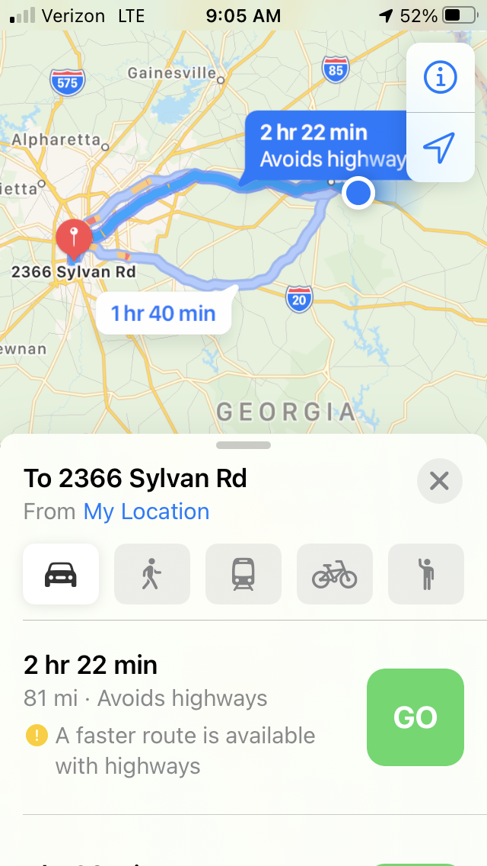
Opportunity #1 Mercedes Benz Stadium Ga Aquarium Americus Amphitheatre Waste Management

Slide 16
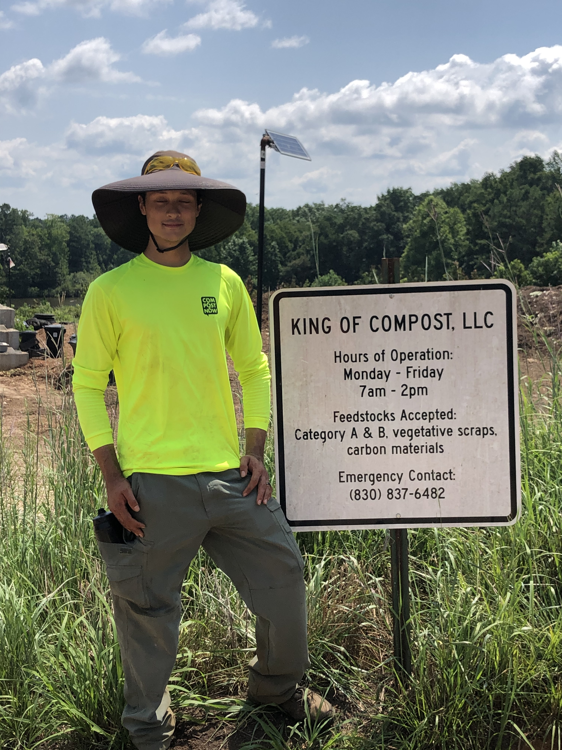

Slide 17
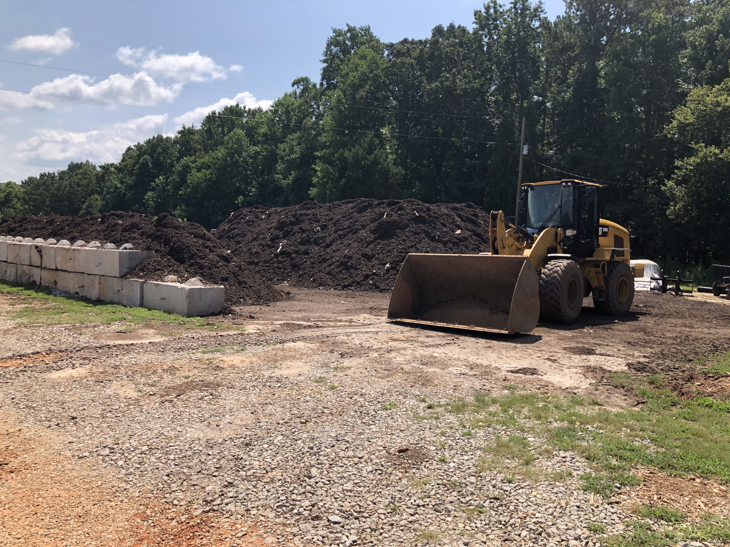

Slide 18
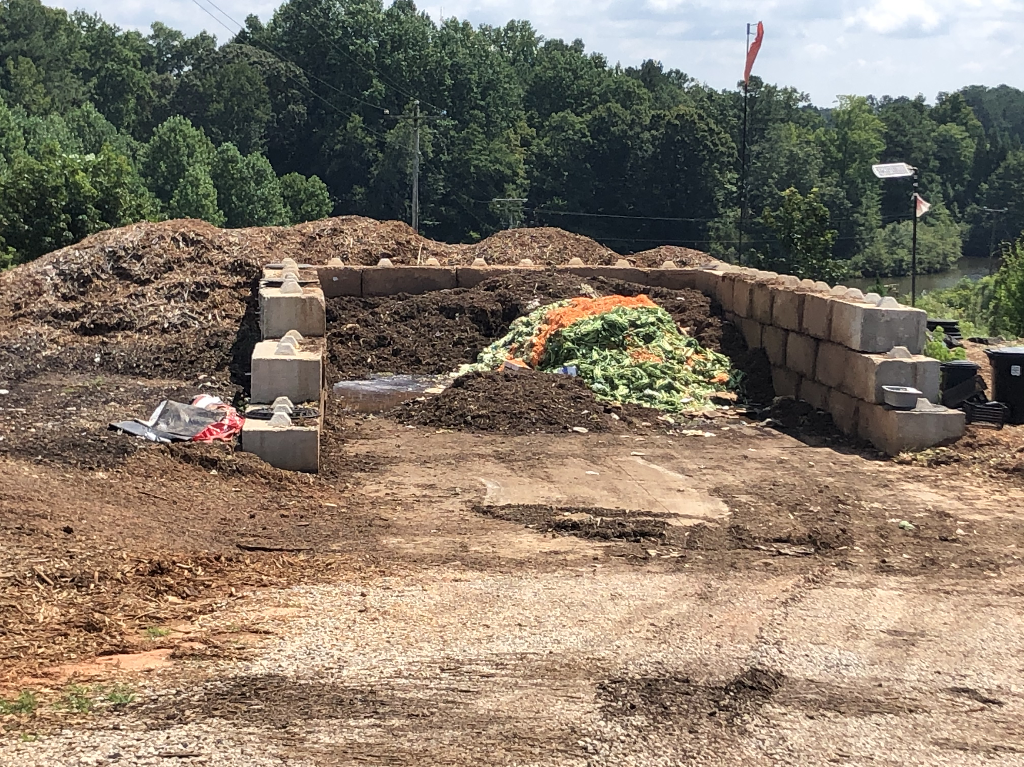

Slide 19
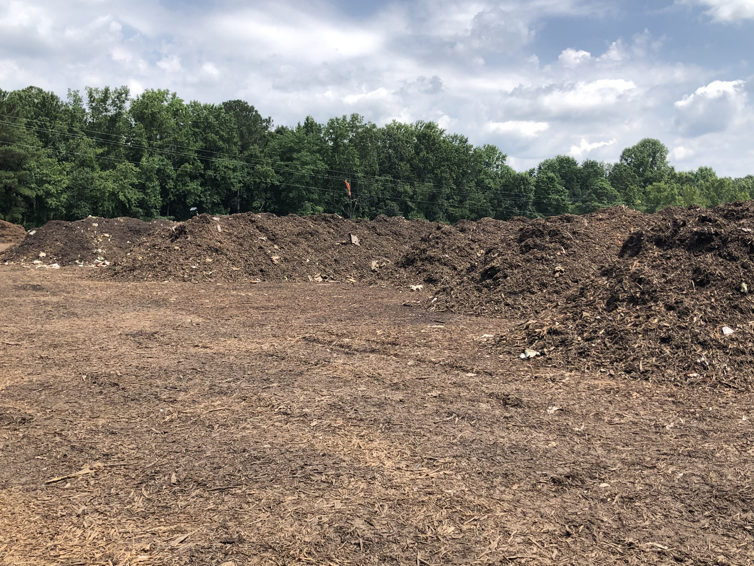

Slide 20
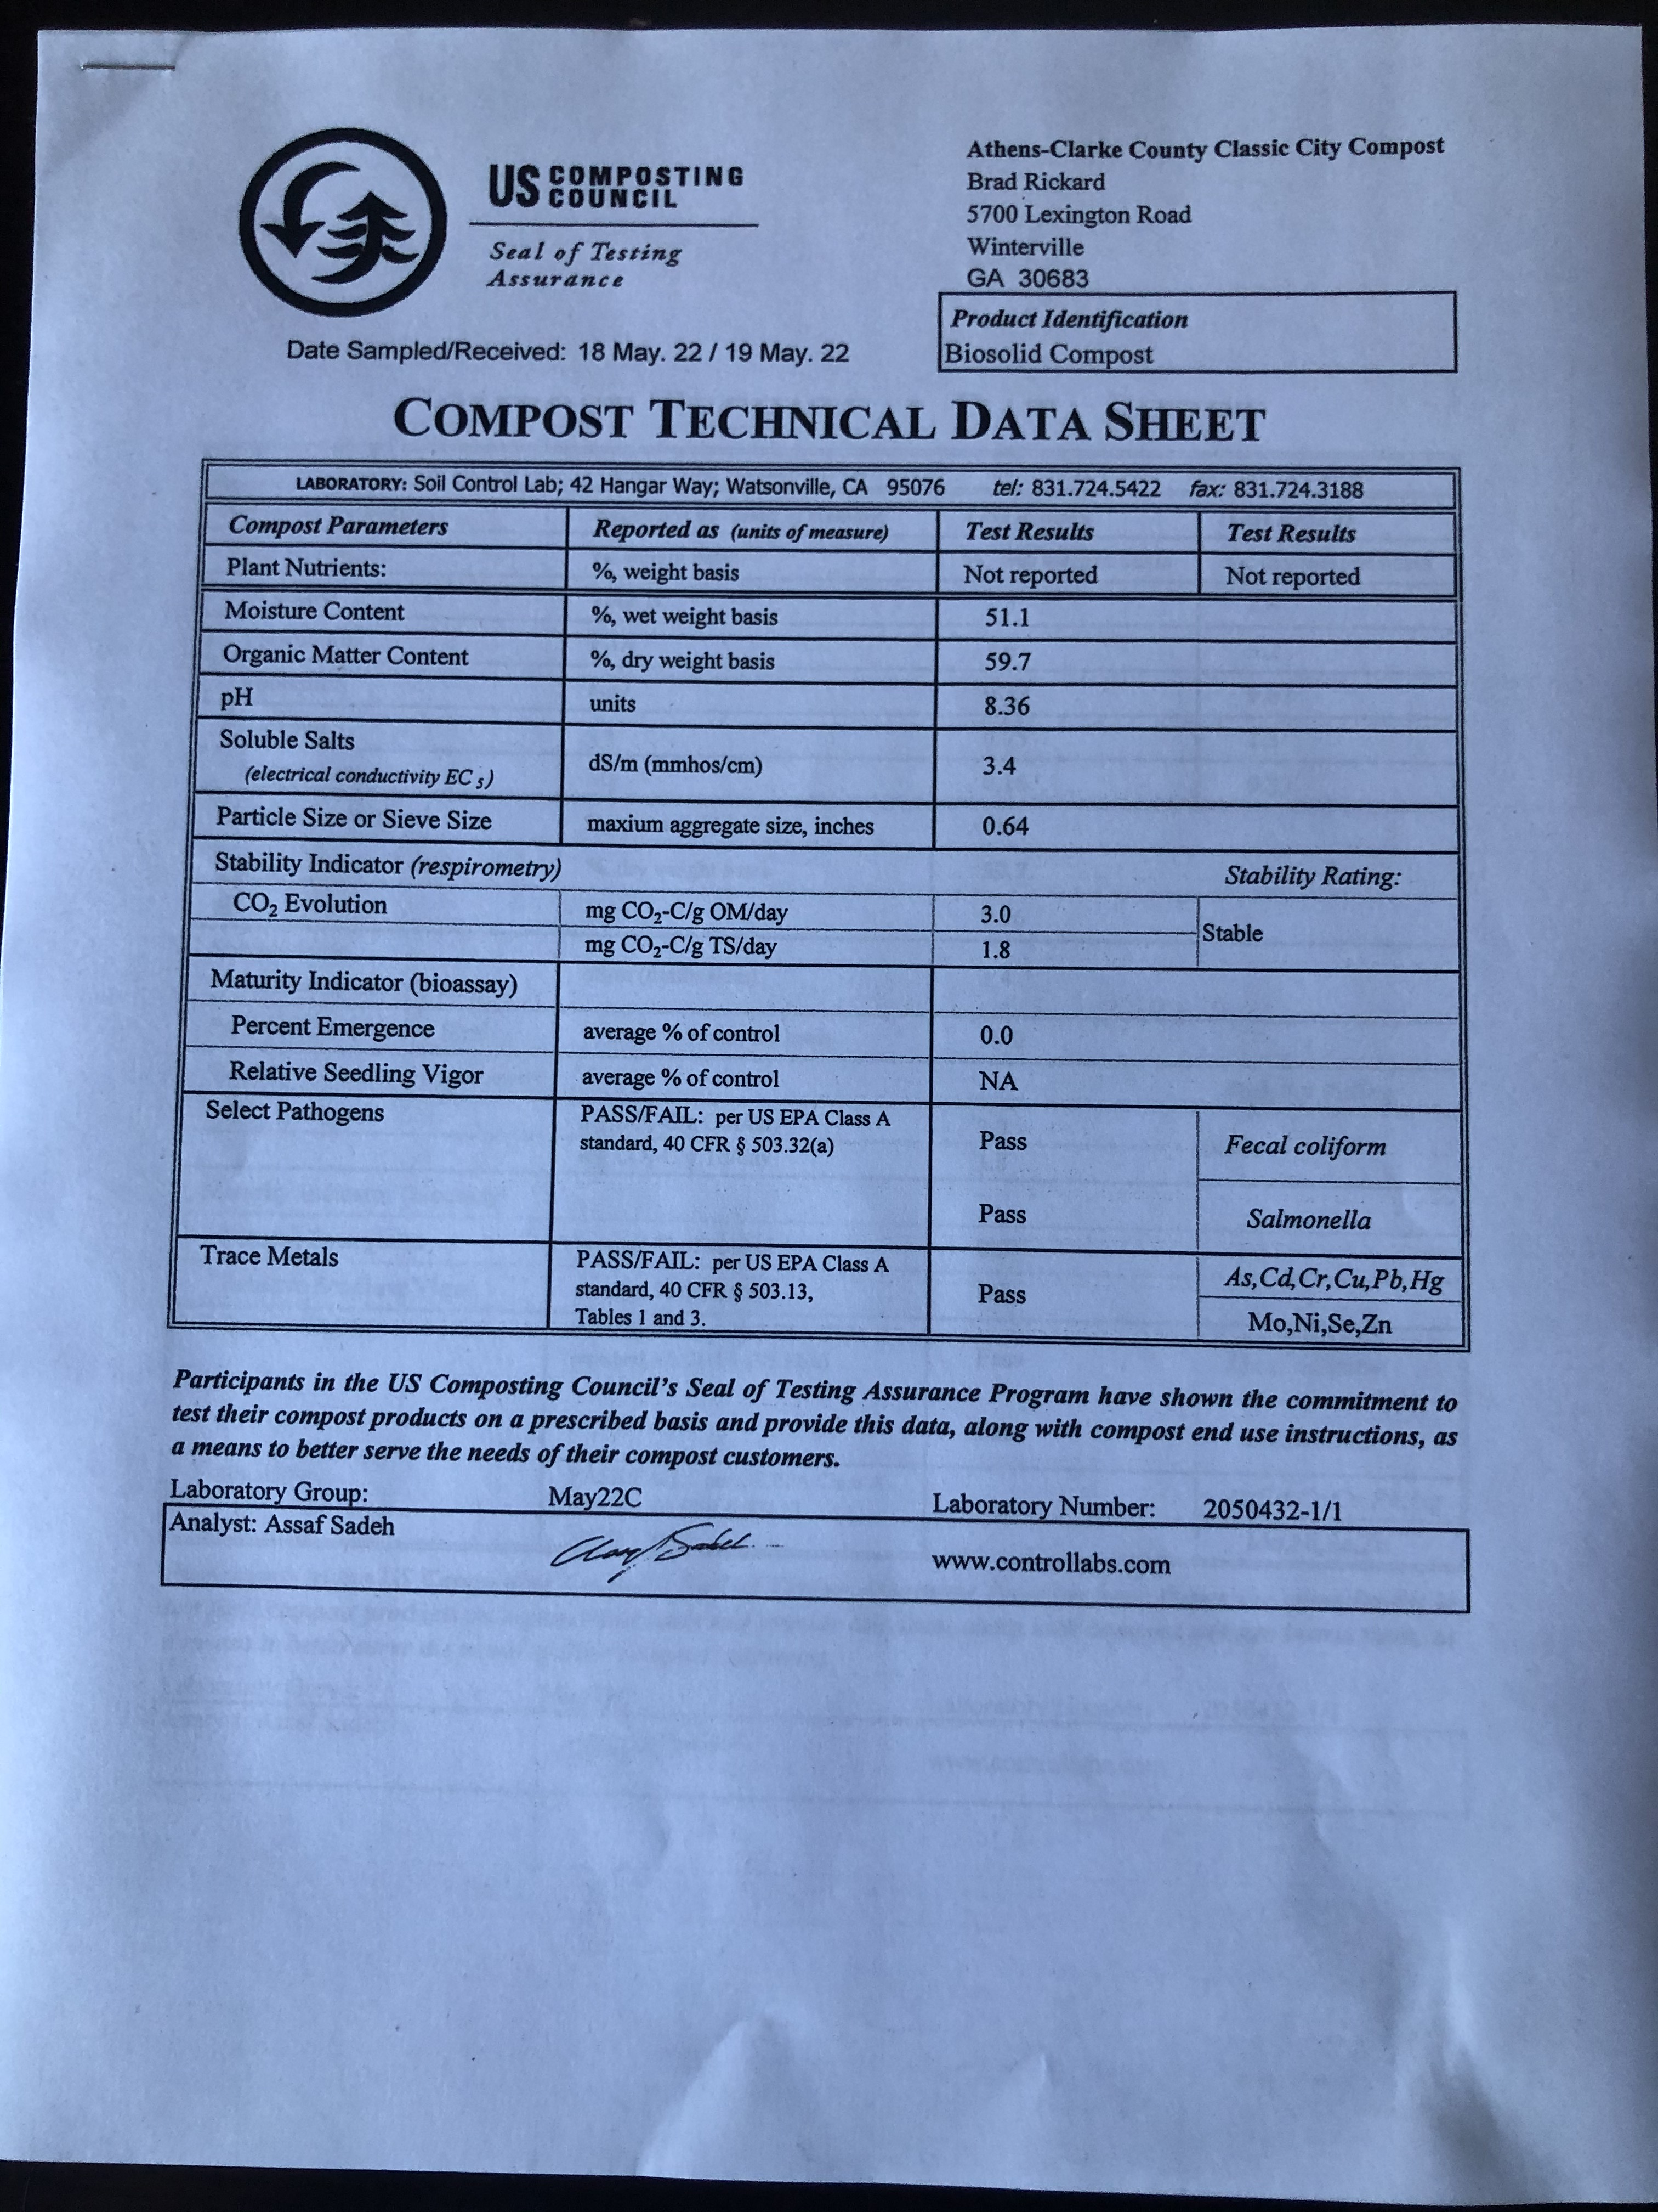
Composting can be simple and straight forward, 3:1 4:1 volumes moisture

Slide 21
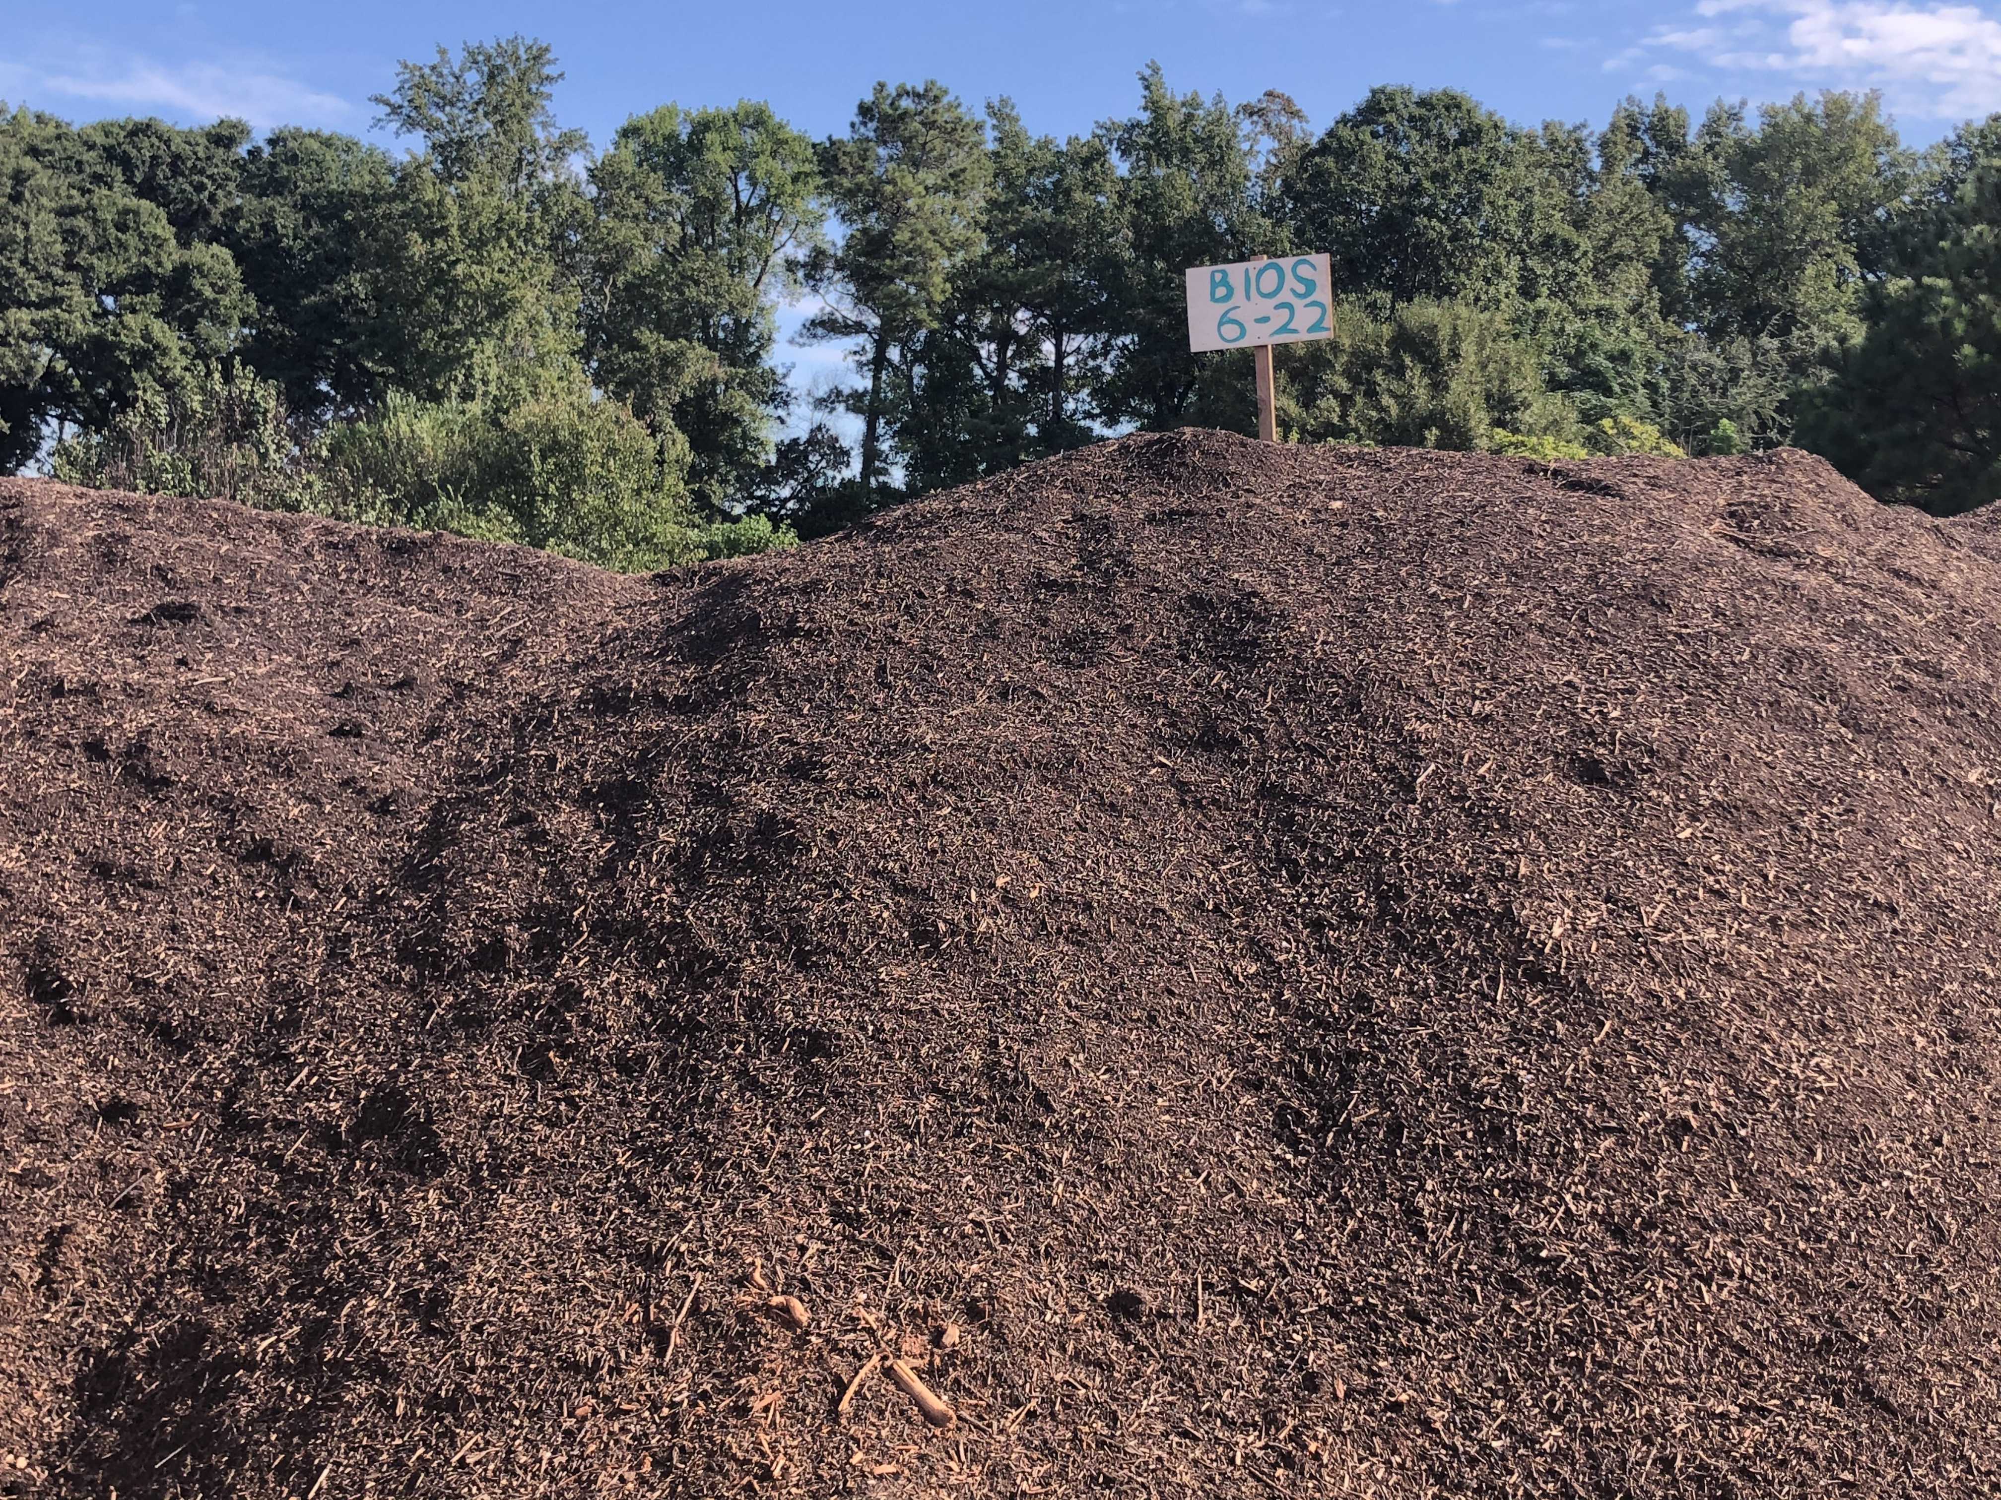
Opportunity #2

Slide 22
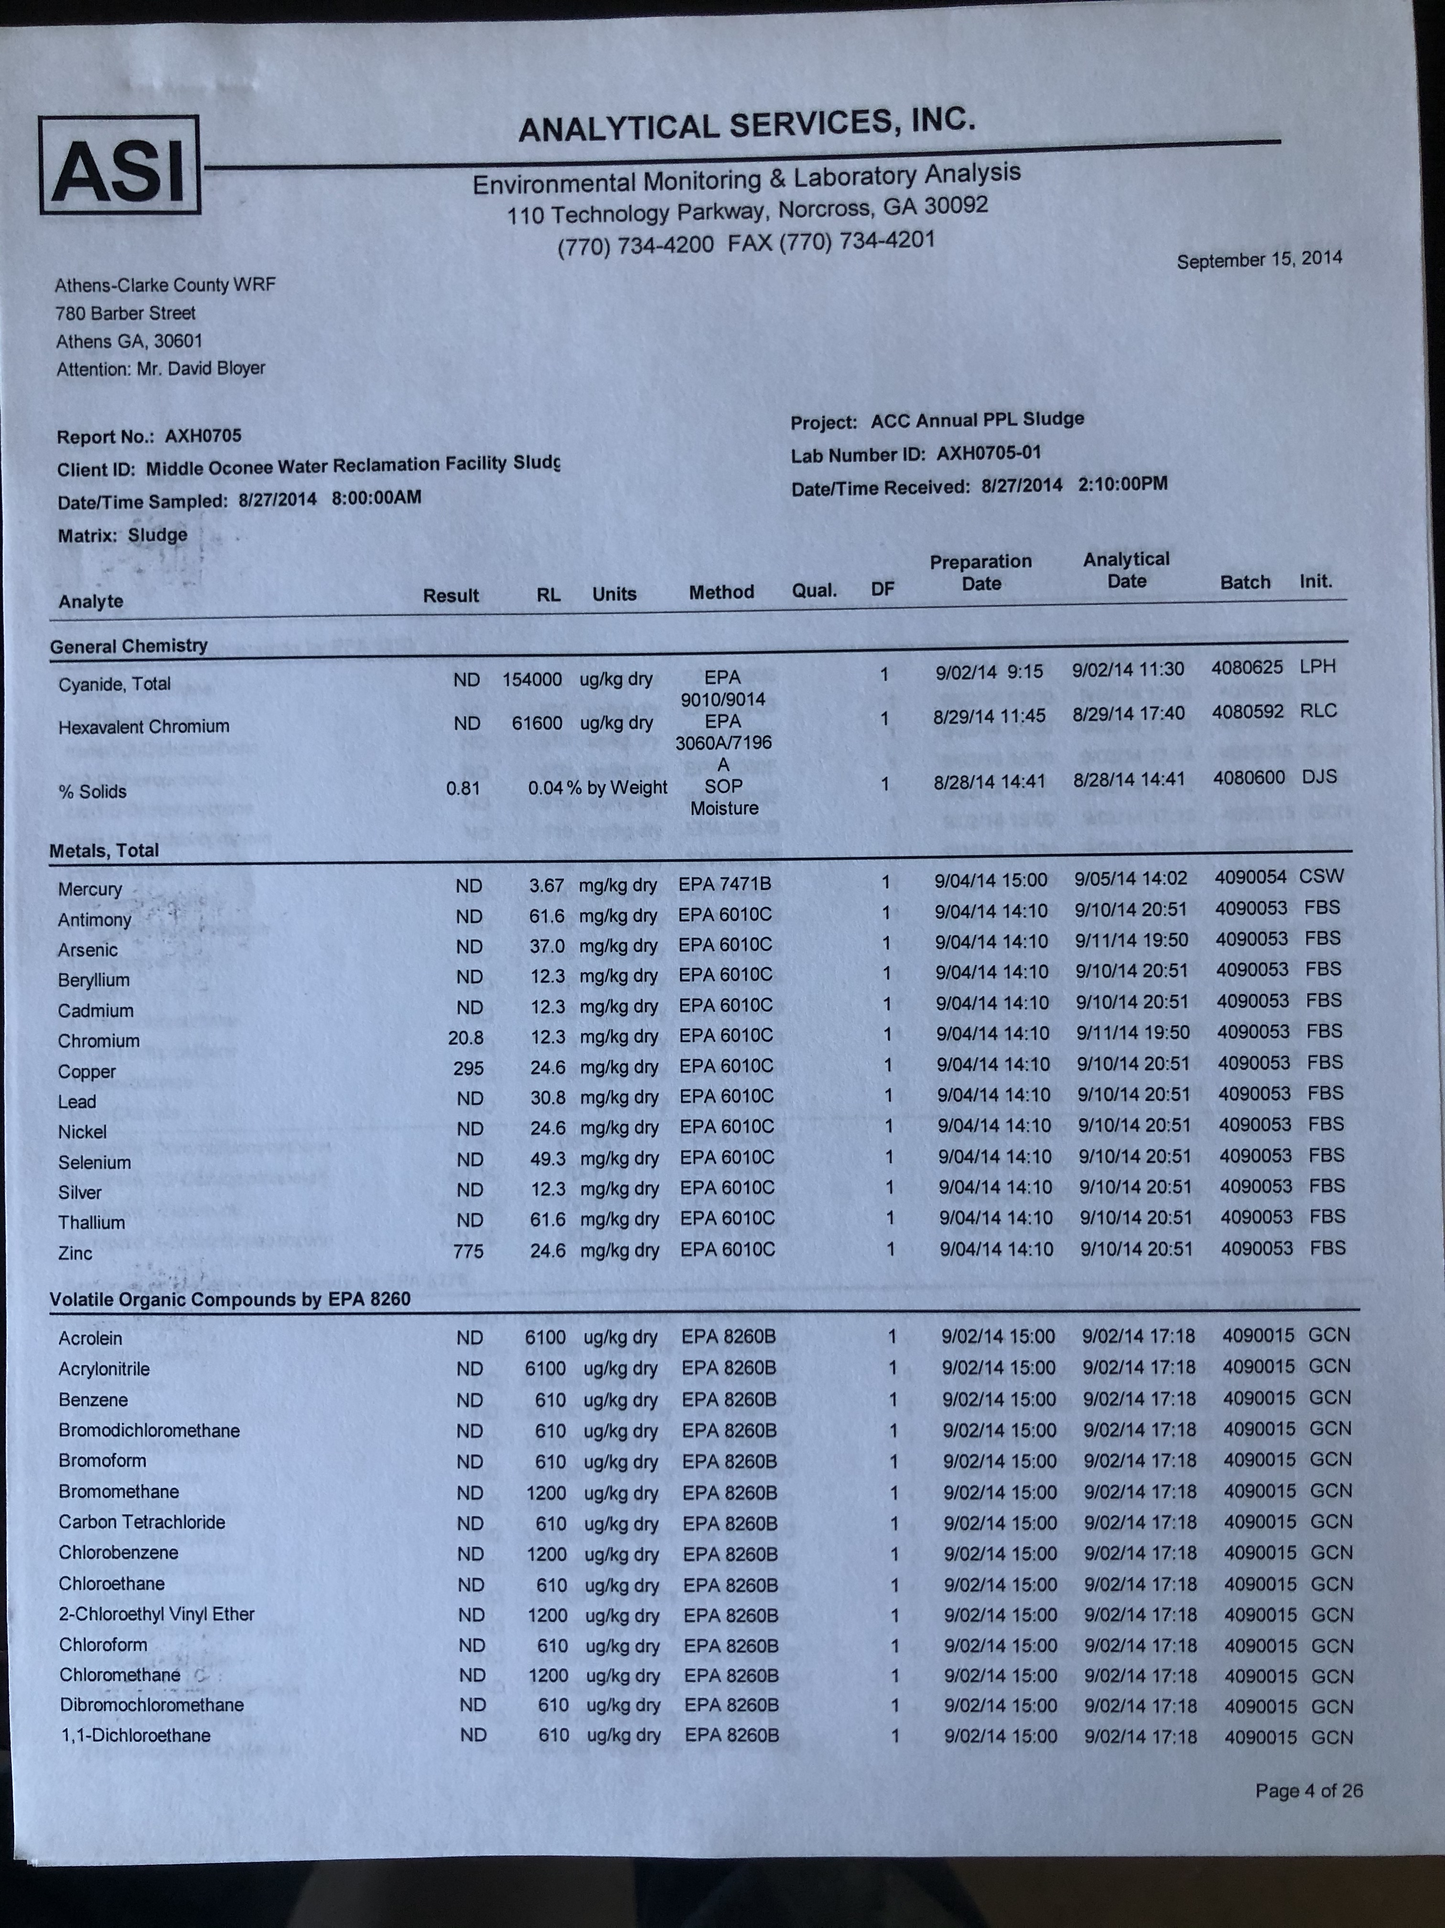
Know the ingredients before you start cooking

Slide 23
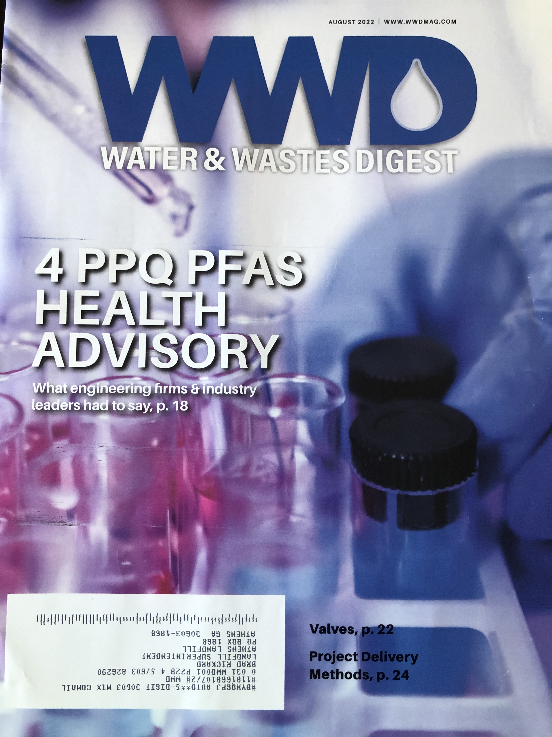

Slide 24
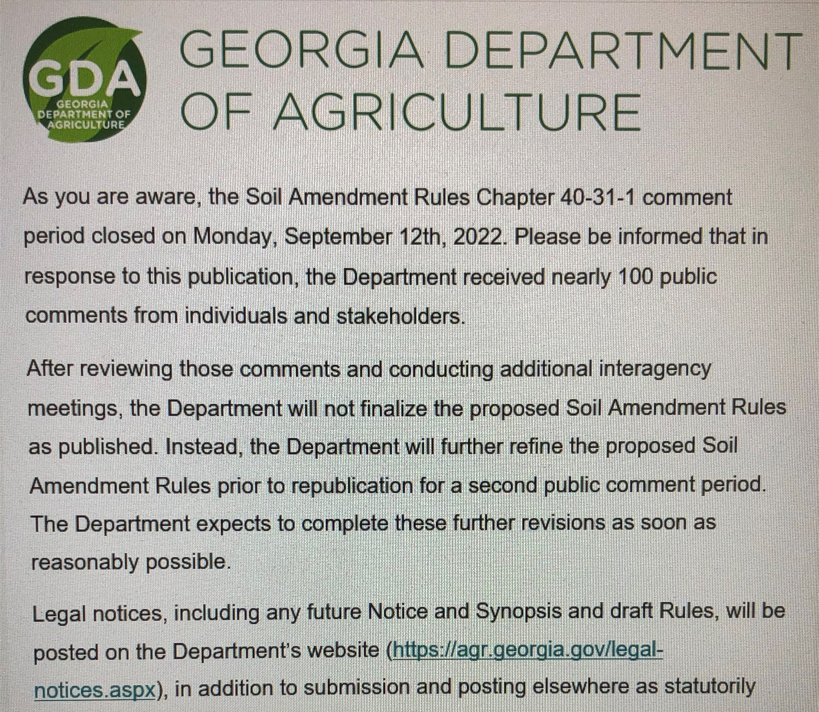

Slide 25
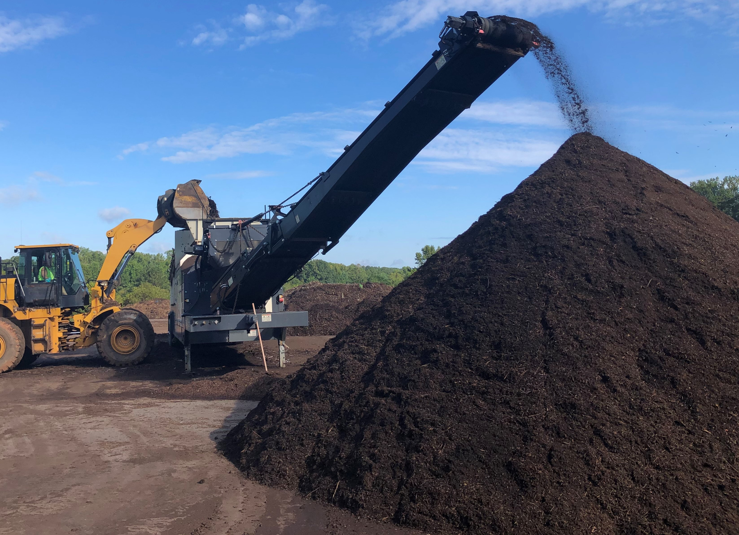
What’s Next SW wants a bigger truck Wash/Container Facility More Food, Fans, Pipes Grow our market Social Media Covered area? Conveyors?

